Slide 1
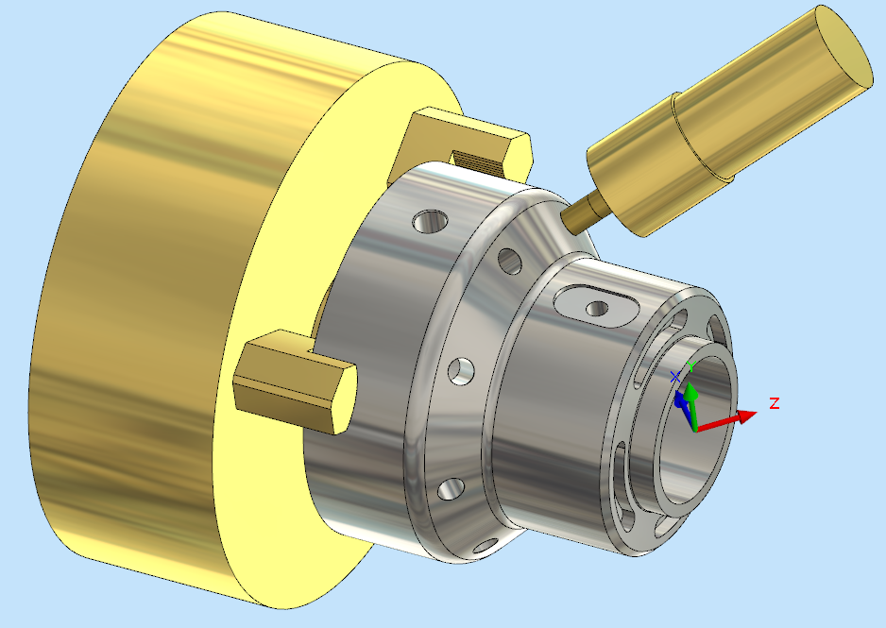
Jig & Fixture Design
Dr. Apiwat Muttamara

Slide 5
Magnetic chuck

Slide 6
apron
Centre Lathe

Slide 7
BED

Slide 8
CERMET
Ceramic+metal

Slide 9
INSERT ENDMILL
INSERT ENDMILL

Slide 10
Gear Cutting
INDEXING HEAD

Slide 11
Work Holding Method
vice
Notes:
In the machining of a complex component, it is usually started off with the milling of a rectangular block. To ensure that each surface of the rectangular block is perpendicular to its neighbouring surfaces, the following points should be noted:-
The jaws and the workpiece must be free from burrs, chips, and cutting fluid.
Smaller workpiece should be supported by parallel bars to provide the supporting datum.
Round bar must be placed between the workpiece and the movable jaw to ensure that the workpiece is in perfect contact with the fix jaw.
The vice handle should be tightened by hand to avoid over clamping of the workpiece as well as the vice. Hide face hammer should be used to assure that the workpiece is in perfect contact with the supporting base.
On completion of the milling of the first face, the workpiece should be unloaded, deburred, and cleaned before the next operation.
To machine the second and the third faces, the workpiece should be clamped with its preceding machined surface facing against the fix jaw of the vice.
Similar clamping method can be applied in the machining of the fourth face.
Yet it can also be clamped on the vice without the round bar.
Both ends of the workpiece can be machined with the periphery flutes of the cutter using up cut milling as shown in figure 23.

Slide 12
Dial gauge
The accuracy of dial 0.010 mm.
It is usually used for calibration of machine.
Notes:
principle of dial indicator () is that the linear mechanical movement of the stylus is magnified and transferred to the rotation of pointer as shown in figure 12.

Slide 13
COUNTERSINK&BORE

Slide 14
Classifications of Metal Alloys
Metal Alloys
Ferrous
Nonferrous
Steels
Cast Irons
Steels
Cast Irons
Cu
Al
Mg
Ti
<1.4wt%C
<1.4wt%C
3-4.5
wt%C
3-4.5
wt%C
Ferrous alloys: iron is the prime constituent
-Alloys that are so brittle that forming by
deformation is not possible ordinary are cast

Slide 15
Steel
Percent of carbon in Iron
Iron with controlled amounts of carbon. Steels
are classified by their carbon content.
Designation
Wrought Iron
Low Carbon
Medium Carbon
High Carbon
Very High Carbon
Gray Cast Iron
% Carbon
.02 - .03
.05 - .30
.30 - .45
.45 - .75
.75 - 1.00
1.7 - 4.5

Slide 16
Summary: Steels
Low-Carbon Steels
Properties: nonresponsive to heat treatments; relatively soft and weak; machinable and weldable.
Typical applications: automobile bodies, structural shapes, pipelines, buildings, bridges, and tin cans.
Medium-Carbon Steels
Properties: heat treatable, relatively large combinations of mechanical characteristics.
Typical applications: railway wheels and tracks, gears, crankshafts, and machine parts.
High-Carbon Steels
Properties: hard, strong, and relatively brittle.
Typical applications: chisels, hammers, knives, and hacksaw blades.
High-Alloy Steels (Stainless and Tool)
Properties: hard and wear resistant; resistant to corrosion in a large variety of environments.
Typical applications: cutting tools, drills, cutlery, food processing, and surgical tools.

Slide 17
Standards Designation Equivalent of Tool Steels ---
AISI | American Iron & Steel Institute
JIS | Japanese Industrial Standards
DIN | Deutsches Institut für Normung
 | (German Standards Institute)
SS | Svensk Standard
 | (Swedish Standard)
BS | British Standards

Slide 19
 | DAIDO BRAND | JIS | AISI | DIN
Cold Work Tool Steels | YK30 | SKS93 | - | - | -
 | YK4 | SK4 | W1/W2 | 1.154 | C100W1
 | G0A | SKS3mod. | - | - | -
 | G05 | - | - | - | -
 | DC11 | SKD11 | D2 | 1.2379 | X165CrMoV12
 | DC53 | SKD11mod. | - | - | -
Hot Work Tool Steels | DHA1 | SKD61 | H13 | 1.2344 | X40CrMoV51
 | DH2F | SKD61mod. | - | - | -
 | GFA | SKT4mod. | L6 | 1.2714 | 55CrNiMoV6

Slide 20
 | DAIDO BRAND | JIS | AISI | DIN
High Speed Tool Steels | MH51 | SKH51 | M2 | 1.3343 | S6-5-2
 | MH85 | - | - | - | -
Plastic Mold Steels | PXZ | - | - | - | -
 | PX4 | - | p20mod. | - | -
 | PX5 | - | p20mod. | - | -
 | NAK55 | - | - | - | -
 | NAK80 | - | - | - | -
 | S-STAR | SUS420J2mod. | 420mod. | 1.4034 | X40Cr13
 | G-STAR | - | - | - | -

Slide 21
Application | Usual Hardness HRC | Recommended DAIDO BRAND
 |  | General Uses
 |  | Short Life | Long Life
Trimming Dies | 58-62 | YK30 | GOA
Pressing Dies | 58-63 | YK30 | GOA
Crimping Dies | 58-63 | GOA | DC11
Extrusion Dies | 55-62 | GOA | DC11
Extrusion Punches | 55-62 | GOA | DC11
Brick Forming Dies | 60-65 | GOA | DC11
Powder Compacting Dies | 58-62 | GOA | DC11
Cross Punches | 60-64 | MH51 | MH51
Plastic Mold Dies | 56-60 | GOA | -

Slide 22
Characteristics of Tool Material
Hot Hardness
the ability to retain its hardness at high temperatures.
Strength and Resistance to Shock
At the start of a cut the first bite of the tool into the work results in considerable shock
Low Coefficient of Friction
Notes:
. Hot Hardness
This means
Strength and Resistance to Shock
loading on the tool. It must obviously be strong enough to withstand it.
Low Coefficient of Friction
The tool rubbing against the workpiece and the chip rubbing on the top face of the tool produce heat which must be kept to a minimum.

Slide 23
Tool Materials in Common Use
High Carbon Steel
Contains 1 - 1.4% carbon with some addition of chromium and tungsten to improve wear resistance.
The steel begins to lose its hardness at about 250° C, and is not favoured for modern machining operations where high speeds and heavy cuts are usually employed.
High Speed Steel (H.S.S.)
Steel, which has a hot hardness value of about 600° C,
commonly used for single point and multi point cutting tools
Cemented Carbides (WC-Co)
An extremely hard material made from tungsten powder.
Carbide tools are usually used in the form of brazed or clamped tips
HSS may be readily machined using carbide tipped tool.
High cutting speeds may be used and materials difficult to cut with HSS
Notes:
High Carbon Steel
High Speed Steel (H.S.S.)
Cemented Carbides

Slide 24
Alloying compositions of
common high speed steel grades (
by %wt)
Grade. | C | Cr | Mo | W | V | Co | Mn | Si
M2 | 0.95 | 4.2 | 5.0 | 6.0 | 2.0 | - | - | -
M7 | 1.00 | 3.8 | 8.7 | 1.6 | 2.0 | - | - | -
M35 | 0.94 | 4.1 | 5.0 | 6.0 | 2.0 | 5.0 | - | -
M42 | 1.10 | 3.8 | 9.5 | 1.5 | 1.2 | 8.0 | - | -

