Slide 1
Advanced Forming
Sheet metal operations not performed on presses
Apiwat Muttamara

Slide 2
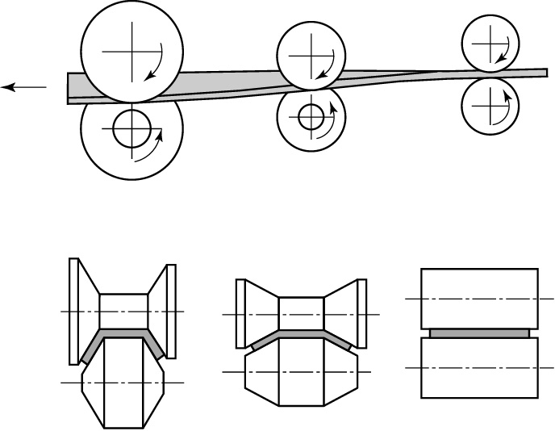
Roll Forming
Figure 16.26 Schematic illustration of the roll-forming process.

Slide 3
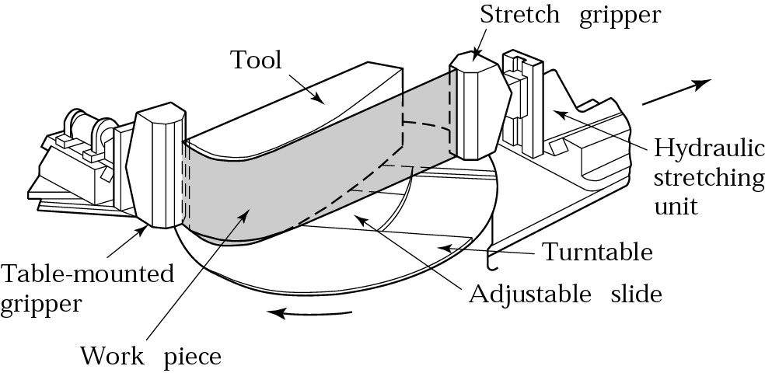
Stretch Forming
Figure 16.30 Schematic illustration of a stretch-forming process. Aluminum skins for aircraft can be made by this method. Source: Cyril Bath Co.

Slide 4
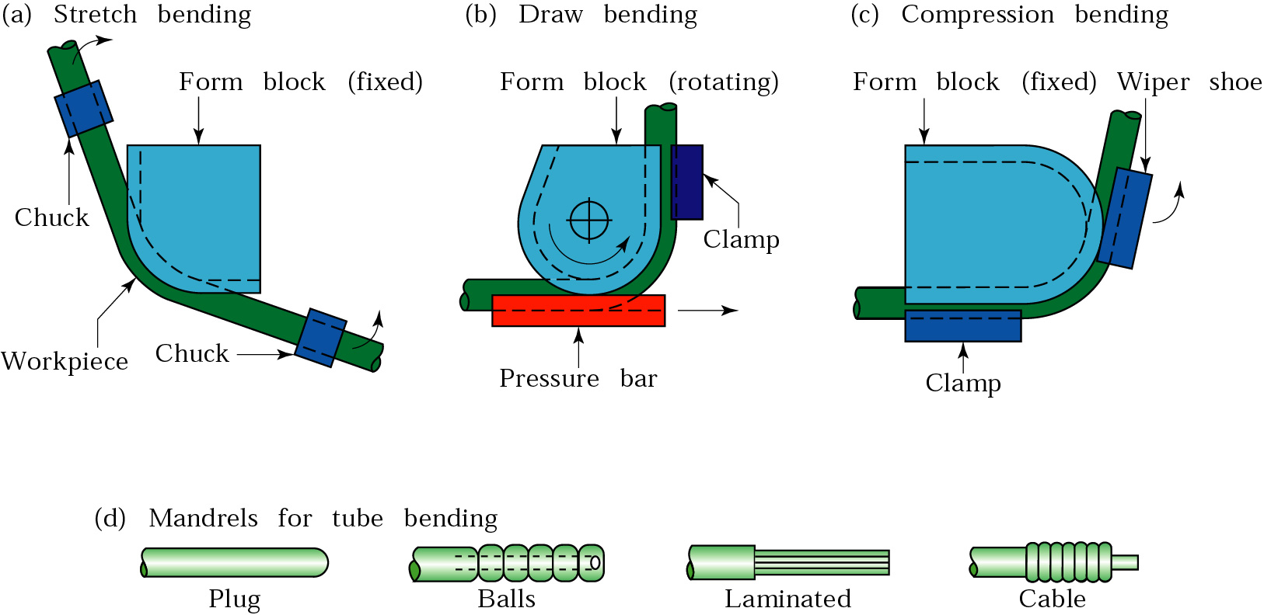
Tube Bending
Figure 16.27 Methods of bending tubes. Internal mandrels, or the filling of tubes with particulate materials such as sand, are often necessary to prevent collapse of the tubes during bending. Solid rods and structural shapes can also be bent by these techniques.

Slide 5
Manufacturing of Bellows
Figure 16.29 Steps in manufacturing a bellows.

Slide 6
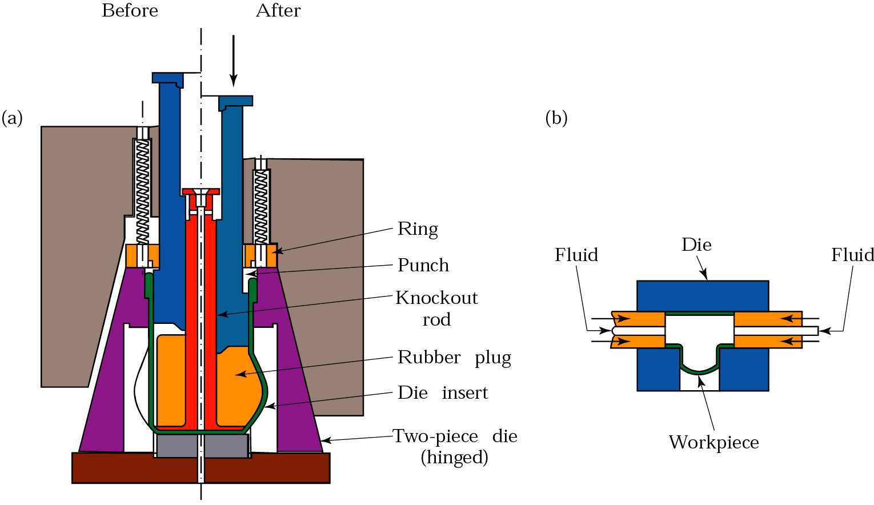
Bulging
Figure 16.28 (a) The bulging of a tubular part with a flexible plug. Water pitchers can be made by this method. (b) Production of fittings for plumbing, by expanding tubular blanks under internal pressure. The bottomof the piece is then punched out to produce a "T." Source: J. A. Schey, Introduction to Manufacturing Processes (2d ed.)

Slide 7
Rubber Forming Process
Figure 16.39 a) The ram descends, the rubber gradually surrounds the sheet.
The form block can be made of wood plastic or other materials that are easy to shape.

Slide 8
Hydroform Process
Figure 16.39 The hydroform (or fluid forming) process. Note that, in contrast to the ordinary deep-drawing process, the pressure in the dome forces the cup walls against the punch. The cup travels with the punch; in this way, deep drawability is improved.

Slide 9
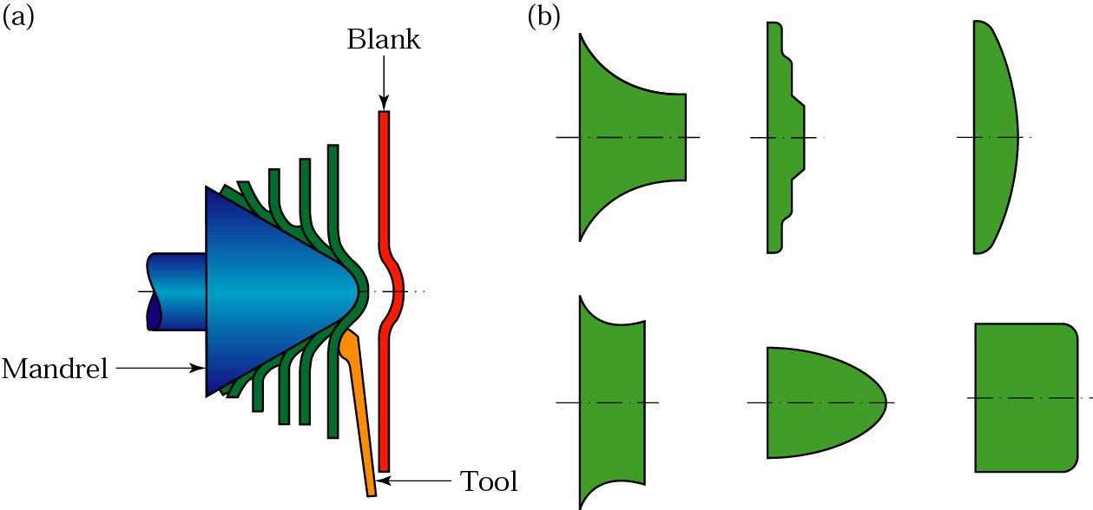
Conventional Spinning
Figure 16.40 (a) Schematic illustration of the conventional spinning process. (b) Types of parts conventionally spun. All parts are axisymmetric.

Slide 10
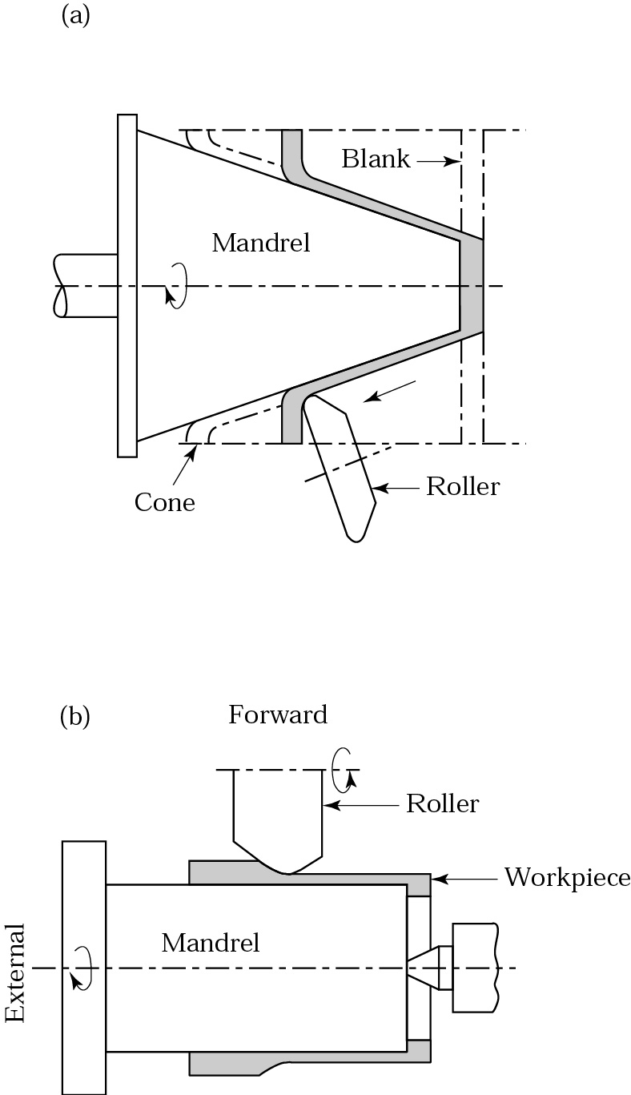
Shear and Tube Spinning
Figure 16.41
(a) Schematic illustration of the shear spinning process for making conical parts. The mandrel can be shaped so that curvilinear parts can be spun.
(b) Schematic illustration of the tube spinning process.

Slide 11
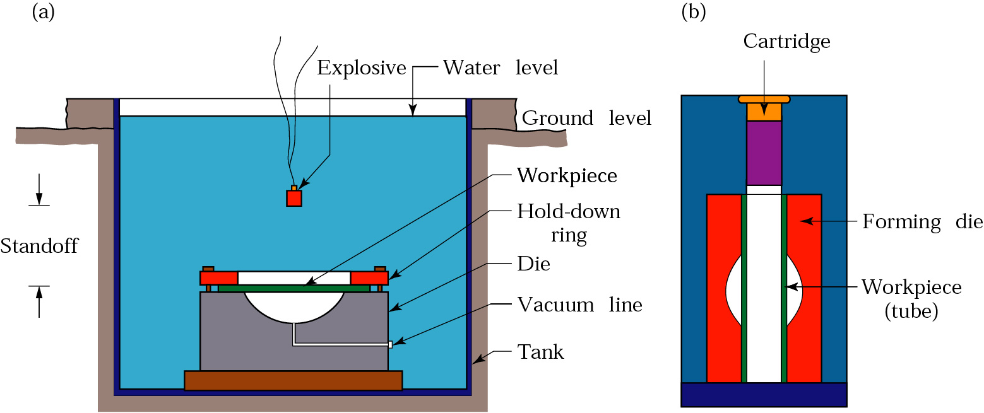
Explosive Forming
Figure 16.44 (a) Schematic illustration of the explosive forming process. (b) Illustration of the confined method of explosive bulging of tubes.

Slide 12
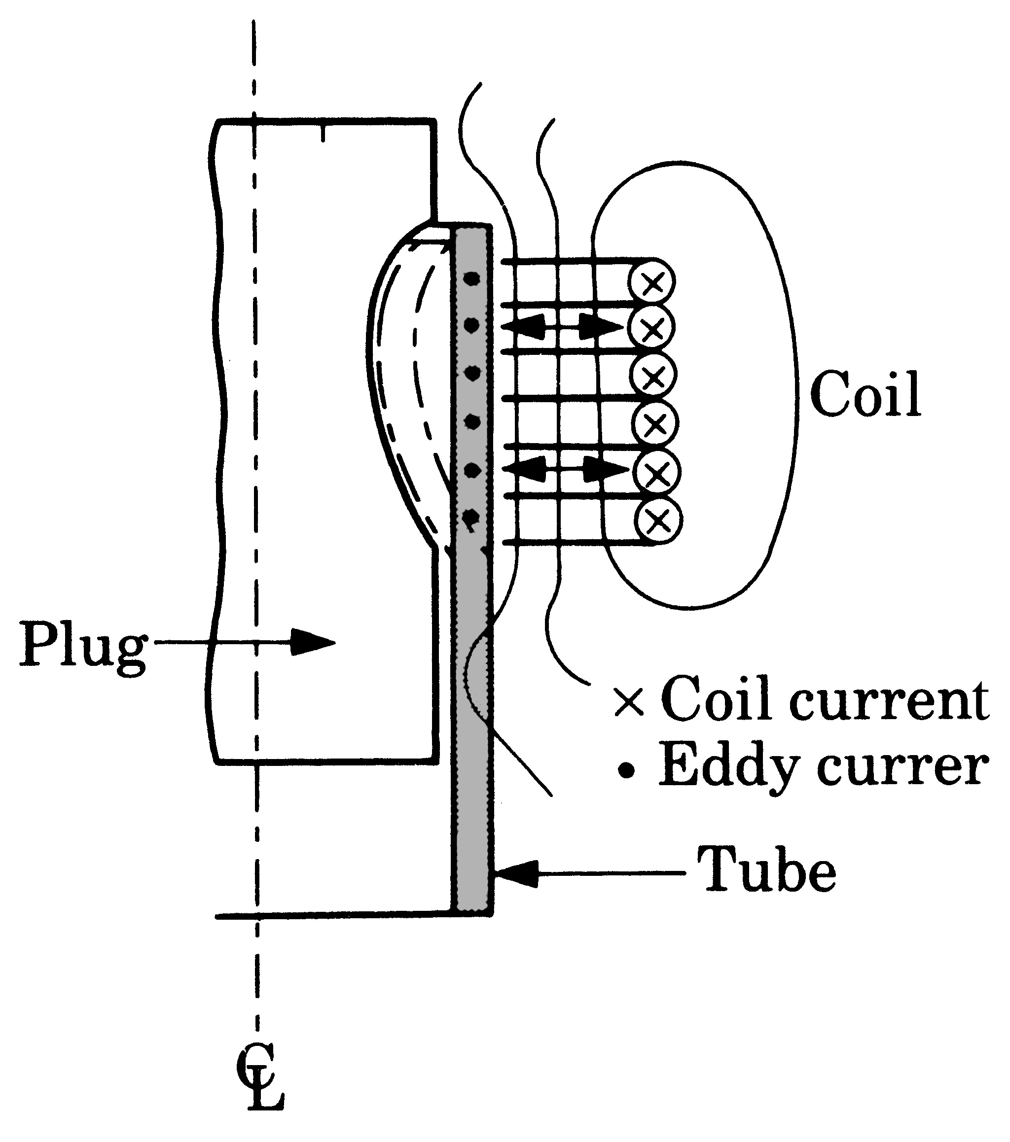
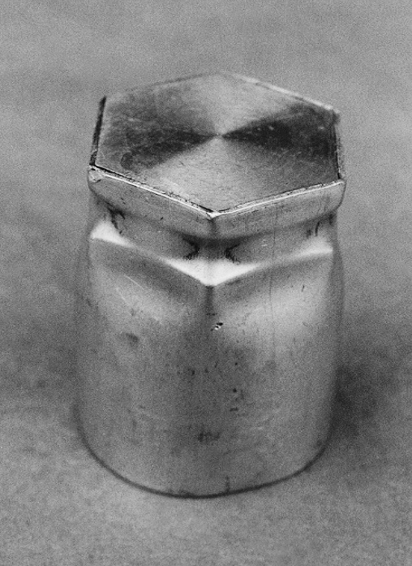
Magnetic-Pulse Forming
(a)
(b)
Figure 16.45 (a) Schematic illustration of the magnetic-pulse forming process used to form a tube over a plug. (b) Aluminum tube collapsed over a hexagonal plug by the magnetic-pulse forming process.

Slide 13
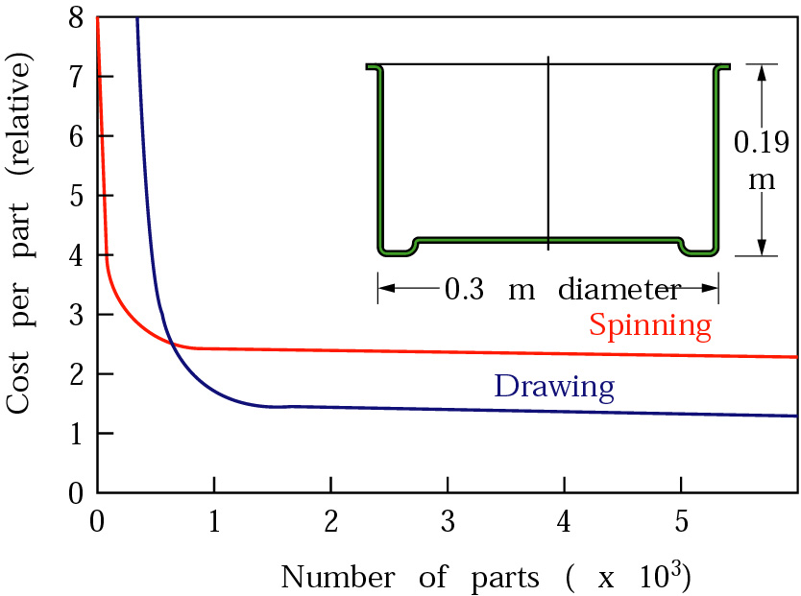
Cost Comparison for Spinning and Deep Drawing
Figure 16.48 Cost comparison for manufacturing a round sheet-metal container either by conventional spinning or by deep drawing. Note that for small quantities, spinning is more economical.

Slide 14
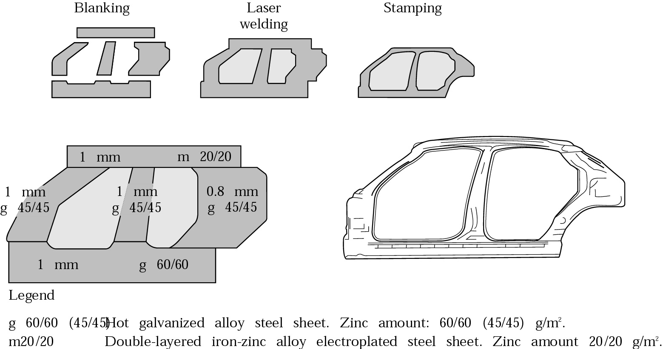
Laser Welding
Production of an outer side panel of a car body, by laser butt-welding and stamping. Source: After M. Geiger and T. Nakagawa.

Slide 15
Characteristics of Sheet-Metal Forming Processes

