Slide 1
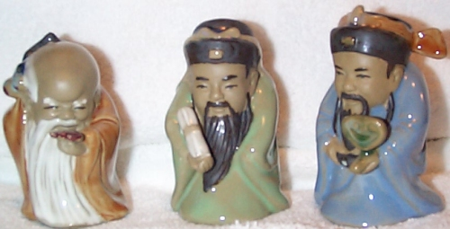
Ceramics
Apiwat Muttamara

Slide 2
Topic
Traditional and Engineering ceramics
Simple ceramic crystal structures
Processing of ceramics
Properties of ceramics
Glasses

Slide 3
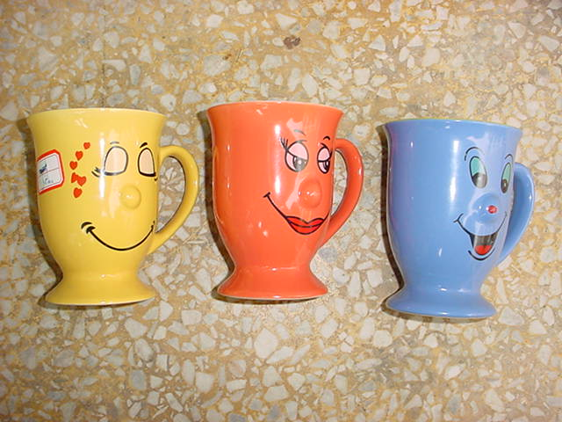
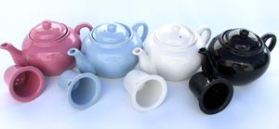
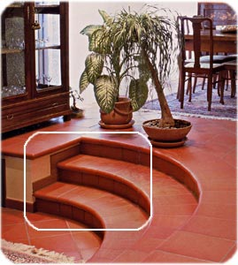
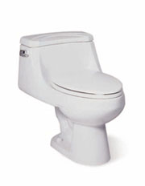
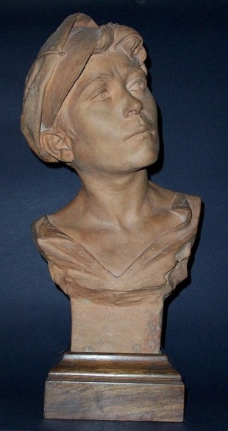
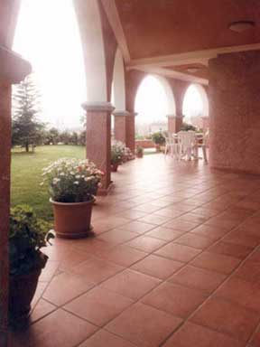

Slide 4
Clay Products:
Structural products (Bricks, tiles, sewer pipes)
Whitewares (Porcelain, pottery, tableware, china, plumbing fixtures)
These products are composed of:
Alumina (Al₂O₃) + Silica (SiO₂)

Slide 5
Ceramics are compounds between metallic and nonmetallic elements
which can be oxides, nitrides, and carbides.
The wide range of materials that falls within this classification includes ceramics that are composed of clay minerals, cement and glass.
Products that are considered to be traditional ceramics are china, porcelain, bricks, tiles and in addition, glasses and high-temperature ceramics.
Notes:
Since the atomic bonding in ceramic materials is either partially or totally ionic, most ceramic crystal structures may be thought of as being composed of electrically charged ions instead of atoms. The metallic ions are positively charged cations and the nonmetallic ions are negatively charged anions. Ceramics are composed of at least two elements and their crystal structures are far more complex than those of metals
Since the atomic bonding in ceramic materials is either partially or totally ionic, most ceramic crystal structures may be thought of as being composed of electrically charged ions instead of atoms. The metallic ions are positively charged cations and the nonmetallic ions are negatively charged anions. Ceramics are composed of at least two elements and their crystal structures are far more complex than those of metals
Over the years, significant progress has been made in understanding the fundamental character of ceramics and of the phenomena that occur in them that are responsible for their unique properties. Consequently, a new generation of these materials has evolved, and the term “ceramic” has taken on much broader meaning. These new materials have a rather dramatic effect on our lives; electronics, computer, communication, aerospace and a host of other industries rely on their use.

Slide 6
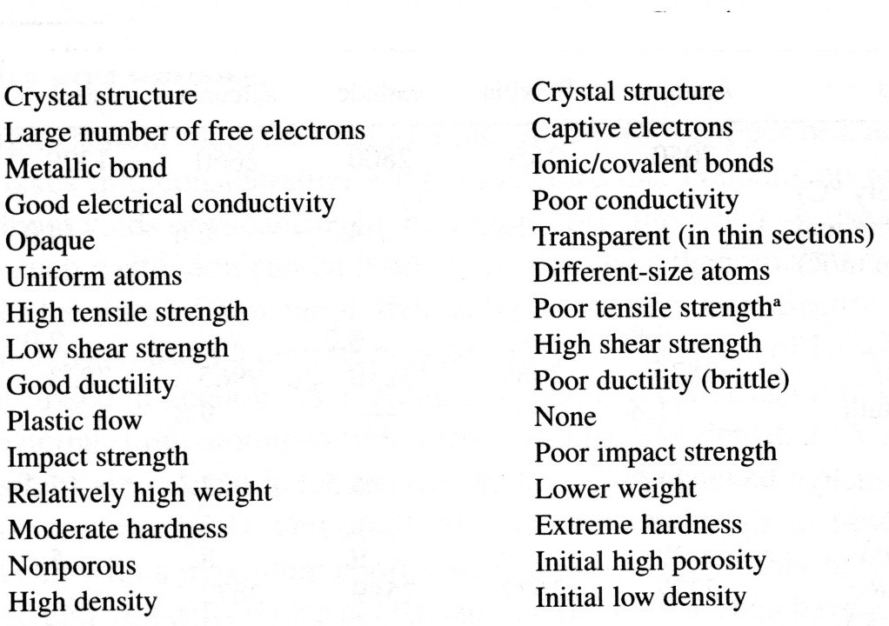
Comparison
Metals
Ceramics

Slide 7
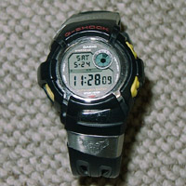

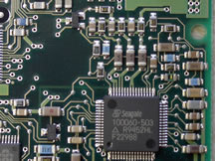
electroluminescence
R C insulating Mat

Slide 8
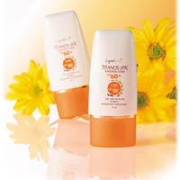
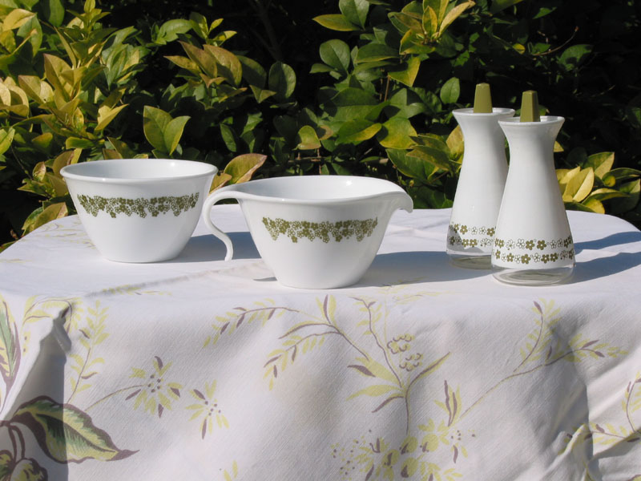
Boron nitride
Corelle

Slide 9
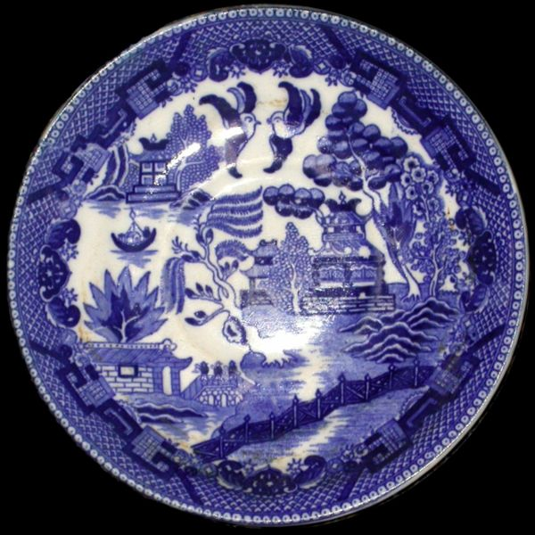
Ceramics
1.Traditional ceramics ‑
clay products such as
pottery and bricks,
common abrasives, and cement
2.New ceramics ‑ more recently developed ceramics based on oxides, carbides, etc., and generally possessing mechanical or physical properties superior or unique compared to traditional ceramics

Slide 10
(Classification based on application)

Slide 11
Properties of Ceramic Materials
Crystalline and noncrystalline states
High melting temperatures (varying from 3500 to 7000 º F)
All ceramics are brittle at room temperatures
Very low resistance to tensile loads. Very low fracture strengths. Microcracks are formed very easily under tensile stresses.
Stronger under compressive loads and microcracks are not formed as easily as in tension.

Slide 12
Properties of Ceramic Materials (Cont’d)
High hardness nd good wear resistance.
High toughness
Low thermal and electrical conductivity.
High creep resistance at elevated temperatures
Capacity to remain unreactive and inert when exposed to severe environments
Can be magnetized and demagnetized, some can be permanently magnetized

Slide 13
Advanced Ceramics
Structural: Wear parts, bioceramics, cutting tools, engine components, armour.
Electrical: Capacitors, insulators, integrated circuit packages, piezoelectrics, magnets and superconductors
Coatings: Engine components, cutting tools, and industrial wear parts
Chemical and environmental: Filters, membranes, catalysts, and catalyst supports

Slide 14
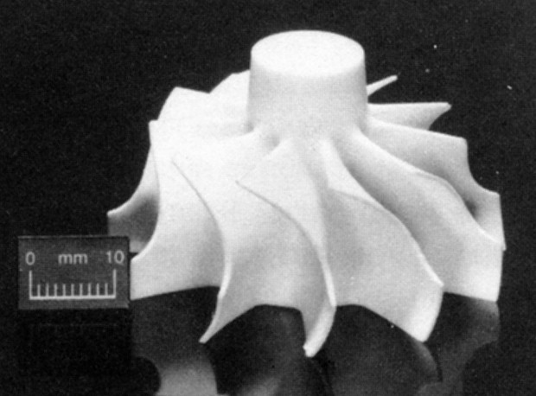
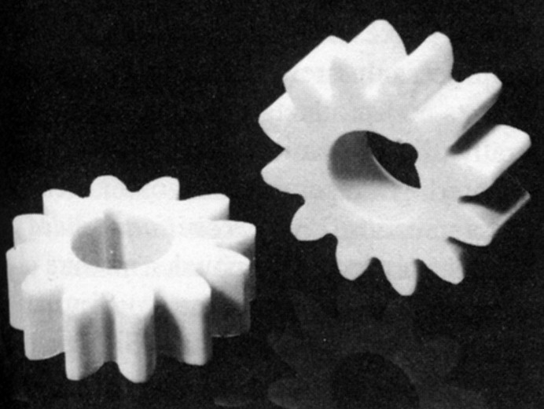
Engine Components
Rotor (Alumina)
Gears (Alumina)

Slide 15
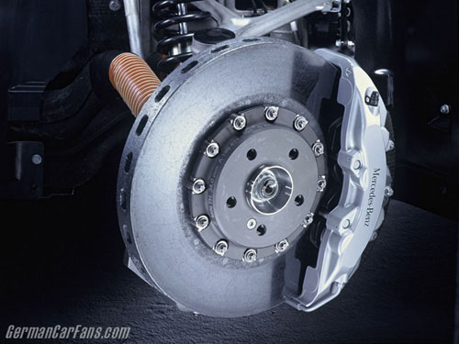
Ceramic Brake Discs

Slide 16
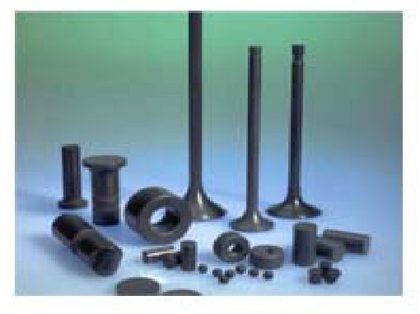
Silicon Carbide
Automotive Components in Silicon Carbide
Chosen for its heat and wear resistance

Slide 17
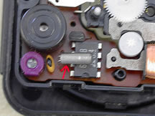
Quatz
สนามไฟฟ้า
Piezoelectric
Piezzein+electric
Notes:
พวกนี้จะใช้พลังงานไฟฟ้าบางส่วนส่งผ่านผลึกควอทซ์ แล้วรับสัญญาณความถี่ กลับออกมาให้ ไมโครโพเซสเซอร์ประเมินออกมาเป็นเวลา

Slide 18
piezoelectric
Unit Cell Under Mechanical
Compression (“pushing” force):
Electrical polarity as shown
+ + +
Unit Cell at Rest
+
-
+
-
+
-
- - -
Unit Cell Under mechanical
Tension (“pulling” force):
Electrical polarity reverses.
- - -
Neutral Charge
-
+
+
+
-
-
+
+ + +

Slide 19

Crystals
Quartz SiO2
Berlinite AlPO4
Gallium orthophosphate GaPO4
Tourmaline
Ceramics
Barium titanate BaTiO3
Lead zirconate titanate PZT
Other materials
Zinc oxide ZnO
Aluminum nitride AlN
Polyvinylidene fluoride PVDF
More piezo materials
Raincap

Slide 20
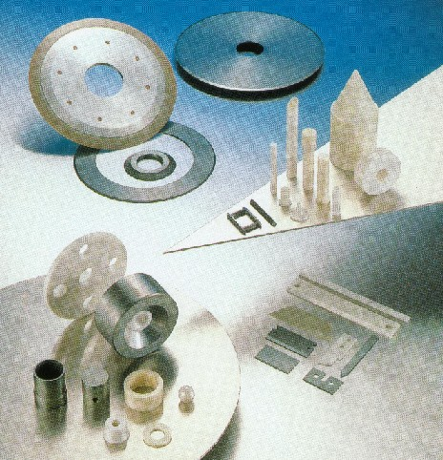
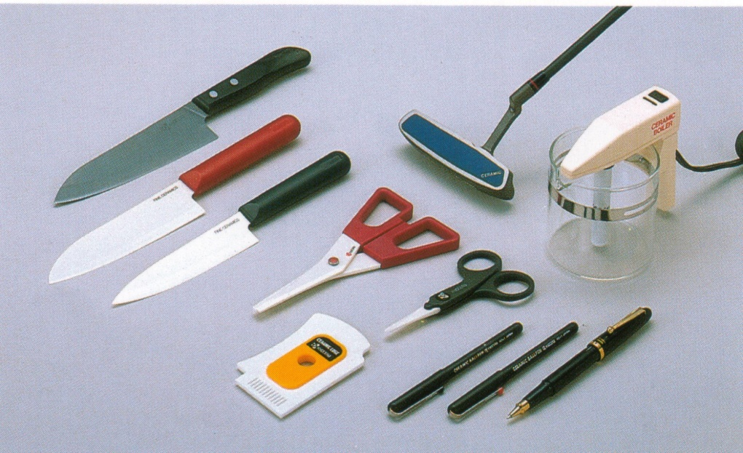
Zirconia (ZrO₂)
Properties:
the highest strength and toughness at room temperature
excellent surface smoothness
Applications:
household appliances and pump parts
Household appliances

Slide 21
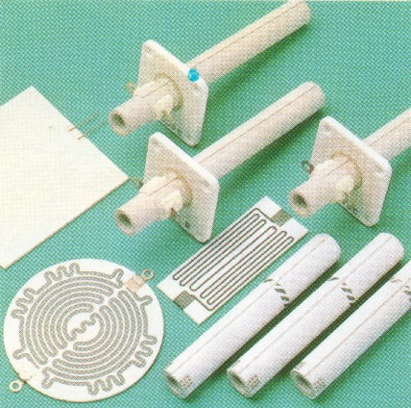
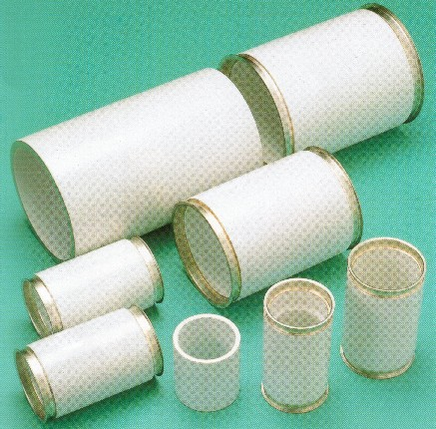
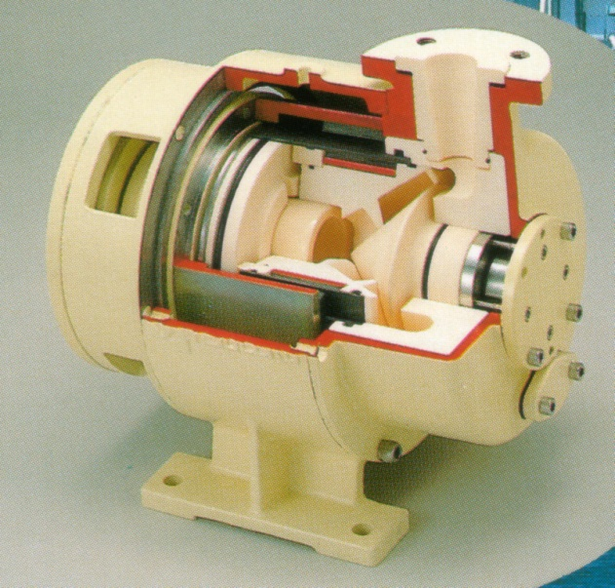
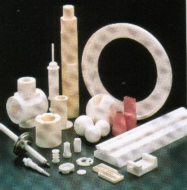
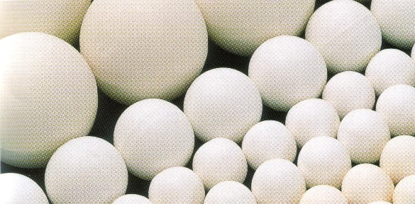
Al₂O₃
Heaters
Vacuum circuit breaker
Ceramic centrifugal pump
Liners of sliding surfaces for carrying and storing powder, Valves for chemical analysis, Rollers, nozzles, seal valves,
and grinding machine parts

Slide 22
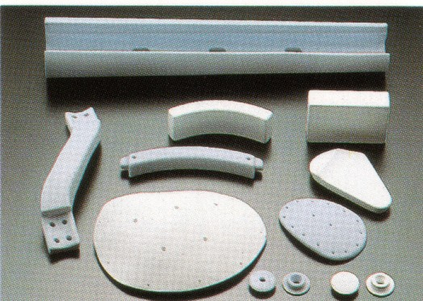
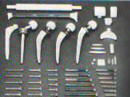
Bioceramics

Slide 23
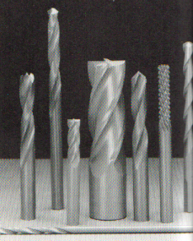
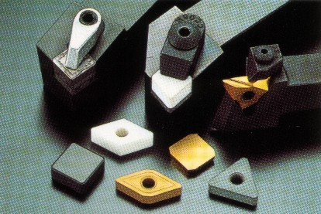
Non-oxide ceramics: SiC, Si₃N₄, BN, TiN
  Heat-resistance and high temperature structural material
  Corrosion and wear resistance
Drilling tool
Cutting tool

Slide 24
Blade material and major uses
Carbon steel, steel alloy | Slow cutting
High-speed steel | General cutting, difficult-to-cut material
Coated super-hard alloys | General cutting
Ceramics | High-speed cutting finishing cuts
Sintered Diamond | Non-ferrous alloy, non-metal material cutting
Sintered cubic boron nitride (CBN) | Super-hard alloy, quenched steel, finish cut

Slide 25
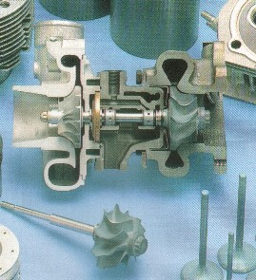
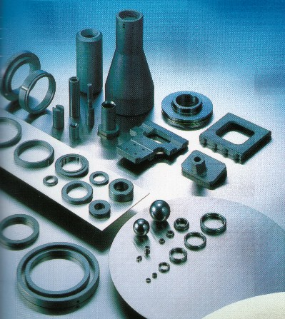
Silicon nitride (Si₃N₄)
Properties:
Heat resistance,
High temperature strength
Applications:
Engine and gas turbine parts
Silicon carbide (SiC)
Properties:
high temperature strength
highest corrosion resistance
Applications:
mechanical seals and pump parts

Slide 26
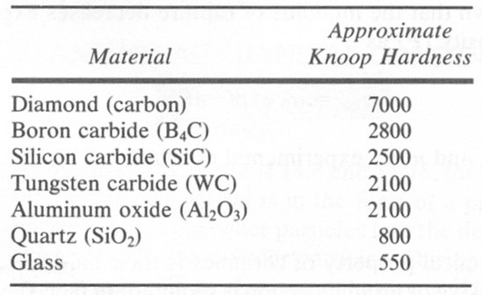
Hardness of Ceramics

Slide 27
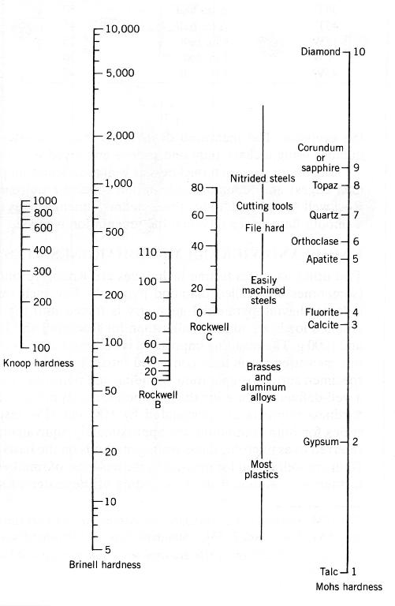
Relative Hardness
B4C, SiC
WC, Al₂O₃
Glass

Slide 28
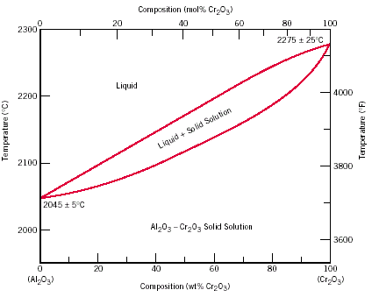
Ceramic Phase Diagrams: Al₂O₃-Cr₂O₃ System
Notes:
Note: They are similar to metal alloy systems - except the temperatures are generally higher.

Slide 29
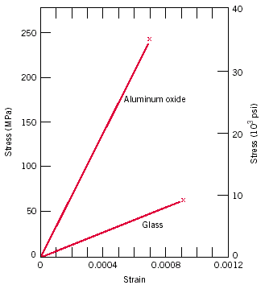
Stress-strain behavior for aluminum oxide and glass

Slide 30
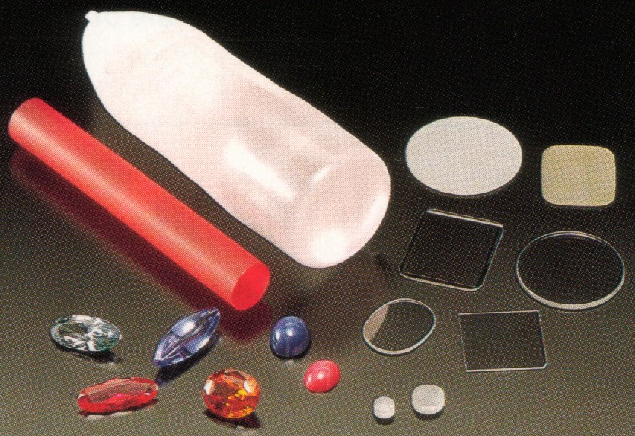
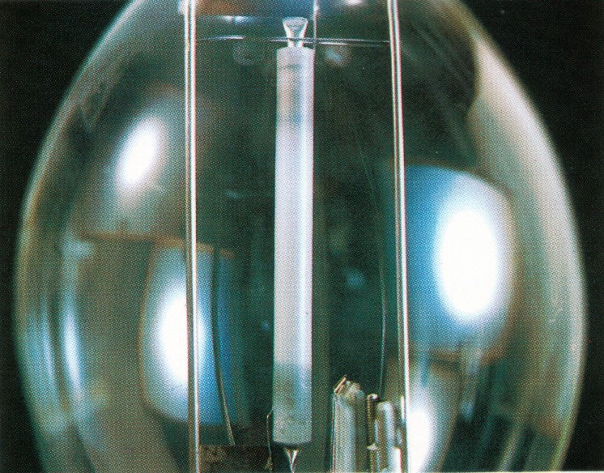
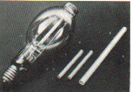
High purity alumina
manufacturing of sapphire for cover glass,
single crystal, translucent alumina ceramics
transparent alumina
sheaths for high-voltage sodium lamps

Slide 31
Processing of Ceramics

Slide 32
Ceramics’Production processes
Raw materials : Chemicals & minerals
milling: Particle Size Distribution
powder
Pressing-(Plastic forming)
(Casting)
Green body
(heat) :Sintered
Ceramic product

Slide 33
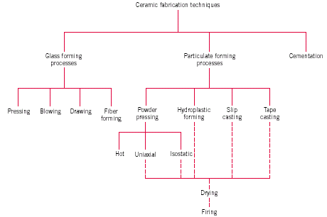
Ceramics forming

Slide 34
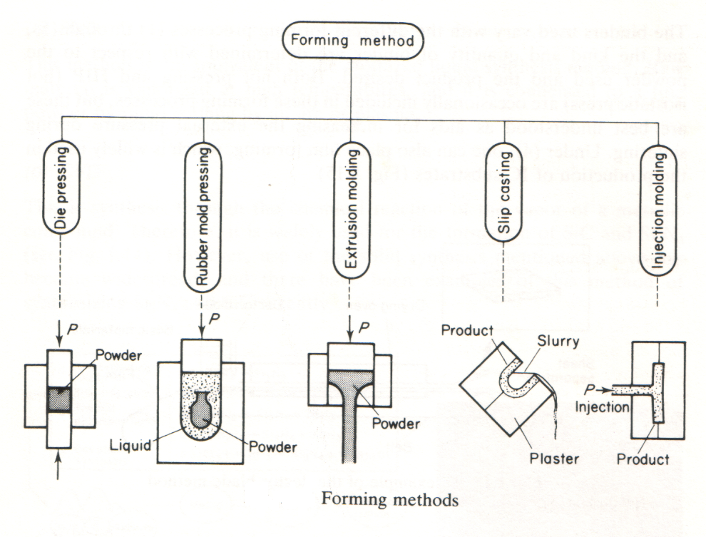

Slide 35
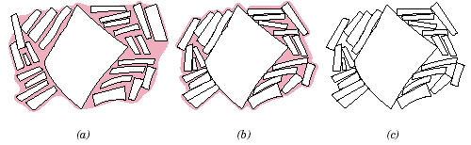
Thermal Treatment
Drying process or de-binding
  Debinder- organic binder ~ 200-300ºC
  Green ware

Slide 36
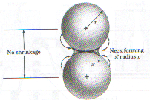
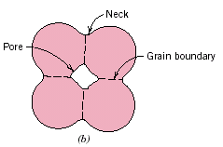
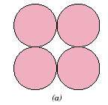
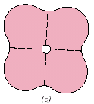
Sintering
  solid-state diffusion
  porous compact
  Temp. less than melting Temp.
  Ex. Al₂O₃ spark plug is sintered at 1600ºC (melting point Al₂O₃ is 2050ºC)

Slide 37
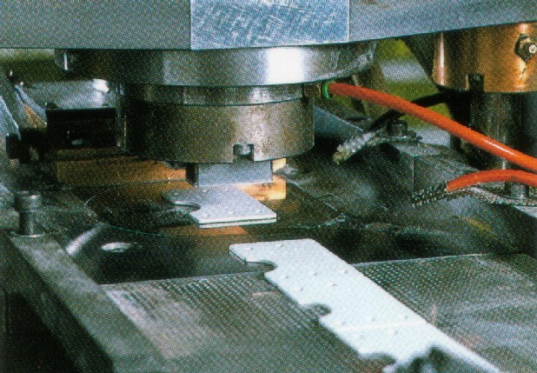
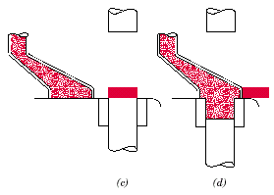
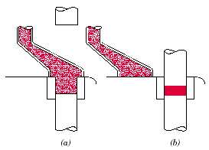
Powder Pressing
Uniaxial pressing
  -Economic
    Mass production
    Tile, Electronics’industry

Slide 38
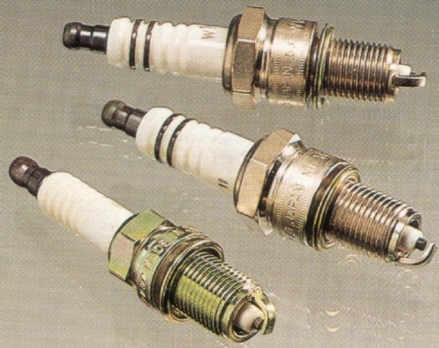
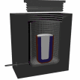

  Isostatic Pressing
    Rubber Mold
    High Quality, Intricate parts
    Spark plug

Slide 39


  Hot pressing
    Uniaxial pressing OR HIP
      reduce the porosity of metals. This improves the mechanical properties and increases workability.
    Mold mist be good thermal shock resistance
    Si₃N₄ , SiC, Al₂O₃

Slide 40


Extrude
Cordiarite ceramics ( 2MgO.2Al₂O₃.5SiO₂ )
Honey comb for gas purification catalyst carriers

Slide 41

Amorphous Ceramics (Glasses)
Insulator
Chemical resistance
Good corrosion resistance
Main ingredient is Silica (SiO2)
If cooled very slowly will form crystalline structure.
If cooled more quickly will form amorphous structure consisting of disordered and linked chains of Silicon and Oxygen atoms.
This accounts for its transparency as it is the crystal boundaries that scatter the light, causing reflection.
Glass can be tempered to increase its toughness and resistance to cracking.

Slide 42
Glass Types
Three common types of glass:
Soda-lime glass - 95% of all glass, windows containers etc.
Lead glass - contains lead oxide to improve refractive index
Borosilicate - contains Boron oxide, known as Pyrex.

Slide 43
Glasses
Flat glass (windows)
Container glass (bottles)
Pressed and blown glass (dinnerware)
Glass fibres (home insulation)
Advanced/specialty glass (optical fibres)

Slide 44

Silicate glasses
Amorphous silica forms a “network” with relatively large open areas where foreign atoms and particles may be easily introduced.
Silicates: amorphous silica with impurities
Glass-modifying oxide
Ex. Na2O, K2O, CaO , MgO
(reduce viscosity)
Sodium-silicate glass
  Intermediate oxides
  Improve properties
  Ex.Al2O3 Improve melting point

Slide 45

  Vitrification is a process
  of converting a material
  into a glass-like amorphous solid which is free of any crystalline structure, either by the quick removal or addition of heat, or by mixing with an additive. Solidification of a vitreous solid occurs at the glass transition temperature (which is lower than melting temperature, Tm, due to supercooling).
Vitrification

Slide 46

Glass Transition
T_{m} : melting temperature
T_{g} : glass transition temperature
Temp. < T_{g} → glass
Temp. > T_{g} → supercooled liquid

Slide 47


Slide 48

Effect of Temp&Viscosity
The melting point (100 Poises) :
The working point (10⁴ P):
The softening point (4 x 10⁷ P): Without shape change
The annealing point (10¹³ P) :
  (residual stress)
The strain point ( 3x10¹⁴ P)

Slide 49

Glass Forming
  pressing
  blowing
  drawing
  fiber forming

Slide 50

Fiber forming

Slide 51


Plate Glass Drawing Processes

Slide 52


Tempered Glass
softening point rapid air cooling, oil bath
safety glass for door

Slide 53

Chemically Strengthened Glass
Cations with large ionic radius are diffused into the surface
This strains the “lattice” inducing compressive strains and stresses.
Sodium aluminosilicate + Potassium nitrate at 50ºC below strain point (500ºC ) for 6-10 hours cause compressive stress นon Surface and tensile stress in the part.
Airplane glass , Optical glasses
Si⁴⁺
Na⁺
K³⁺
Al³⁺
Notes:
Sodium aluminosilicate จุ่มใน Potassium nitrate ที่ 50ºC ต่ำกว่า strain point (500ºC ) เป็นเวลา 6-10 ชั่วโมง Potassium ions ซึ่งมีขนาดใหญ่กว่า Sodium ions จะไปแทนที่ Sodium ions ทำให้เกิด compressive stress ที่ผิว และ tensile stress ภายในชิ้นงาน
ใช้ทำกระจกสำหรับเครื่องบิน และเลนส์แว่นตา

Slide 54
Structured like a single crystal
Polycrystal → not transparent
  grain boundaries or pore absorb or scatter light
Like a single crystal → transparent
  extra-high purity ceramics
  grains are sintered so close to each other
Application: protective goggles, camera shutters
Transparent ceramics
Ordinary ceramics

Slide 55


Ceramic single crystal
Yttrium Aluminum Garnet (YAG) single crystal
MgO single crystal

