Slide 1
Die Design
Dr. Apiwat Muttamara

Slide 2
Agenda
Material selection
Die Design
Structure of Die

Slide 3
Standards Designation Equivalent of Tool Steels ---
AISI | American Iron & Steel Institute
JIS | Japanese Industrial Standards
DIN | Deutsches Institut für Normung
 | (German Standards Institute)
SS | Svensk Standard
 | (Swedish Standard)
BS | British Standards

Slide 5
 | DAIDO BRAND | JIS | AISI | DIN
Cold Work Tool Steels | YK30 | SKS93 | - | - | -
 | YK4 | SK4 | W1/W2 | 1.154 | C100W1
 | G0A | SKS3mod. | - | - | -
 | G05 | - | - | - | -
 | DC11 | SKD11 | D2 | 1.2379 | X165CrMoV12
 | DC53 | SKD11mod. | - | - | -
Hot Work Tool Steels | DHA1 | SKD61 | H13 | 1.2344 | X40CrMoV51
 | DH2F | SKD61mod. | - | - | -
 | GFA | SKT4mod. | L6 | 1.2714 | 55CrNiMoV6

Slide 6
 | DAIDO BRAND | JIS | AISI | DIN
High Speed Tool Steels | MH51 | SKH51 | M2 | 1.3343 | S6-5-2
 | MH85 | - | - | - | -
Plastic Mold Steels | PXZ | - | - | - | -
 | PX4 | - | p20mod. | - | -
 | PX5 | - | p20mod. | - | -
 | NAK55 | - | - | - | -
 | NAK80 | - | - | - | -
 | S-STAR | SUS420J2mod. | 420mod. | 1.4034 | X40Cr13
 | G-STAR | - | - | - | -

Slide 7
Application | Usual Hardness HRC | Recommended DAIDO BRAND
 |  | General Uses
 |  | Short Life | Long Life
Trimming Dies | 58-62 | YK30 | GOA
Pressing Dies | 58-63 | YK30 | GOA
Crimping Dies | 58-63 | GOA | DC11
Extrusion Dies | 55-62 | GOA | DC11
Extrusion Punches | 55-62 | GOA | DC11
Brick Forming Dies | 60-65 | GOA | DC11
Powder Compacting Dies | 58-62 | GOA | DC11
Cross Punches | 60-64 | MH51 | MH51
Plastic Mold Dies | 56-60 | GOA | -

Slide 8
Back post
Die set

Slide 9
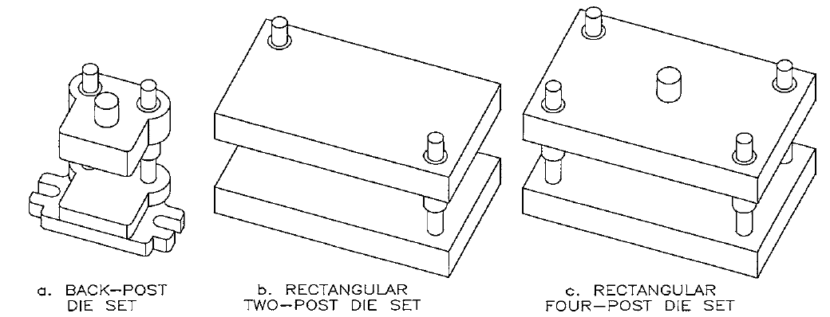

Slide 10
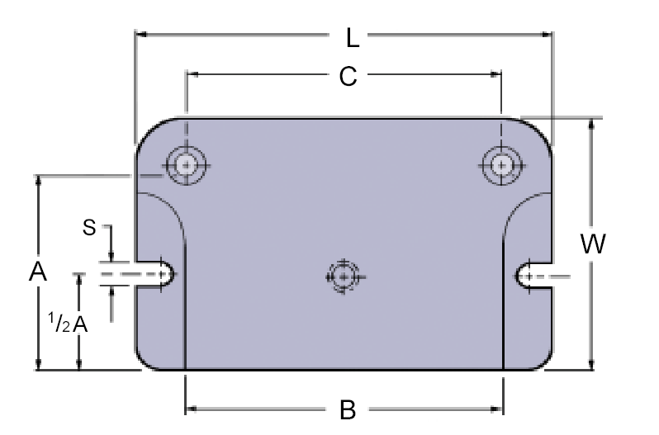
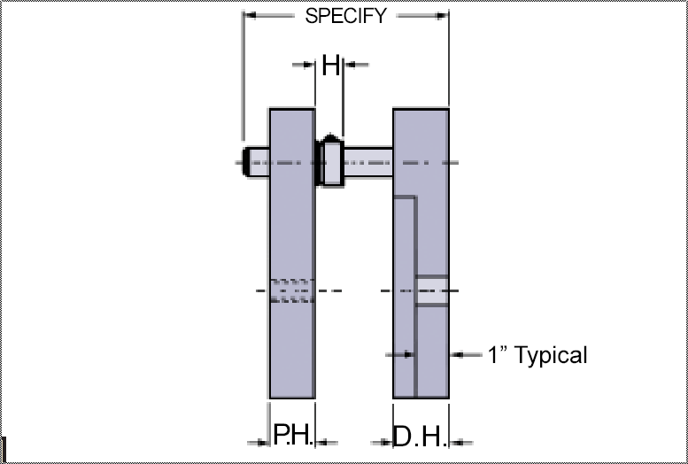

Slide 11
Steel | I=1.5D
Cast Iron | I=2D
Aluminum | I=2.5D
Plastic | I=3D up
H > 1.5D
J = I+3 | K=3
O > D
P > D

Slide 12
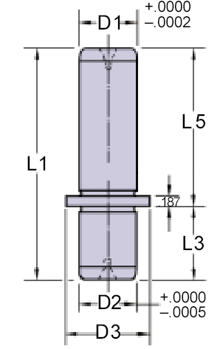
Guide & Bush

Slide 13
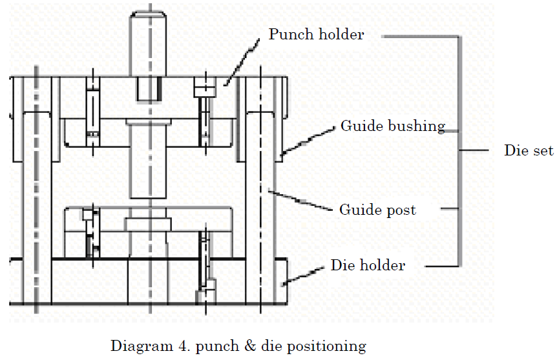

Slide 14
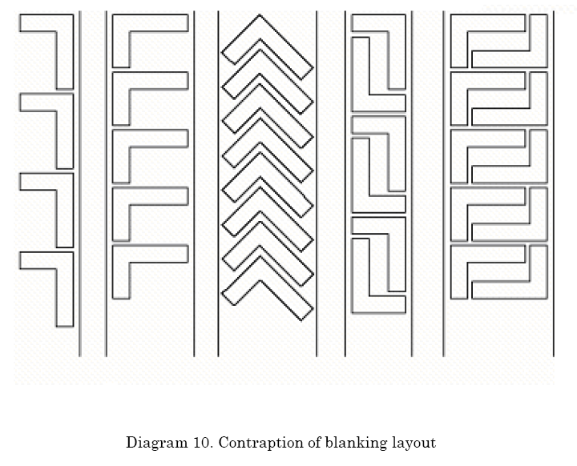

Slide 15
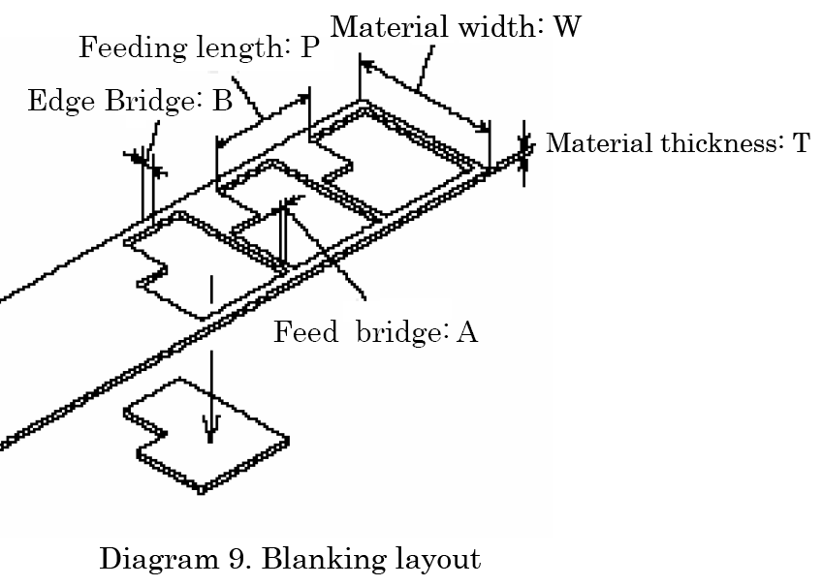
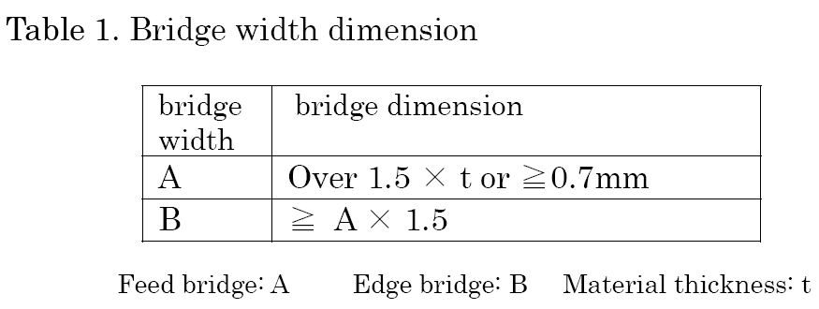

Slide 16
8

Slide 18
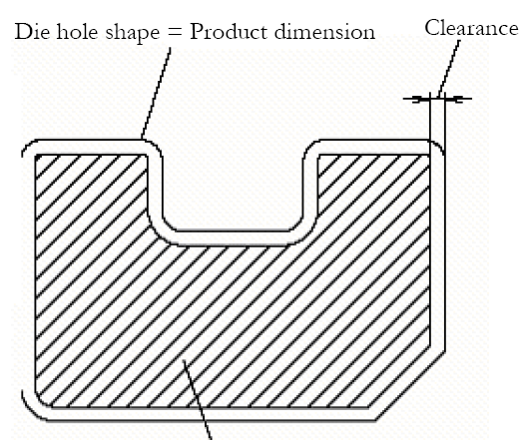
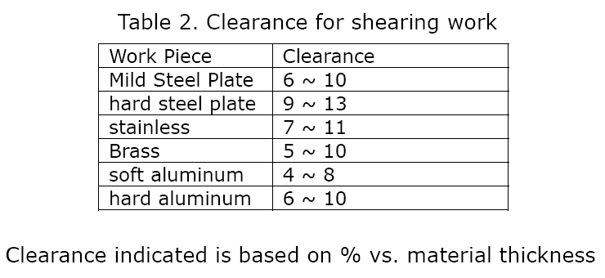

Slide 19
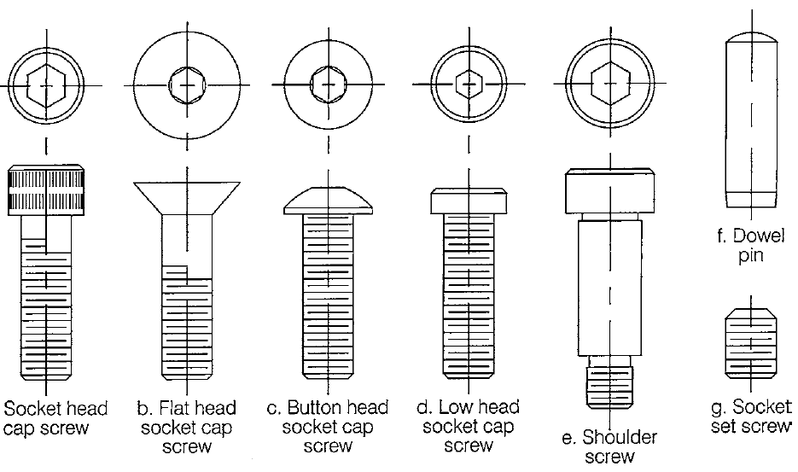

Slide 21
Stopper

Slide 22
Front space

Slide 23
Stripper plate
Pin

Slide 24
Relief Angle

Slide 26
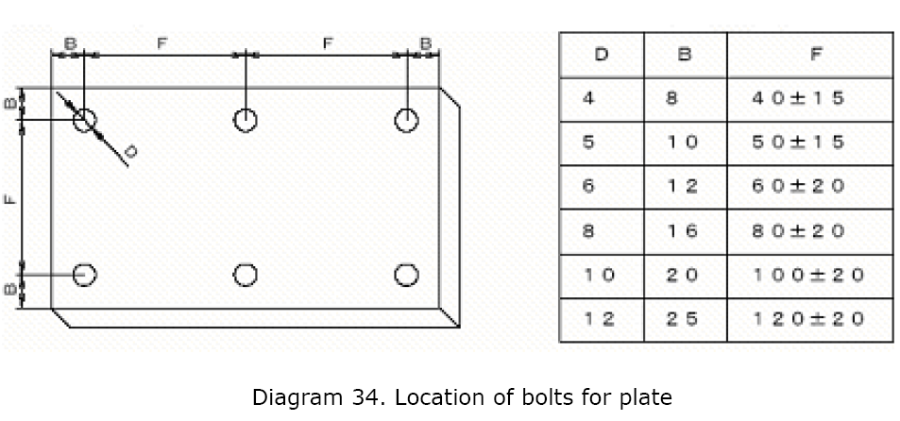
Location of bolts

Slide 27
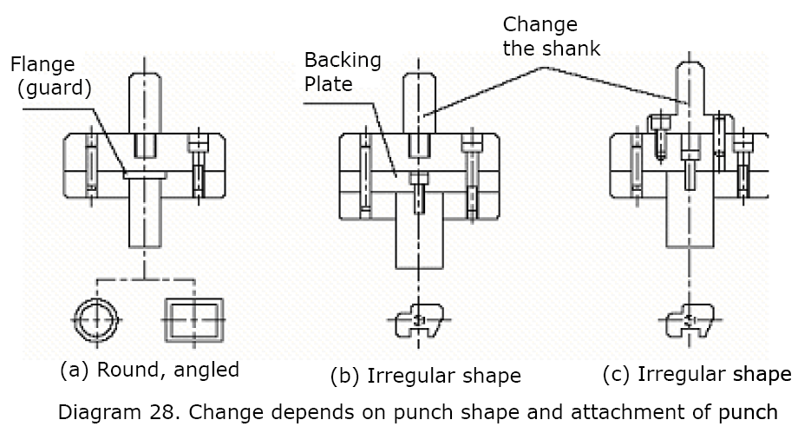
Punch Plate

Slide 28
Stripper Thickness

