Slide 1
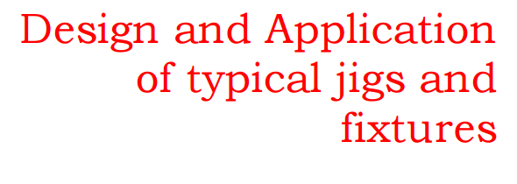

Slide 2
Agenda
(i) Analyze economic viability and judge necessity of jig – fixture for specific production by machining
(ii) Plan for designing a fixture or jig
(iii) Design fixture or jig (configuration and working) for specific jobs and their machining requirements.

Slide 3
Economic Viability Analysis And Judging Necessity Of Jig – Fixture.
The three possible modes of manufacturing a lot of a product by machining are :
using ordinary machine and without jig or fixture
using ordinary machine but with jig or fixture
using automatic special purpose machine

Slide 4
Economical viability, considering
cost of manufacturing, based on ο cost of the basic machine ο cost of the jig or fixture, if to be used ο volume of production (i.e. no. of pieces) ο material and labour cos

Slide 5
A specific case, for example,
A lot of 120 pieces have to be machined. The estimated cost components in three different modes are as follows

Slide 6
Assume
uniform quality possible, by all the modes, selection is made on the basis of total production cost
with the given cost components a graph; total machining cost vs quantity of production, has been plotted as shown

