Slide 1
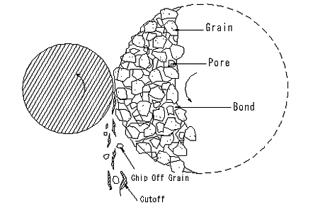
Grinding
Grinding is a process which utilizes the use of abrasive particles bounded together to produce superior surface finishing
An abrasive: is a small, nonmetallic hard particle having sharp edges and an irregular shape

Slide 3
Types of Abrasives
Conventional
Aluminum oxide
Silicon carbide
Super abrasives
Cubic boron nitride
diamond
Notes:
The kind of abrasive used depends on the hardness of both the material and the abrasive and also the kind of surface finishing needed

Slide 4
Grinder Forms cont’d

Slide 5
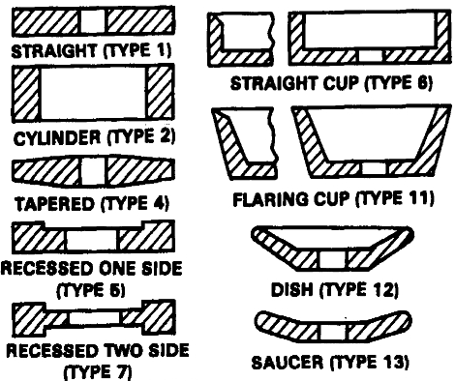
Grinder Wheels

Slide 6
Grinding Wheels
Operations done to preserve the properties of the wheel
Dressing
Truing
shaping
Notes:
Dressing: is used when the wheel becomes dull from developing wear flats or when the porosities on the wheel become filled with clogged chips. The process involves removing the external layer of the wheel and exposing fresh cutting abrasive edges to the work piece.
Truing: is a kind of dressing operation where the purpose is to restore the circular shape to the grinding wheel.
Shaping: grinding wheels can be shaped to take the negative of the shape that need to be grinded.

Slide 8
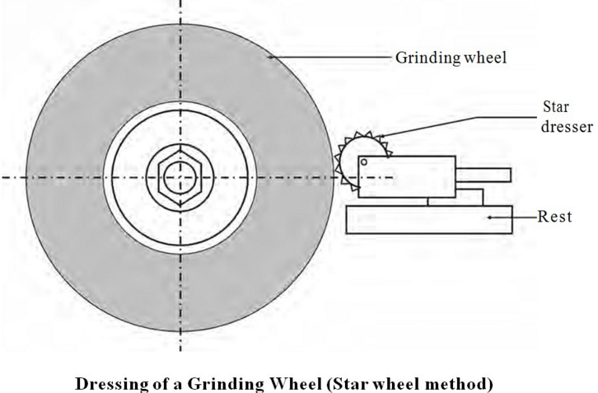
Dressing

Slide 9
Grinding Operations
Examples of grinding operations
Surface grinding
Cylindrical grinding
Internal grinding
Notes:
Surface grinding: is the process of grinding flat surfaces. The work-piece is mounted on a magnetic chuck or any other clamped device and the wheel is mounted on a horizontal spindle. The table reciprocates vertically and feeds horizontally to allow grinding the whole surface.
Cylindrical grinding: circular cross sections are ground by rotating the work-piece between two centers and moving it laterally on the grinder. Thread grinding also take place on cylindrical grinders.
Internal grinding: small wheels are used to grind the inside of the work-piece.

Slide 10
Grinding Machines

Slide 11
Grinding Machines

Slide 12
Grinding Machines

Slide 13
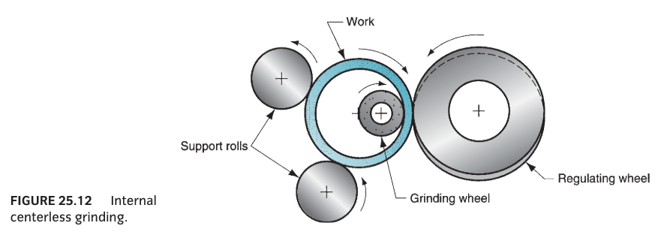
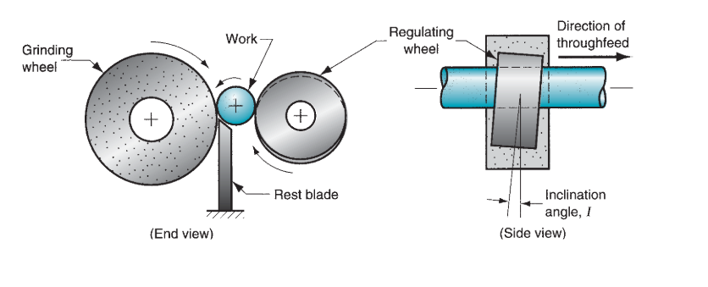

Slide 15
Surface Finishing
Any of different processes employed for surface, edge, and corner preparation, as well as cleaning, and coating.
Notes:
Surface Finishing usually constitutes a final operation in machining.

Slide 16
Lapping
Finishing operation in which a loose, fine-grain abrasive in a liquid medium abrades material.

Slide 17
Lapping cont’d
Lapping is an extremely accurate process
It corrects minor shape imperfections.
Refines surface finishes
Provides a close fit between mating surfaces.
Dimensional Tolerances = 0.00005mm

Slide 18
Polishing
An operation to smooth off roughness from a work-piece, or put a high finish on metal by using a polishing wheel.
Polishing wheel is a wheel made of one of several kinds of materials and coated with abrasive grain and glue.

Slide 19
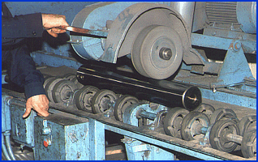
Polishing cont’d

Slide 20
Questions

