Slide 1
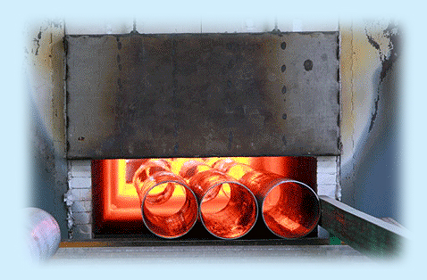
Tool & Die Materials
Heat & surface treatment
Apiwat Muttamara

Slide 2
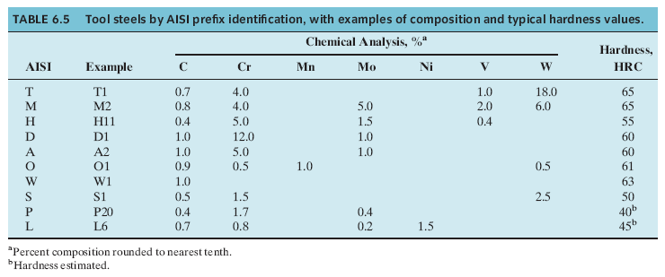
Example of tools steel

Slide 3
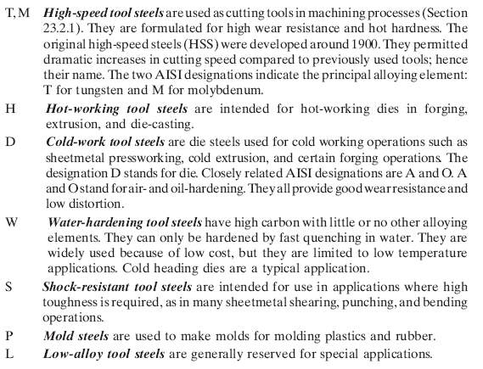

Slide 4
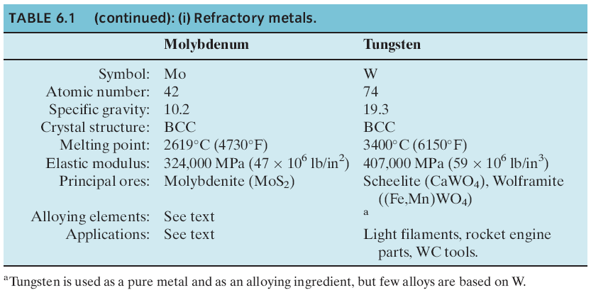
Refractory metal

Slide 5
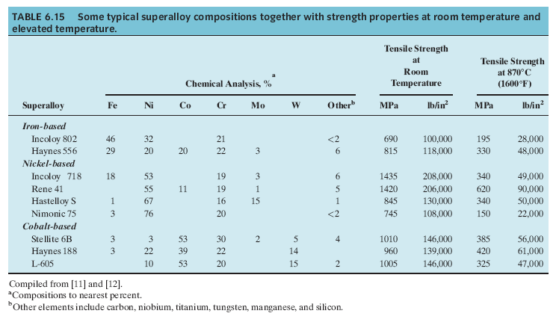
Super alloy

Slide 6
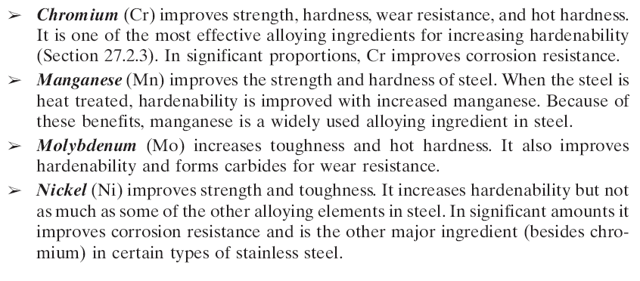
The effects of the
principal alloying ingredients

Slide 7
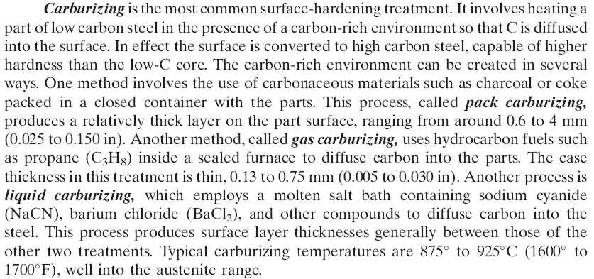
SURFACE HARDENING

Slide 8
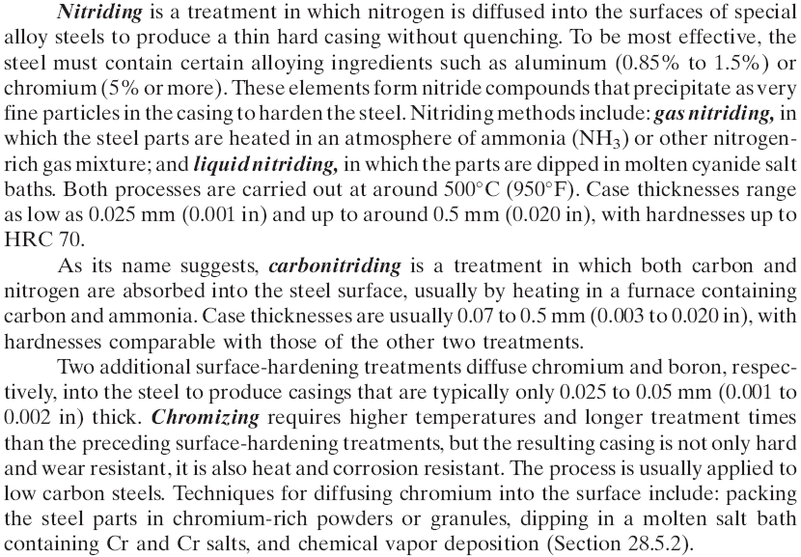

Slide 9
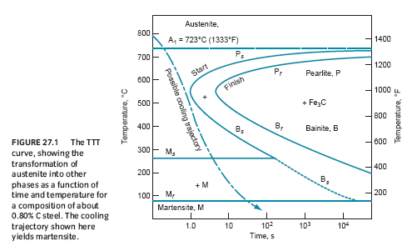
TTT curve

Slide 10
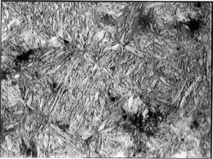
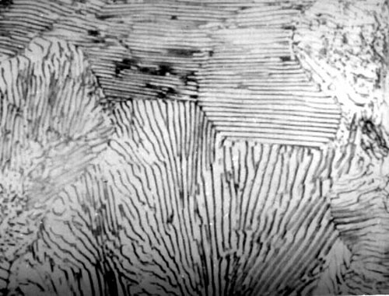
Bainite
Pearite

Slide 11
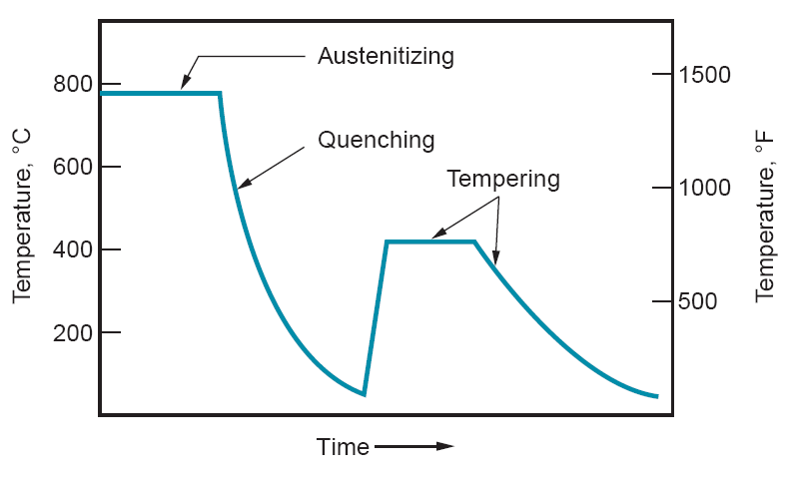
Heat Treatment

Slide 12
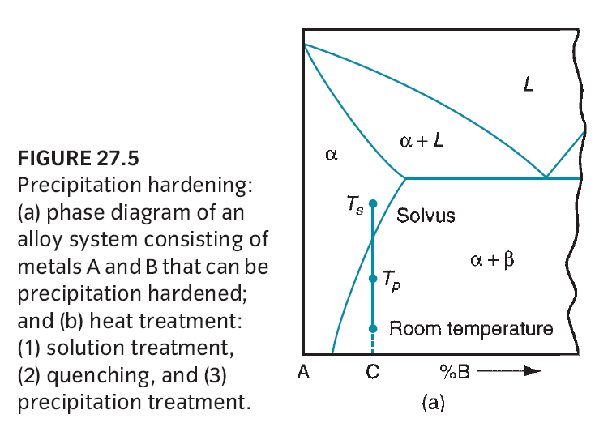
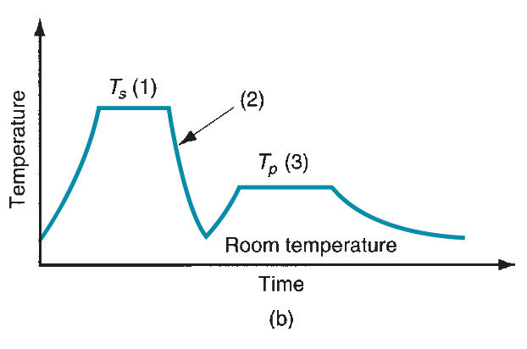
Precipitate

Slide 13
Surface hardening
Carburizing
Nitriding
Boronizing

