Slide 1
Injection Molding
Dr.Apiwat Muttamara

Slide 2
Outline
Equipment and process steps
Design for Part
Design for manufacturing, tooling and defects

Slide 3
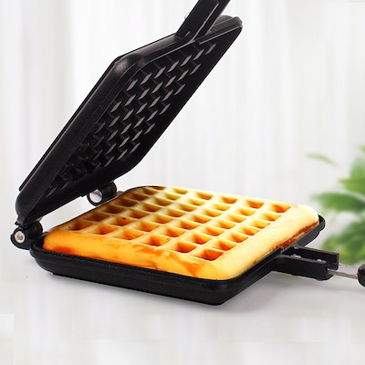
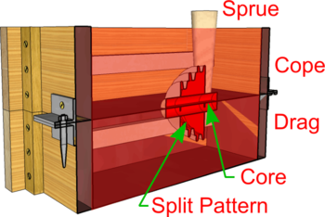
Mold

Slide 4
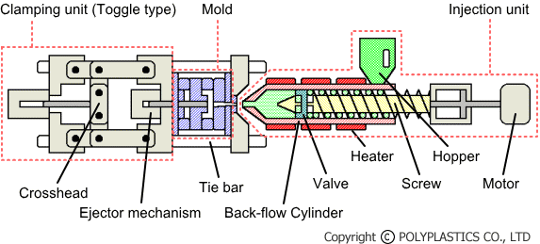
Plastics Processing: Injection Molding

Slide 5
THERMOPLASTIC, THERMOSET:
Thermoplastics
resins that can be reground after molding, and molded again.
Thermoplastic are often compared to Wax.
Thermosets
can be molded once only; they tend to be denser materials for special purposes ,
thermosets are often compared to an egg; once the egg is hard boiled

Slide 6
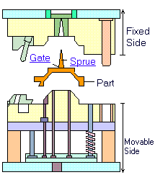
Two plate mold
One parting line

Slide 7
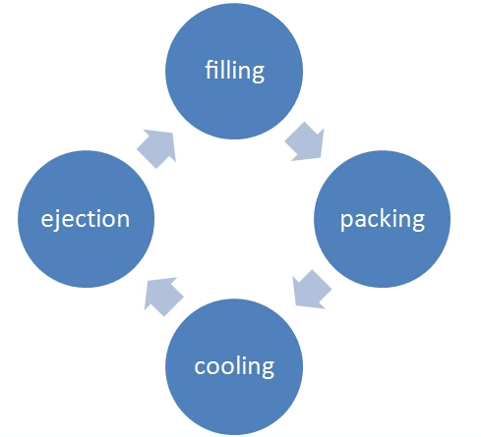
Injection Cycle

Slide 8
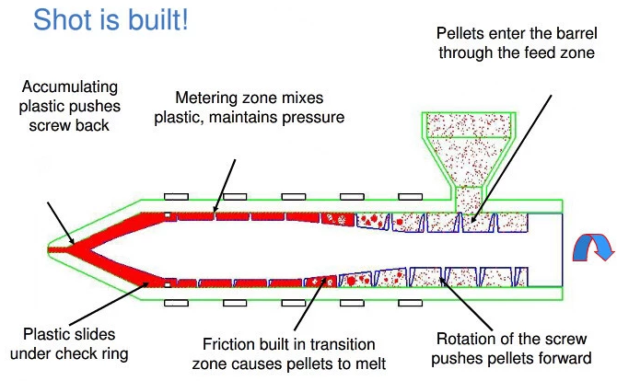
Melting System

Slide 9
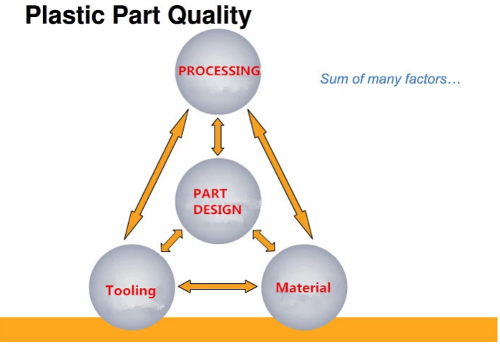

Slide 10
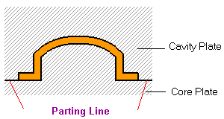
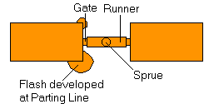
Mold Structure: Parting line
A dividing line between a cavity plate and a core plate of a
mold.
- Make a parting line on a flat or simple-curved surface so that flash cannot be generated.
- Venting gas or air.

Slide 11
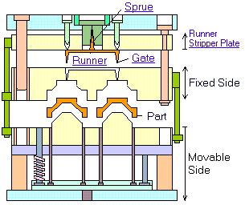
Three plate mold
Parting lines

Slide 12
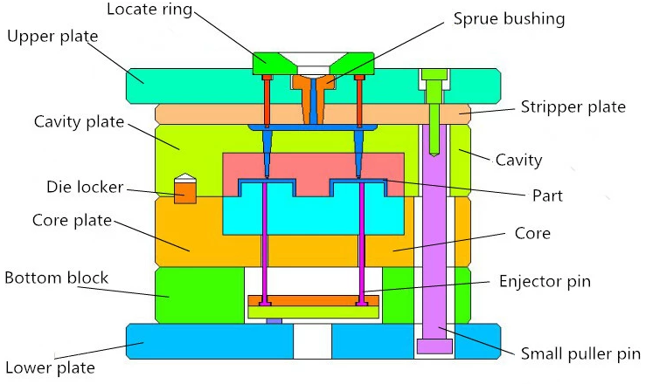
Three plate structure

Slide 13
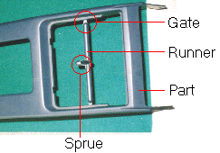
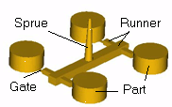
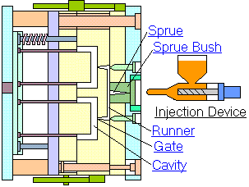
Melt Delivery
Notes:
Sprue
A sprue is a channel through which to transfer molten plastics injected from the injector nozzle into the mold.
Runner
A runner is a channel that guides molten plastics into the cavity of a mold.
Gate
A gate is an entrance through which molten plastics enters the cavity.

Slide 14
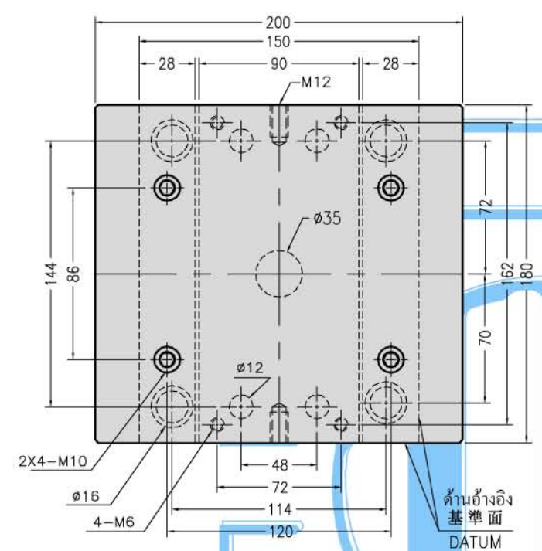
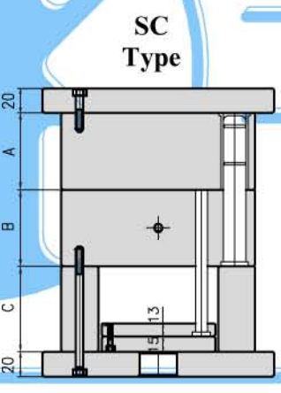
Moldbase
Moldbase 1518
www.taikin.com

Slide 15
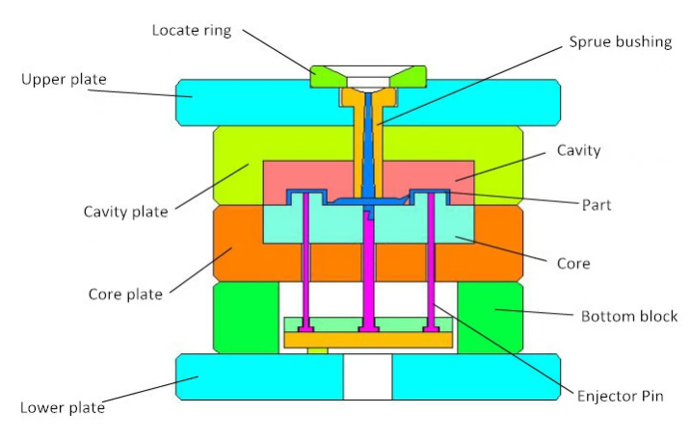
Mold & Parts

Slide 16
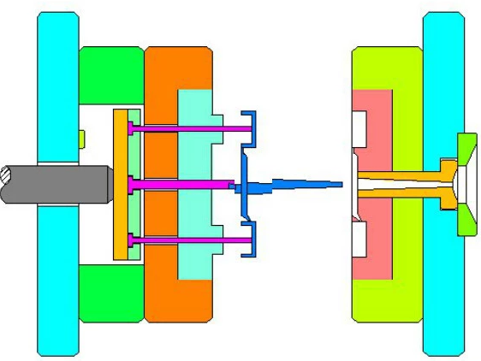
Mold processing

Slide 17
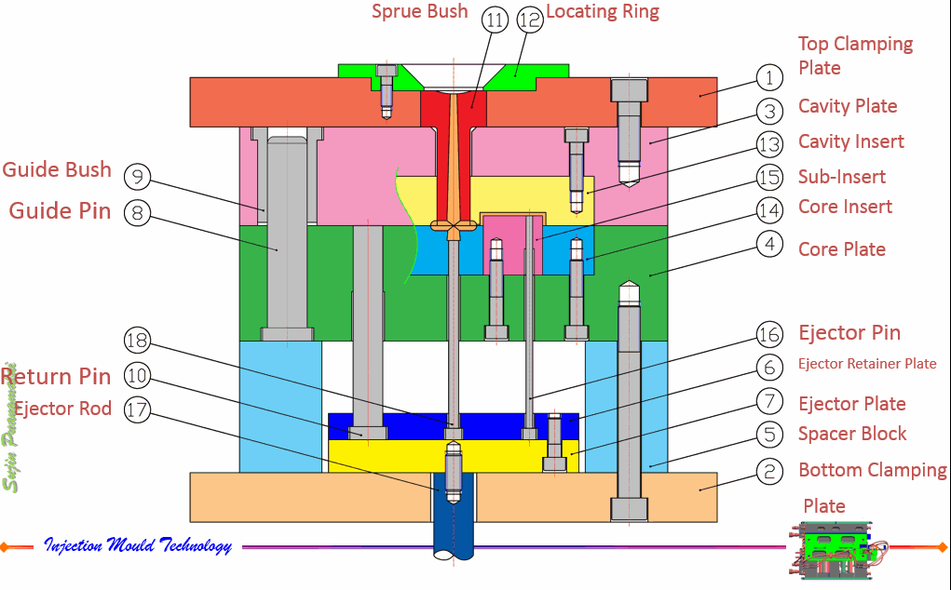
Mold Structure

Slide 18
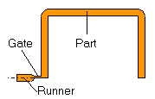
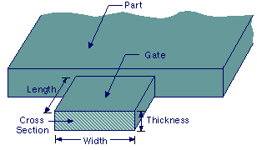
Gate
Delivers the flow of molten plastics.
Quickly cools and solidifies to avoid backflow after molten plastics has filled up in the cavity.
Easy cutting from a runner
Location is important to balance flow and orientation and to avoid defects.
L = 0.5-0.75 mm
h(thickness) = n.t
W= n A^{1/2}
³⁰

Slide 19
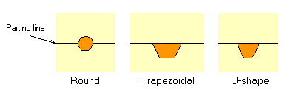
Runner cross section
Runner cross section that minimizes liquid resistance and temperature reduction when molten plastics flows into the cavity.
Too big
  Longer cooling time, more material, cost
Too small
  short shot, sink mark, bad quality
Too long
  pressure drop, waste, cooling
Hot runner, runnerless mold

Slide 20
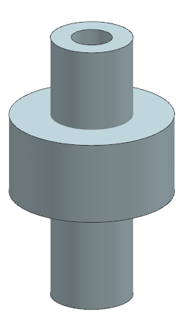
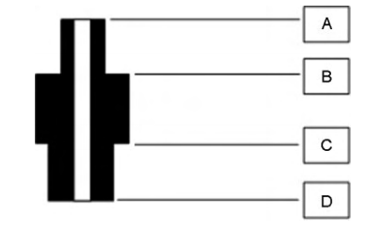
Parting Line

Slide 21
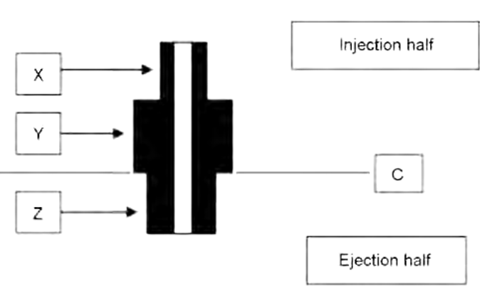
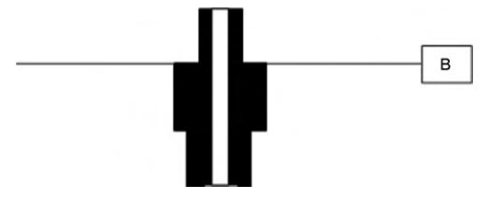
Split B or C

Slide 22
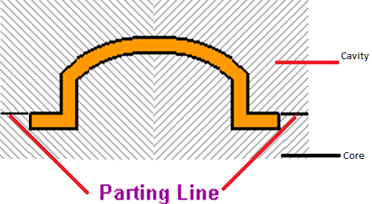

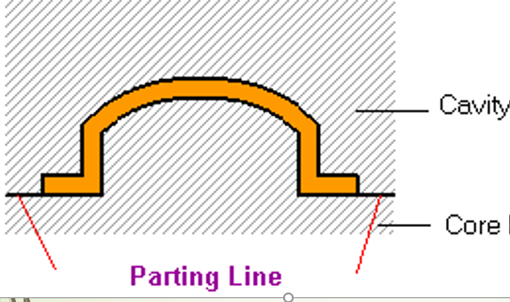
A
Which one better ?
B

Slide 23
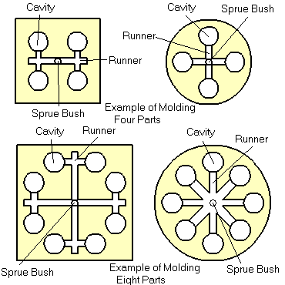
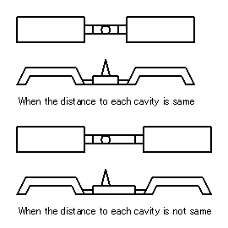
Runner balancing
Balanced
Not balanced

Slide 24
Defects
Molding defects are caused by related and complicated reasons as follows:
* Malfunctions of molding machine
* Inappropriate molding conditions
* Flaws in product and mold design
* Improper Selection of molding material

Slide 25
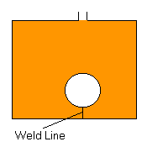
Weldline
This is a phenomenon where a thin line is created when different flows of molten plastics in a mold cavity meet and remain undissolved. It is a boundary between flows caused by incomplete dissolution of molten plastics. It often develops around the far edge of the gate.
Cause
Low temperature of the mold causes incomplete dissolution of the molten plastics.
Solution
Increase injection speed and raise the mold temperature. Lower the molten plastics temperature and increase the injection pressure. Change the gate position and the flow of molten plastics. Change the gate position to prevent development of weldline.

Slide 26
Flashes
Flashes develop at the mold parting line or ejector pin installation point. It is a phenomenon where molten polymer smears out and sticks to the gap.
Cause
Poor quality of the mold. The molten polymer has too low viscosity.
Injection pressure is too high, or clamping force is too weak.
Solution
Avoiding excessive difference in thickness is most effective.
Slow down the injection speed.
Apply well-balanced pressure to the mold to get consistent clamping force, or increase the clamping force.
Enhance the surface quality of the parting lines, ejector pins and holes.

Slide 27
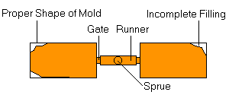
Short shot
This is the phenomenon where molten plastics does not fill the mold cavity completely. and the portion of parts becomes incomplete shape.
Cause
The shot volume or injection pressure is not sufficient.
Injection speed is so slow that the molten plastics becomes solid before it flows to the end of the mold.
Solution
Apply higher injection pressure. Install air vent or degassing device. Change the shape of the mold or gate position for better flow of the plastics.

Slide 28

Warpage
This deformation appears when the part is removed from the mold and pressure is released.
Cause
Uneven shrinkage due to the mold temperature difference (surface temperature difference at cavity and core), and the thickness difference in the part. Injection pressure was too low and insufficient packing.
Solution
Take a longer cooling time and lower the ejection speed. Adjust the ejector pin position or enlarge the draft angle. Examine the part thickness or dimension. Balance cooling lines. Increase packing pressure.

Slide 29
Sink marks
ts
ts < t
t
-Equal cooling from the surface
-Secondary flow
-Collapsed surface
→Sink Mark

Slide 30
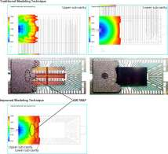
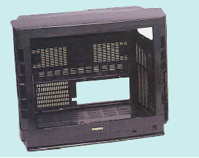
CAE (computer aided engineering)
Process simulation
Material data base
CAD
MOLDFLOW
C-Flow

Slide 31
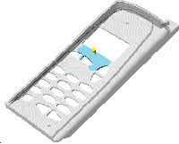
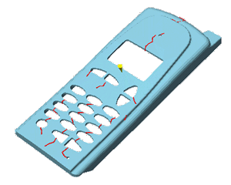
Considerations in design of injection molded parts
Guideline (3)
gate location determines weld lines
weld lines
* Source: http://www.idsa-mp.org/proc/plastic/injection/injection_design_7.htm

Slide 32
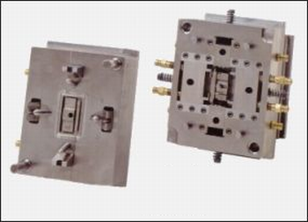
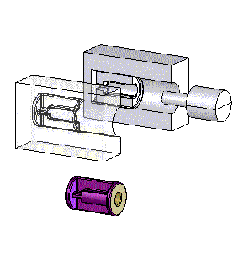
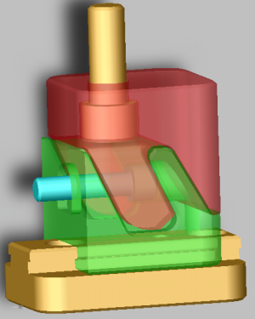
Injection Molding: molds with moving cores and side-action cams
- If the geometry of the part has undercuts [definition ?]

Slide 33
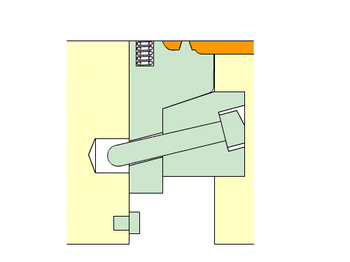

Undercut, Slide core

Slide 34
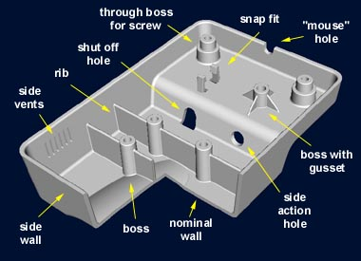
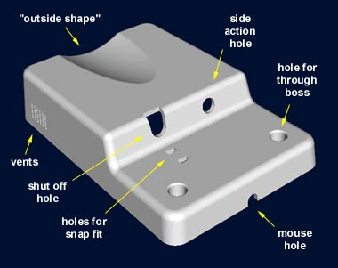
Designing injection molds: typical features
[source: www.idsa-mp.org]

Slide 35
Designing injection molds: typical features

Slide 36
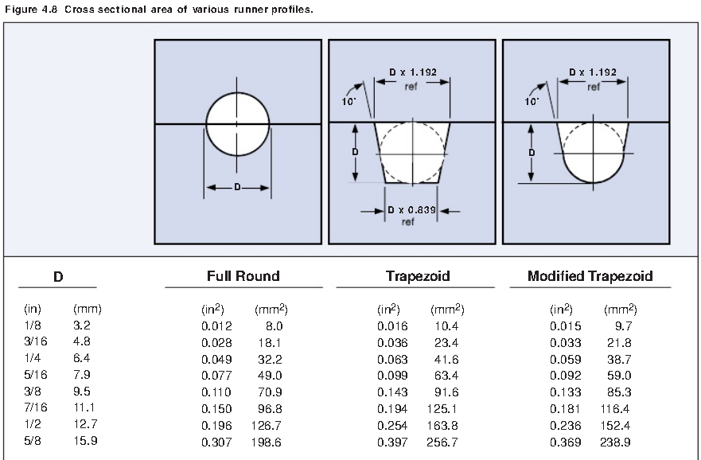

Slide 37
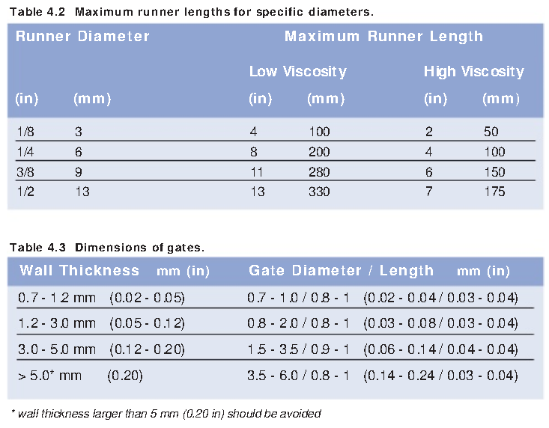

Slide 38
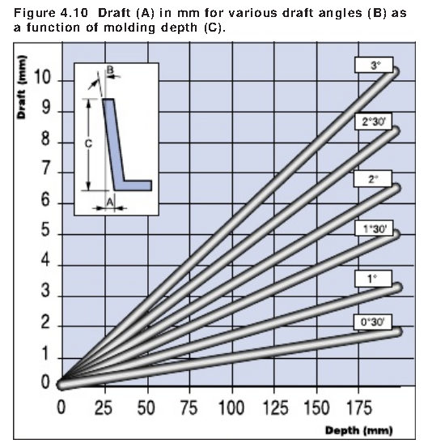

Slide 39
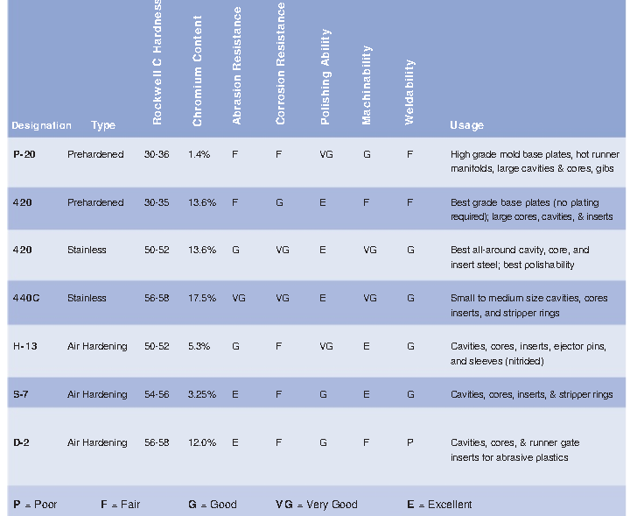

Slide 40
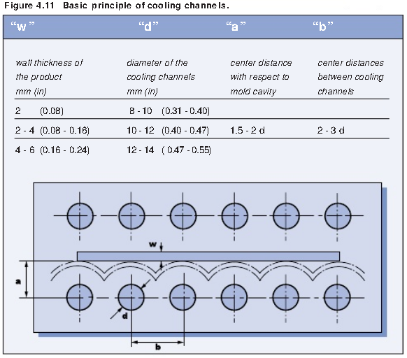

Slide 41
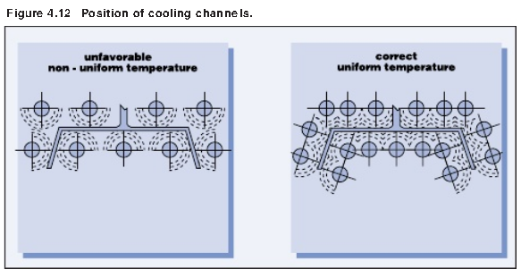

Slide 42
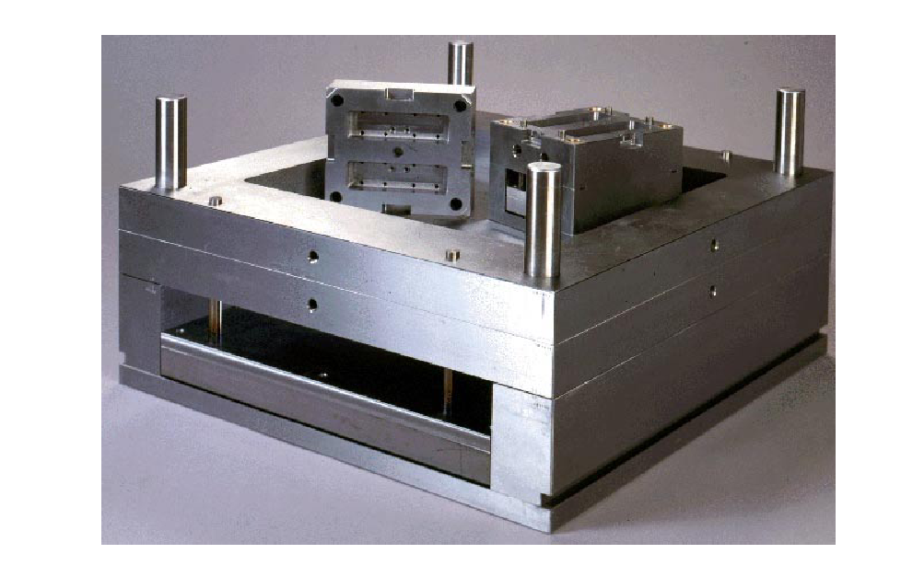

Slide 43
Q&A
mapiwat@engr.tu.ac.th
LINE ID: 1apiwat

Slide 44
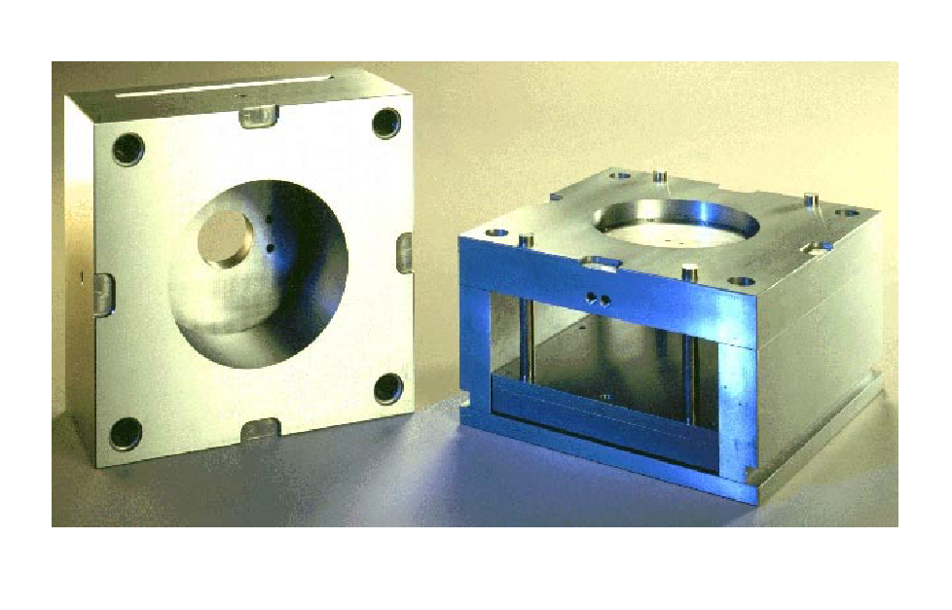
Excercises

Slide 45

Design Steps

Slide 46

1. Plastic’s Type- Shrinkage
    Ex. ABS=0.5%, PP=1-3%

Slide 47

2. Parting line

Slide 48

3.

Slide 49



Slide 50


Core
Cavity

Slide 51

3. Number of Cavity

Slide 52


Ejector system

Slide 53


Slide 54

Mold base

Slide 55

Slide

Slide 56


Insert

Slide 57


Cooling System

