Slide 1
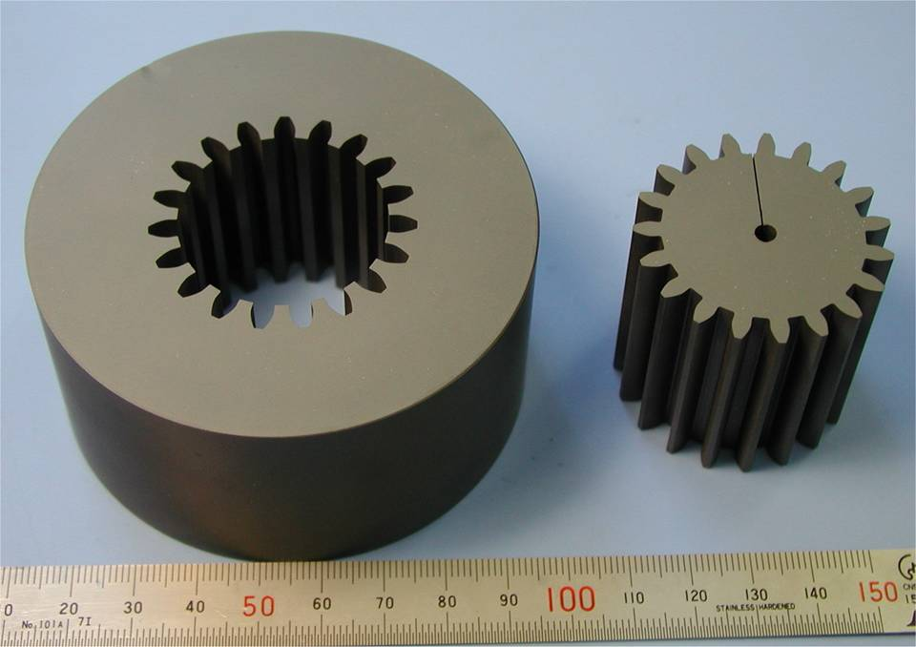
Nontraditional Machining
Dr.Apiwat Muttamara

Slide 2
Review of Machining
Machining is a generic term, applied to material removal processes.
Traditional machining: turning, milling, drilling, grinding, etc.
Metal cutting refers to processes in which excess metal is removed by a harder tool, through a process of extensive plastic deformation or controlled fracture.
Non-traditional machining: chemical machining, ECM, EDM, EBM, LBM, machining of non-metallic materials.

Slide 3
Nontraditional Machining
Chemical Machining (CM)
Electrochemical machining
Electrical discharge machining
High energy beam machining
Water jet/Abrasive water jet machining
Ultrasonic machining
Machining of non-metallic materials

Slide 4
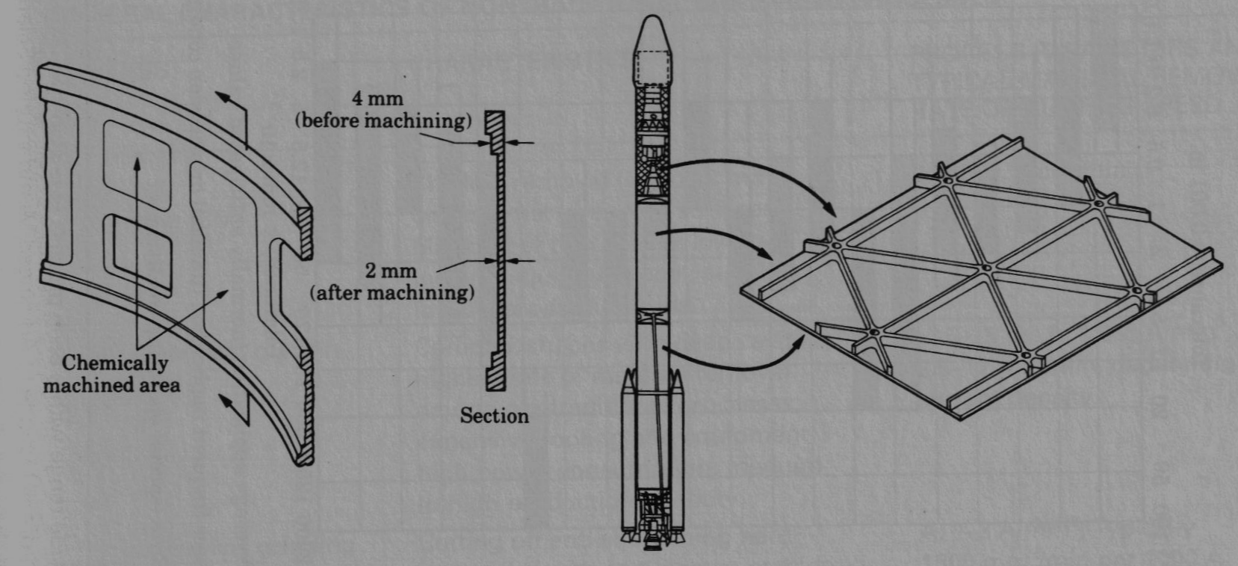
Chemical Machining (Chemilling)
Used to produce shallow cavities (<12mm) on large areas.
A maskant is applied over areas you don’t want to machine.
Place the part in a chemical bath (acid or alkali depending upon the metal)
Control temperature and time of exposure to control material removal
Material removal rate is slow, 0.025-0.1 mm/min

Slide 5
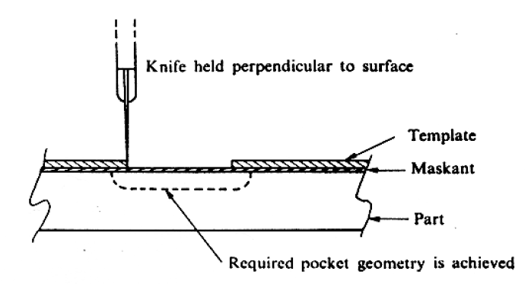
Innert Mat.Such as rubber or Plastic

Slide 6
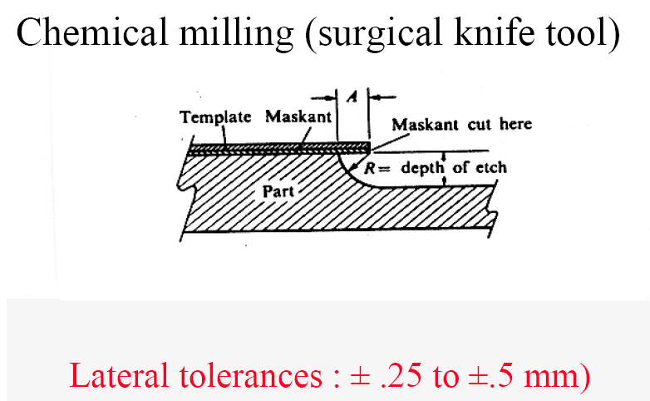

Slide 7
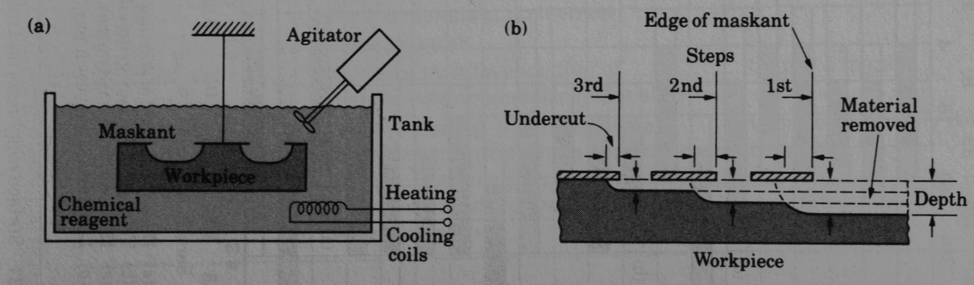

Slide 8
Chemical Machining
Etching:
Chemical reaction between reagent (in gas, solution, or paste form)
and workpiece.
Main uses:
- Shallow, wide cavities on plates, forgings, castings → reduce weight
Electronics manufacturing (Lead frames)
Hydrogen Fluoride

Slide 9
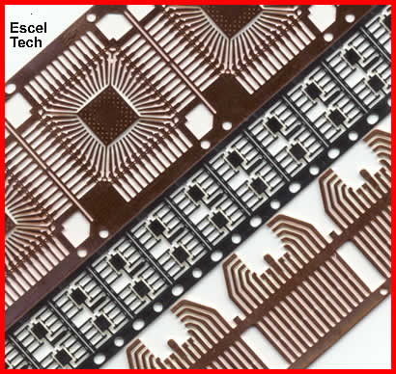
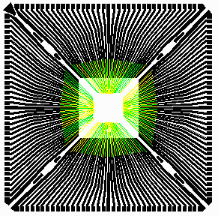
Lead frame For IC

Slide 10
UV Lithography
uses image transfer technology to create a precise, acid-resistant image of a part on a flat piece of metal.
Chemicals are applied that etch away the uncoated metal around the part image.
The result is a high precision part that has not been stressed or had its material properties altered.
Photo-chemical machining

Slide 11
Negative artwork object UV light
The UV light react with photographic developing technique
Photo-Chemical Machining
Innert Mat.Such as rubber or Plastic
Immerse to chemical bath that fixes the exposed layer
React with chemical

Slide 12
Electro-Chemical Machining (ECM)
Works on the principle of electrolysis
Die is progressively lowered into workpiece as workpiece is dissociated into ions by electrolysis
Electrolytic fluid flows around workpiece to remove ions and maintain electrical current path
anode (the workpiece) is dissolved into ions and the tool is slowly lowered, maintaining a constant distance between it and the workpiece.
Low DC voltage, very High current (700 amps).
Material removal rate is 2.5-12 mm/min depending on current density.

Slide 13
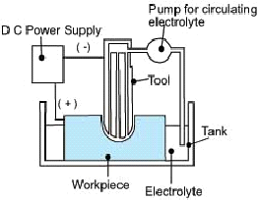
Electrochemical Machining (ECM)
Reverse of electro-plating (workpiece is anode)
Anode

Slide 14
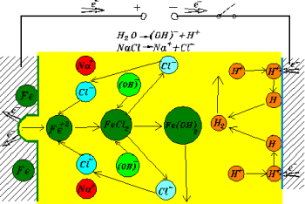
Electrochemical Machining (ECM)

Slide 15
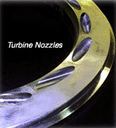
Main uses:
- Dies and glass-making molds, turbine and compressor blades, Holes, Deburring
Due to low forces on tool ECM can be used to make holes at very large angle toa surface an example is shown in the turbine nozzleholes in the figure here. source:

Slide 16
Electrical Discharge Machining EDM

Slide 17
The Principle
removing material from a workpiece, using electrical discharges
This technique is characterized by its aptitude for machining all materials that conduct electricity (metals, alloys, carbides, graphite, etc. whatever their hardness may be.

Slide 18

The tool acts as a cathode and is immersed in a dielectric fluid.
DC voltage (~300V) is applied in modulated pulses.
The sparks erodes the workpiece in the shape of the tool.
The tool is progressively lowered as the workpiece erodes.
Material removal rate is typically 300 mm³/min

Slide 19


To machine with this process, 4 items are required
The purpose of the dielectric (water or mineral oil) is to lower the temperature in the machining area, remove the residual metallic particles, and enable sparks to be created.

Slide 20
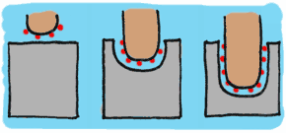
Produced by a spark generator, the sparks at regular intervals create a succession of craters in the workpiece. Each spark produces a temperature between 8,000 and 12,000° C. The size of the crater depends on the energy turned out by the spark generator. The range of the sparks varies from a few microns to 1 mm.

Slide 21


Physical process takes place in 6 stages.
1 The electrode approaches the workpiece.
The two units are energized
2 Concentration of the electrical field towards the point where the space between the electrode and workpiece is smallest.

Slide 22


3 Creation of an ionized channel between the electrode and workpiece
4 Breakdown of the spark. The workpiece material melts locally and disintegrates. The electrode only wears out slightly.

Slide 23


5 The current is cut off, causing implosion of the spark
6 Evacuation of the metallic particles by flushing with dielectric.

Slide 24


Surface finish and machining speed
The surface finish depends on the dimensions of the sparks. If they are energetic, the surface finish will be rough, but on the other hand the speed of machining will be high.
If the sparks are of low energy, the surface finish will be fine, but machining speed will be low.

Slide 25
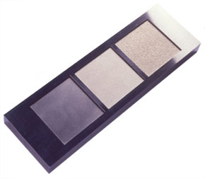
The finest surface finishes will be of the order of Ra 0.10, and the visual effect is almost like a mirror finish. Standard surface finishes, that are easy to obtain, are equivalent to Ra 0.8/1 (N5 - N6).
Machining speeds in EDM are moderate. Depending on the energy of the sparks, material removal rates range from 1 to several thousand cubic millimeters per minute.
Although it uses electrical sparks, the process entails no risk for users or the environment.

Slide 26
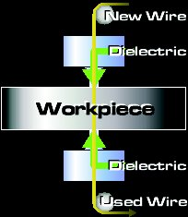
Wire EDM
Wire EDM
  The electrode is a wire that traverses through the part.
  Common for extrusion dies.

Slide 27
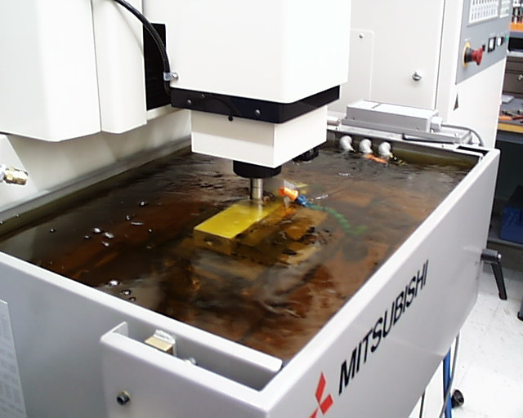
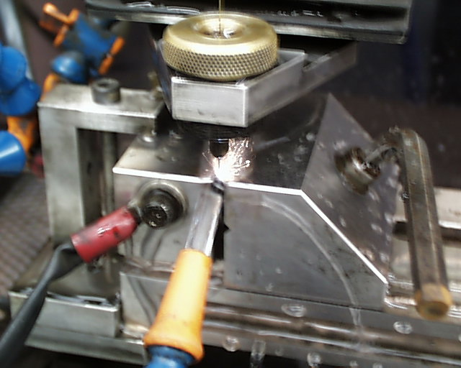
Examples of Die Sinker and Wire EDM

Slide 28
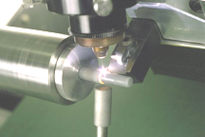
Machining of Nonmetallic Materials
Machining of ceramics:
  Abrasive machining, including abrasive water jet machining
  Laser beam machining
  Laser assisted machining
Laser assisted machining

Slide 29
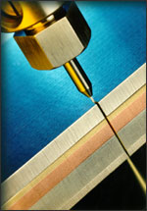
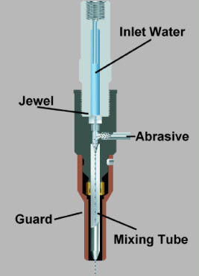
Water Jet and Abrasive Water Jet Cutting
High pressure water (20,000-60,000 psi).
Can cut extremely thick parts (5-10 inches possible).
Thickness achievable is a function of speed.

Slide 30
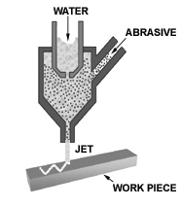
Water-Jet, Abrasive Water-Jet Machining
- Workpiece is fractured by impact from
high pressure (~400 MPa) water-jet
- No heat ➔ no thermal stress, damage
Common applications:
- Fast and precise cutting of fabrics
- Vinyl, foam coverings of car dashboard panels
- Plastic and composite body panels used in the interior of cars
- Cutting glass and ceramic tiles

Slide 31
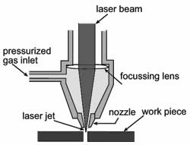
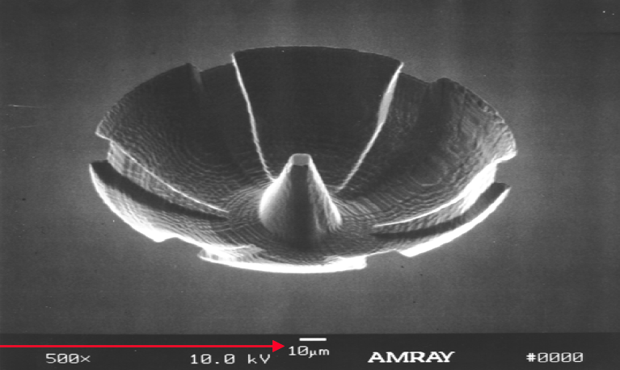
Laser cutting
Light Amplification by Stimulated Emission of Radiation
- High energy density (small focus area)
- Uses: Cutting, welding, precision holes
Common lasers: CO₂, Nd:YAG
(Niobium-Yttrium-aluminium Garnet)
Continuous power or Pulsed (more precise)

Slide 32
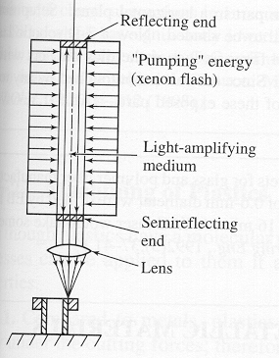
Laser
Laser is an optical transducer that converts electrical energy into a highly coherent light beam.
Cutting and hole making on thin materials; heat-affected zone; does not require a vacuum; but expensive equipment; consume much energy; 0.5-7.5 mm/min depending on thickness.

Slide 33

Ultrasonic Machining
Main uses of USM:
- Welding plastics (package sealing)
- Wire-bonding (IC chips)
- Machining brittle materials

Slide 34
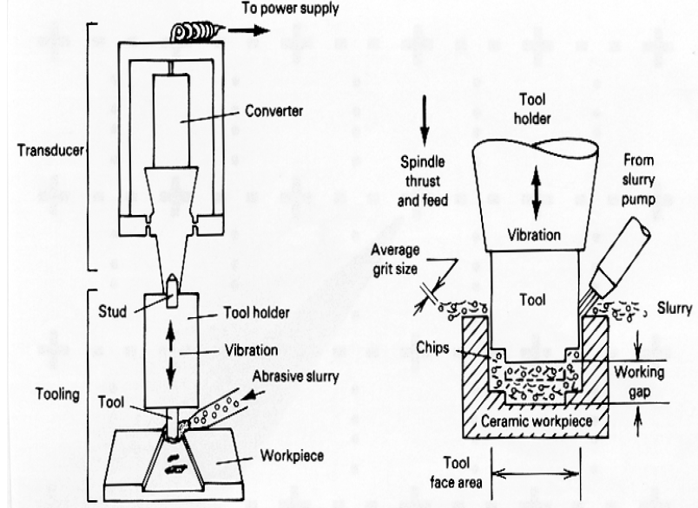

Slide 35
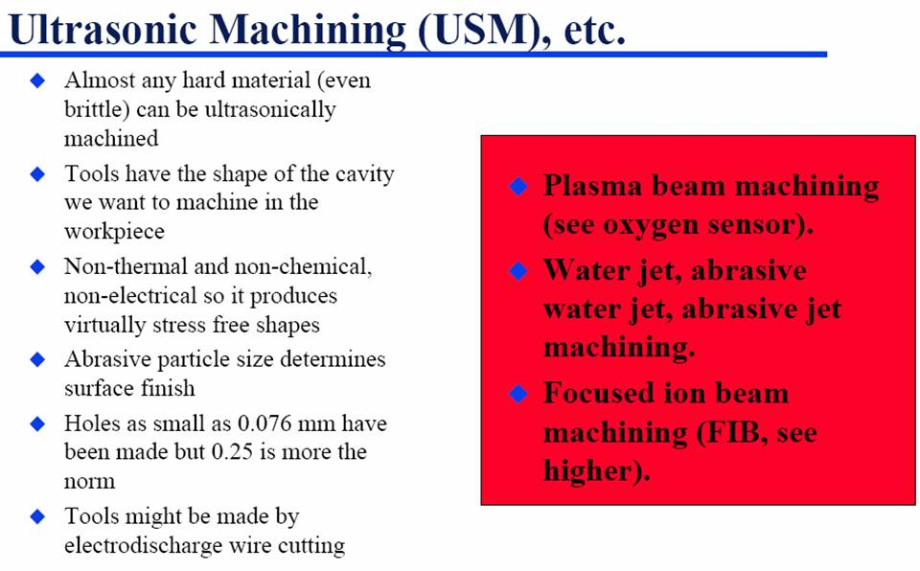
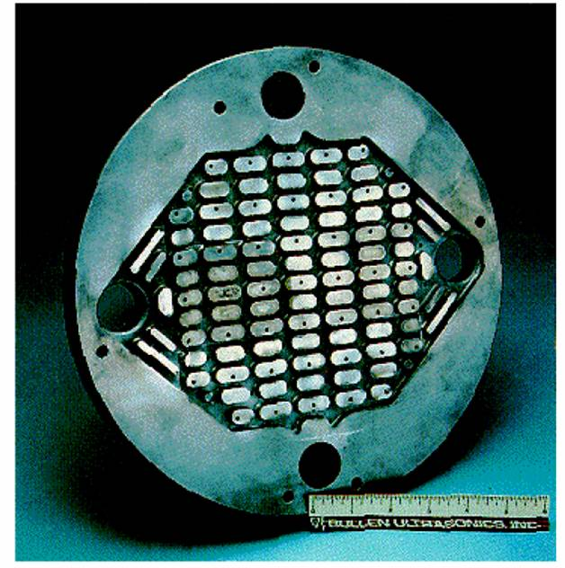

Slide 36
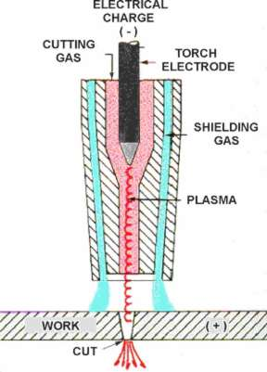
Plasma arc cutting
Cathode
Plasma cutters work by sending an electric arc through a gas that is passing through a constricted opening.
Cutting Temp= 10,000 C
o
Anode

Slide 37
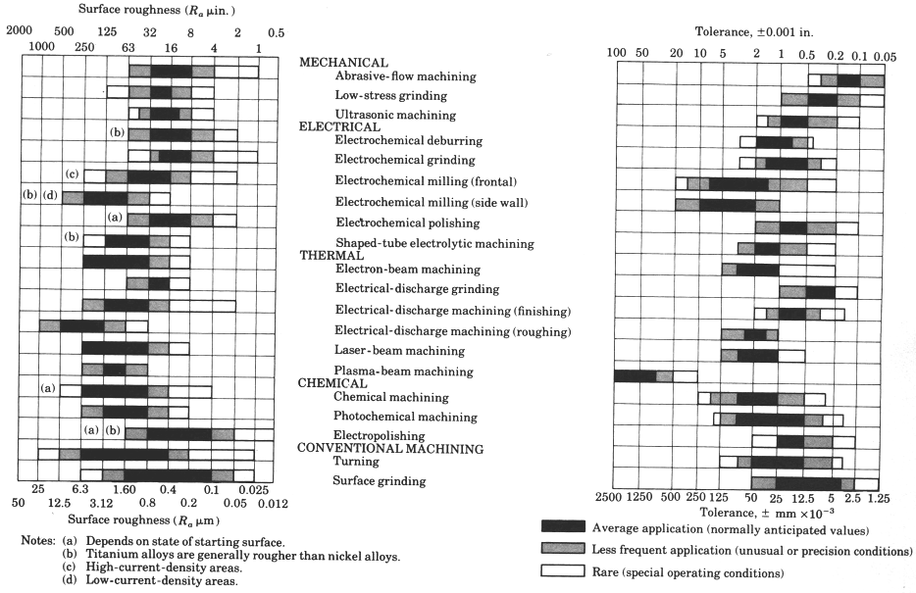
Characteristics of Machining

Slide 38
 |  |  |  |  |  |  |  | Traditional
Mat. | Mech |  | Elec | Thermal |  |  | CHM | Milling
 | USM | WJ | ECM | EDM |  | LBM | CHM | Milling
Al | C | C | B | B |  | B | A | A
Steel | B | D | A | A |  | B | A | A
Ceramic | A | D | D | D |  | A | C | D
Glass | A | D | D | D |  | B | B | D
Plastic | D | B | D | D |  | B | C | B
Card board | D | A | D | D |  | D | D | D
Nontraditional Process

Slide 39
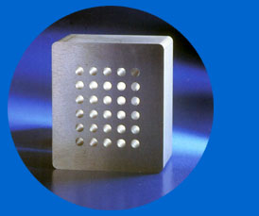
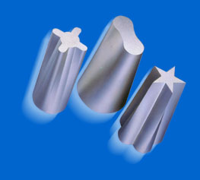
Wire cut 4 axis

Slide 40
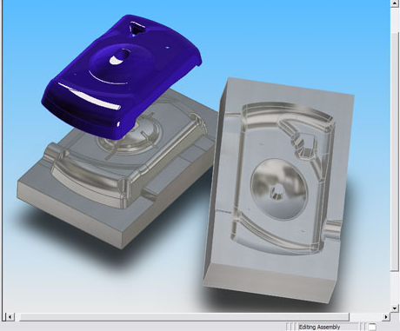

Slide 41

Question

