Slide 1
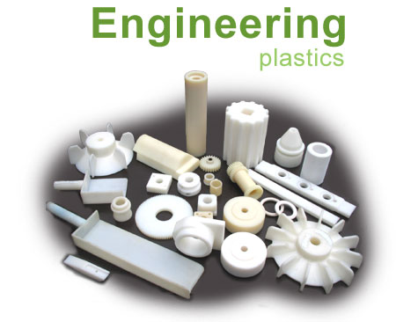
Polymer and
Plastics Manufacturing
Apiwat Muttamara

Slide 2
Outline
Polymer
Equipment and process steps
Design for manufacturing, tooling and defects

Slide 3
Materials
Solid materials
metals
ceramics
Plastics
thermoplastics
thermosetts
elastomers
Plastic: Greek, plastikos, means to form or mold

Slide 4
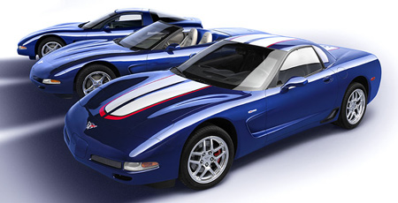
Automotive Plastics and Composites Use
Exterior
  doors
  hoods
  fenders
  bumper covers (most cars have soft fascia)
Interior
  instrument panels, door trim, seats, consoles
Engine
  valve covers, intake manifolds, fluid containers, etc.

Slide 5
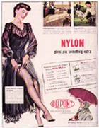
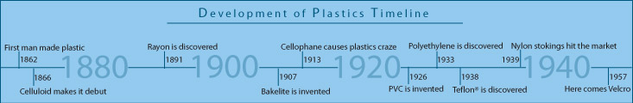
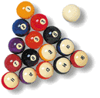
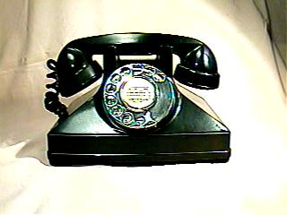
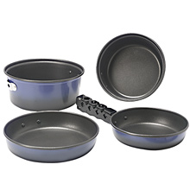
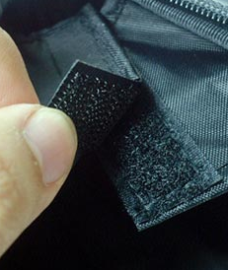

Plastics History

Slide 6
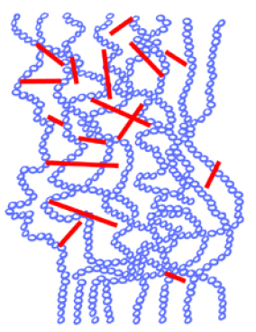
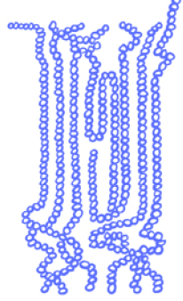
Thermoplastics & Thermosets
amorphous
or
semicrystalline
cross-linked
(3D network)

Slide 7
THERMOPLASTIC, THERMOSET:
Thermoplastics are resins that can be reground after molding, and molded again.
Thermoplastic are often compared to Wax.
Thermosets can be molded once only; they tend to be denser materials for special purposes , thermosets are often compared to an egg; once the egg is hard boiled it can't be returned to a liquid and recooked as sunny side up.

Slide 8
While the term polymer in popular usage suggests "plastic",
poly = many
Polymer
mer = part
A polymer is a long chain molecule
that is composed of a large number
of repeating units of identical structure.

Slide 9
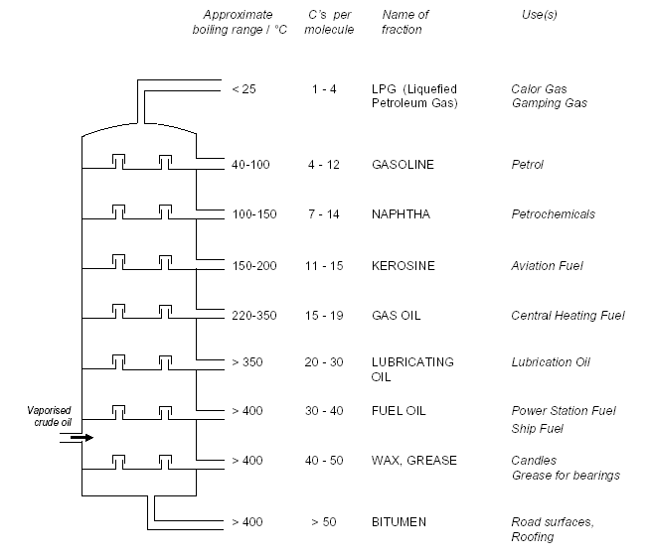
Petroleum
These different hydrocarbons have different boiling points, which means they can be separated by distillation

Slide 10
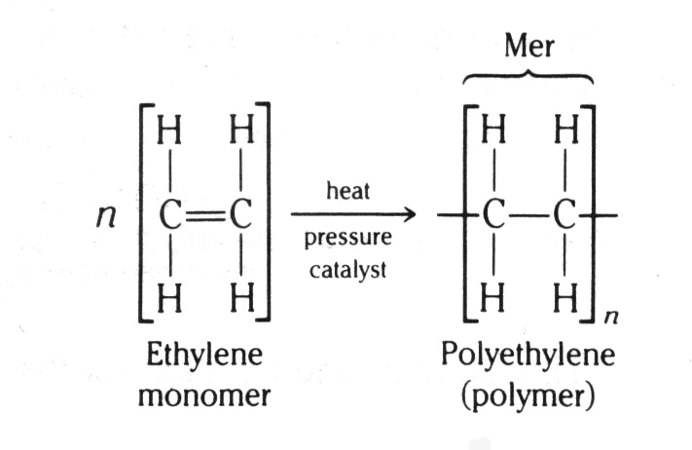
Polymerization of Polyethylene
n = degree of polymerization

Slide 11
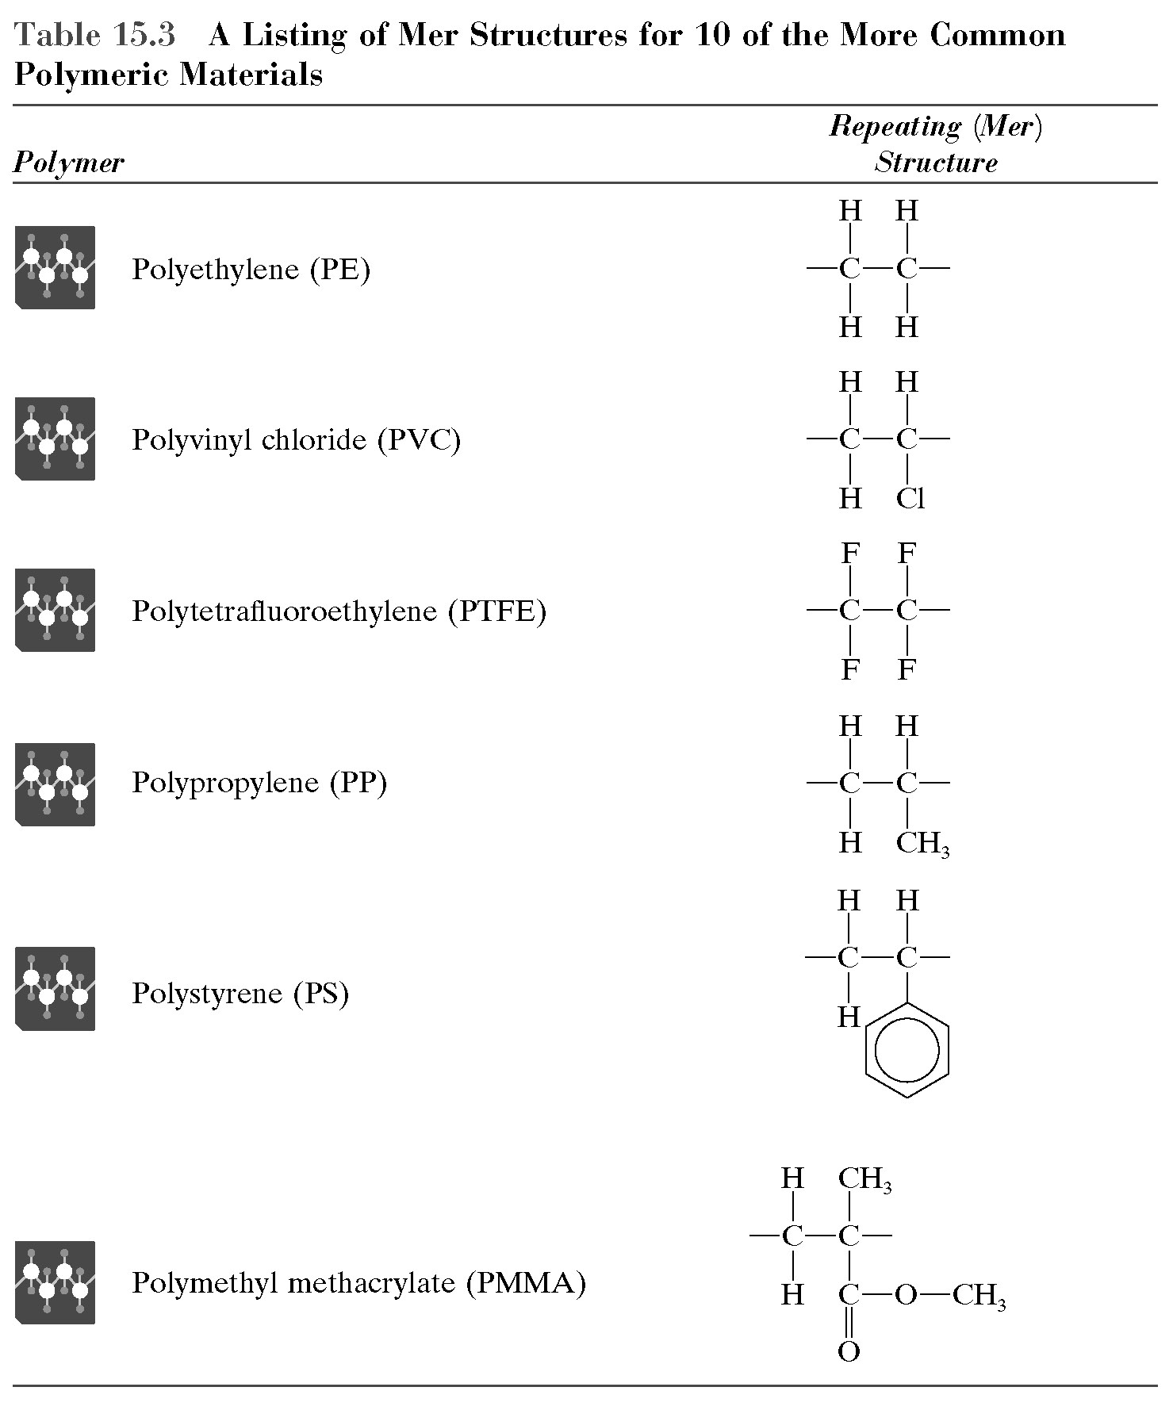

Slide 12
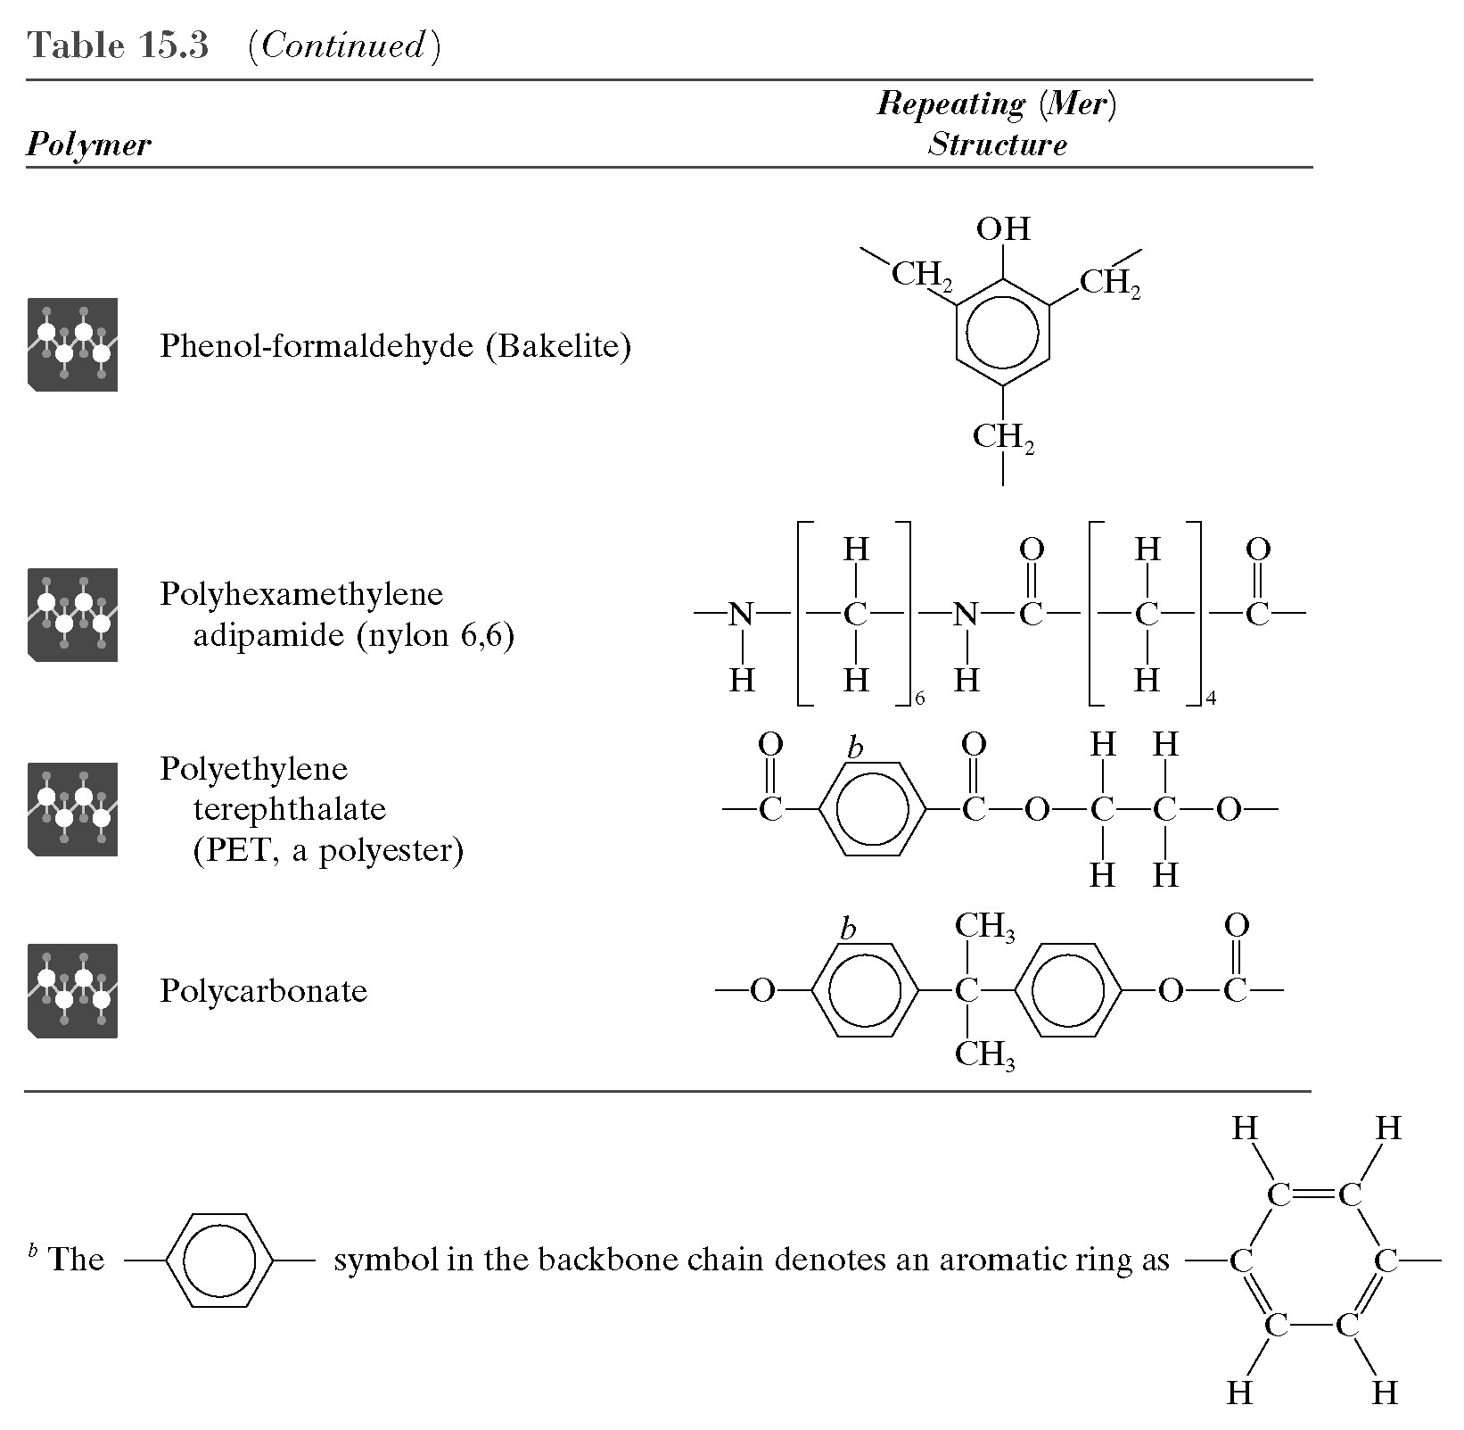

Slide 13
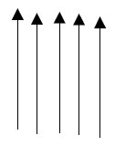
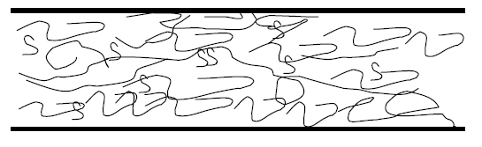
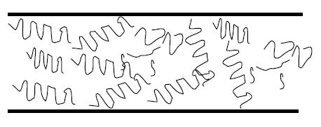
Thermoplastics
Amorphous
Semicrystalline
Transparent
Translucent
Opaque

Slide 14
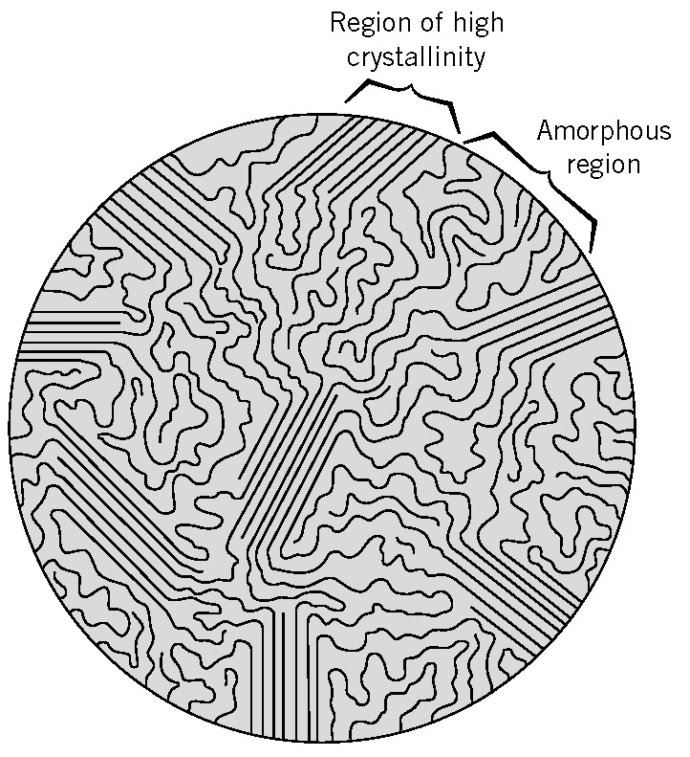
SEMI-CRYSTALLINE POLYMERS
(พอลิเมอร์กึ่งผลึก)
โมเลกุลมีการจัดเรียงโดย
ส่วนหนึ่งเรียงตัวอย่างไม่เป็นระเบียบ
(amorphous region)
และบางส่วนจัดเรียงอย่างเป็นระเบียบ
(crystalline region)
Fringed-micelle model of semicrystalline polymers

Slide 15
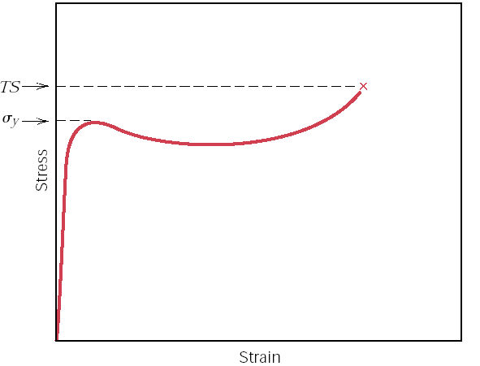
YIELD AND TENSILE STRENGTHS
OF PLASTIC POLYMER
Specimen breaks
YIELD
Yield stress (σ_{y}) ความเค้นที่พบการเสียรูปพลาสติก(plastic deformation)
Tensile strength (TS) (สำหรับพอลิเมอร์) ความเค้นที่ชิ้นงานแตกหัก **
(ทั่วไป) ความเค้นสูงสุดบนกราฟ engineering
stress-strain

Slide 16
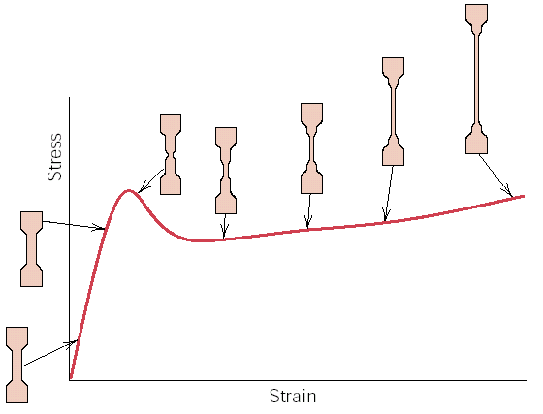
MACROSCOPIC DEFORMATION
necking
STAGES OF DEFORMATION
OF A SEMI-CRYSTALLINE POLYMER
Note: พบลักษณะคอดกิ่วภายใต้การดึง เรียกว่า Necking

Slide 17
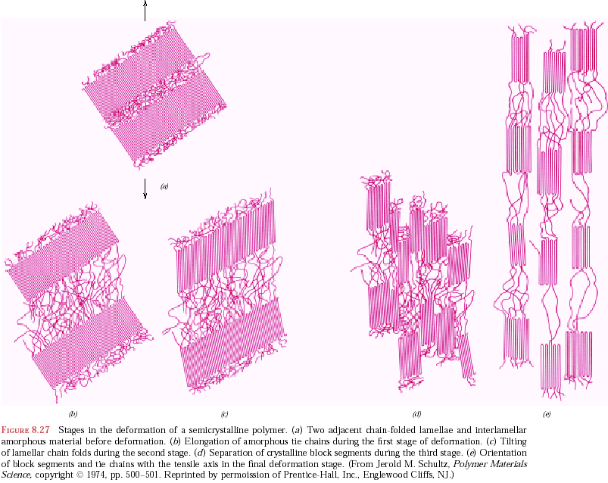
STAGES IN DEFORMATION OF A SEMICRYSTALLINE POLYMER
Before deformation
Elongation of
amorphous tie chains
Tilting of lamellar
chain folds
Separation of
crystalline block
segment
Orientation of
block segments

Slide 18
  Thermoplastic and Thermosetting Polymers
(crosslinked and network polymers)
vulcanized rubbers, Polyurethane Epoxy, Polyester
Polyetherimide
Polysulfone
Polyphenylene
Sulfide (PPS)
PVC, PS
PE, PP
ABS, PC
PPE, Acrylic
PPE/Nylon
PC/PBT
ABS/PC
Acetal
PBT, PET
Polyamide (Nylon)

Slide 19
Early Plastics
Phenolics (named Bakelite by Leo Bakeland)
- Resin could be shaped and hardened with heat
- Phenol and formaldehyde reaction after heat
- Replacement for shellac, natural plastic (1907)
Nylon66
- W. H. Carothers of DuPont (1920’s)
PVC
- W. Semon of B.F. Goodrich (1929)
Notes:
Shellac (ครั่ง) is a natural polymer, thus it is considered a natural plastic.
It can be molded by heat and pressure methods, so it is classified as thermoplastic
shellac was obtained from the secretion of the female bug,
harvested from the bark of the trees where she deposits it to provide a sticky hold on the trunk.

Slide 20
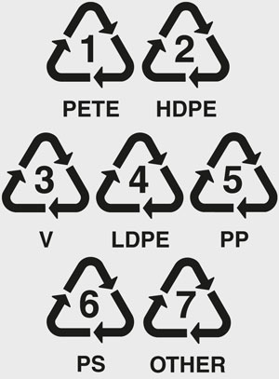
Recycling of Plastics
Codes for plastics

Slide 21
Polymer Additives
A polymer contains several additives to aid during processing, add color, or enhance the mechanical properties.
Fillers
reinforcing fillers → improve mechanical properties
non-reinforcing fillers (or extenders) → reduce cost
Plasticizers
reduce Tg therefore the flexibility is improved
Stabilizers
prevent degradation of polymer from heat or UV
Colorants add color to polymers
Flame Retardants enhance the flammability resistance

Slide 22
Amorphous Commodity Thermoplastics
Key Characteristics
Low cost
Low temperature resistance
Low strength
Good dimensional stability
Bonds well
Typically transparent
Notes:
Remember, an amorphous polymer is a polymer that exists in a random, unordered
structure.

Slide 23
Amorphous Commodity Thermoplastics
Materials
Polymethyl methacrylate (PMMA)
Polystyrene (PS)
Acrylonitrile butadiene styrene (ABS)
Polyvinyl chloride (PVC)
Polycarbonate (PC)
Notes:
These are the materials that fall under the amorphous engineering thermoplastic category.
We will now go through each of them in more detail.
PMMA is also known as acrylic.

Slide 24
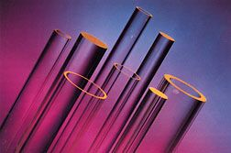
Acrylic (PMMA)
Strengths
Availability of all ranges of optical transparency, including opacity
Rigidity
Surface hardness
Half the weight of glass
Heat resistance
Low impact strength
Notes:
Acrylic acid, methacrylic acid and their esters have been studied for 140 years.
In terms of thermoplastic products the predominant acrylic ester is methyl
methacrylate (MMA).
The proper name for acrylic is polymethyl methacrylate (PMMA).
Acrylic plastics comprise a broad array of polymers and copolymers in which the
major monomeric constituents belong to two families of esters: acrylates and
methacrylates. These materials are used singly or in combination, sometimes with
other monomers, to formulate products ranging from soft, flexible elastomers to hard,
stiff thermoplastics and thermosets.
Other strengths include excellent weather resistance, good dielectrical properties, high
mechanical strength and PMMA has the best optical properties.
Acrylic is produced in many forms including sheet, rod, tube, film, pellets,
beads, solutions, lattices and reactive syrups.

Slide 25
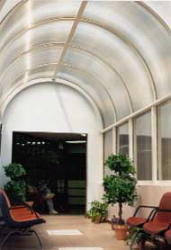
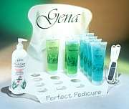
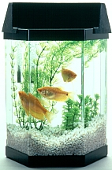
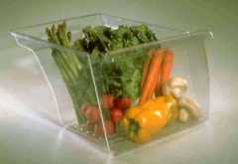
Acrylic (PMMA)
Protective glazing
Windows
Toys
Point of purchase (POP) displays
Notes:
Acrylic’s uses are broad, from signs to the medical industry. Common applications include
awards, signs, point of purchase displays, fish tanks, etc. This versatile material is gaining
more and more popularity.
In the future, the primary aim is to broaden the potential end uses for acrylic polymers.
Therefore, the following properties are the subject of current developments:
Higher impact strength and heat deflection temperature
Improved flame retardancy
Greater clarity
Improved melt flow
PMMA is supplied in general purpose and specialty grades, and can be formed or molded into
a variety of shapes. Grades that are currently in development will give access to new markets,
including barrier packaging applications and high-strength vacuum formable resins.
Next, we will look at polystyrene.

Slide 26
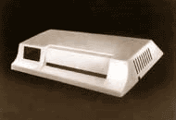
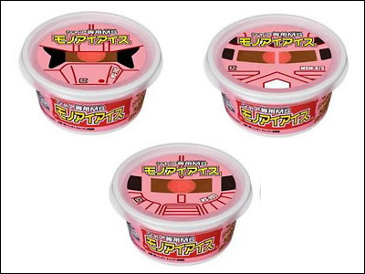
Polystyrene (PS)
Low impact resistance
Brittle after UV exposure
Cannot be used at elevated temperatures
Mechanical stress
Notes:
The styrenics family is one of the largest and most popular families of
thermoplastics containing a broad range of diverse polymers with properties
suitable for applications from insulation board and audiocassette cases to
appliance housings and toys.
Their ease of processing by injection molding and extrusion thermoforming
combined with their balanced range of properties make styrenics a popular
choice with engineers and product designers.
Polystyrene (PS) exhibits high stiffness, good dimensional stability, low specific gravity and
excellent electrical properties. It offers several advantages over other polymers
because of its clarity and ease of processing, both of which are due to its
amorphous nature.
By volume, the largest polymer in the styrenics family is polystyrene. Some
specific strengths of PS are price, it’s easy and quick to bond, and it’s easy to
decorate.

Slide 27
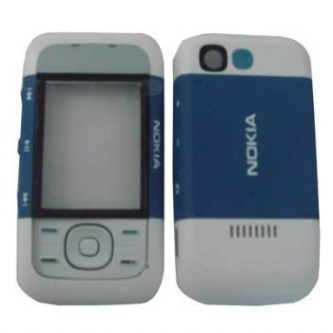
Acrylonitrile Butadiene Styrene (ABS)
Good impact resistance
Easily formable
Many different formulations
EX. Computer housings
Consumer electronics
Automotive
Notes:
ABS resin was commercially introduced in the late 1940s and is the most widely
used engineering thermoplastic in the world. This is due to the resin’s balance
of end use properties: excellent surface appearance, strength and stiffness,
toughness and chemical resistance as well as its processing ease and versatility.
ABS is an engineering resin member of the styrenics family. It is a popular
resin due to its attractive balance of properties. The polymerization of ABS
begins with acrylonitrile, butadiene, and styrene monomer building blocks.
Each of the building blocks contributes its own properties to the material.
Acrylonitrile brings heat stability, chemical resistance and surface hardness,
butadiene adds toughness and impact resistance, and styrene provides rigidity
and processability.

Slide 28
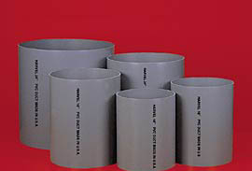
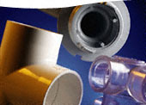
Polyvinyl Chloride (PVC)
Strengths
Low cost
Good chemical resistance
Versatile
Naturally UV resistant
Good strength
Packaging
Notes:
Polyvinyl chloride, or PVC, is commonly referred to as vinyl. PVC is a cost-
effective substitute for many scarce natural resources and is the world’s most
widely used plastic raw material after polyethylene. There are two reasons for
this: vinyl is exceedingly versatile, with end products ranging from thin films to
complex molded parts to rigid pipe for pressurized applications; and it provides
valuable properties like strength and transparency at a relatively low cost. One
source of this economic advantage is the fact that half of the PVC polymer is not
petrochemical-based.
First produced commercially in the 1930s in Western Europe and the U.S., PVC
achieved its first major success in the early 1940s, during WWII, when shortages
of natural raw materials like natural rubber created demand for synthetic polymers.
What made commercialization possible was the discovery of techniques for
stabilizing PVC to enable it to withstand the heat of processing, and for softening
it through plasticization. Thus, the initial uses of PVC were in its flexible form.
The stabilization and processing methodology required for commercializing rigid,
or unplasticized PVC, was not developed until 1950.
Some additional strengths include high rigidity and low flammability (self extinguishing).

Slide 29
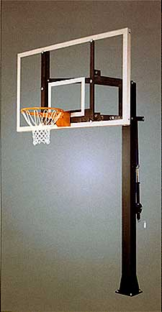
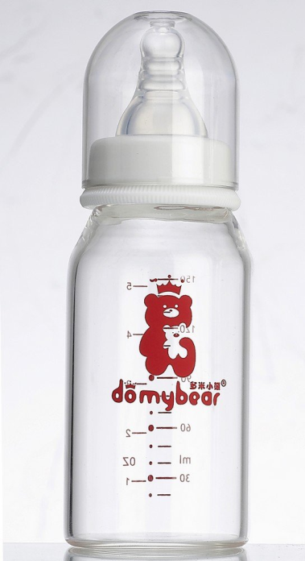
Polycarbonate (PC)
Vandal resistant windows
Machine guards
Outdoor signs
Sky lights
Backboards
Bike, roller blading protective wear
Excellent toughness
Excellent strength
Notes:
Most PC grades are for injection molding. Specialized PC ranges from very-high-flow
resins for optical data storage to extrusion grades for sheet, film and profiles.
Incorporating glass fibers improves the modulus and dimensional stability of PC and
reduces creep, shrinkage, and the coefficient of thermal expansion. Impact modified PC
offers low-temperature ductility and reduced notch-sensitivity. Recently, high-flow
impact-modified grades have been thin-wall molded into miniature cell phone and
battery housings.
PC has an outstanding combination of engineering properties and processing versatility
that make it ideal for many applications, including safety glazing, light covers,
automotive headlamp lenses, water bottles, compact discs, and housings for electrical
applications.

Slide 30
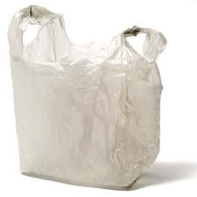
Semi-Crystalline Commodity Plastics
Polyethylene (PE)
  High density polyethylene (HDPE)
  Low density polyethylene (LDPE), (LLDPE)
Polypropylene (PP)
Polyethylene Terephthalate (PET)
Notes:
Next, we’ll look at each of these materials in more detail, including strengths,
limitations and applications.

Slide 31
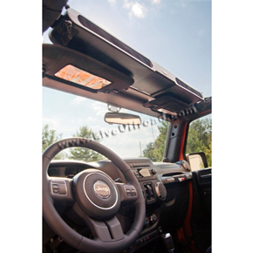
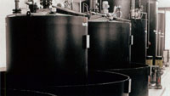
Low Density Polyethylene (LDPE)
High Density Polyethylene (HDPE)
Films
Industrial trash bags
Liners
Shipping bags
Marine industry
Playgrounds
Bathrooms
Pipe
Automotive
Notes:
Traditional markets for LDPE are in packaging films, extrusion coating of
paper, wire and cable coating, injection molding and pipe and tubing. About half of
LDPE production goes into packaging applications such as industrial bags, shrink
bundling, soft goods, product and garment bags. Other applications include blow
molded bottles, industrial containers/tanks, toys, housewares, battery jars and
prosthetic appliances.
Markets for HDPE include:
Pipe products — corrugated, irrigation, sewer/industrial, and gas distribution —
are made mainly of high density PE (HDPE). There is wide usage of HDPE as cutting
boards (pebble finish), bathroom partitions, playground equipment.
Automotive components are made of injection molded HDPE and gasoline tanks
are blow molded HDPE.
Industrial applications include shipping drums, crates and totes, and equipment
housings and covers.

Slide 32
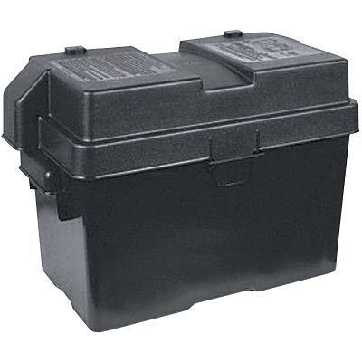
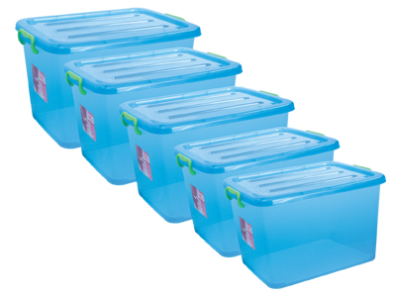
Polypropylenes (PP)
Applications
Packaging
Automotive
Consumer/durable goods
Vacuum formed parts
Fiber/carpet
Notes:
The versatility of PP as a material and its production methods has enabled expansion into several markets,
including those typically dominated by plastics like polyethylene, acrylonitrile butadiene styrene, polystyrene, and
polyvinyl chloride. PP has also begun to replace natural fibers like jute, cellulose, wood, metal, and glass. The
largest markets for commercial PP use are packaging, automotive, durable/consumer goods and fibers.
The impact-resistant and cushioning properties of PP and its manufacturing versatility make it an ideal
packaging material. Present uses of PP in that area include bags, packaging trays, bottle tops and closures.
The low specific gravity of PP is important to the auto industry because car parts that are light weight, but
maintain relatively high impact resistance and good cushioning, can be constructed. With the increasing push
toward more fuel-efficient cars, these properties are in great demand.
For consumer/durable goods, like those in the appliance industry, the good fatigue resistance properties and
chemical resistance to hydrocarbons, alcohols, and nonoxidizing reagents make PP ideal for the use in the housings of
tubs for laundry machines and dishwashers. The greater strength and stiffness, coupled with reduced impact resistance,
also withstand the rigorous performance requirements of these and other appliance applications.
Composing one-third of the total U.S. consumption of PP is fiber and fiber-related applications. Easy to
extrude and very durable, PP has proven to be appropriate for use in carpeting as both primary and secondary
carpet backing, as well as carpet face yarns, upholstery fabrics, automotive fabrics and geotextiles. Additional fiber-related
applications include ropes and cordage, filtration materials, spill-cleanup materials, and flexible packaging and
consumer goods like diapers, medical/surgical clothing and feminine hygiene products.
Other industrial applications include ducting and fume hoods, structural tanks and covers, plating barrels and tanks,
prosthetic and orthotic devices, valve and pump components, rinse and etch tanks and housings, vacuum formed
parts, clean room equipment, spray booths, and photographic processing equipment
Polypropylene is commonly available in various forms such as film, sheet, blocks, pipes, tubing, rod, profiles, valves
and fittings. Virgin grades are generally in compliance with U.S. Department of Agriculture and U.S. Food and
Drug Administration regulations. Flame retardant formulations in accordance with Underwriters Lab and Factory Mutual
standards are also available.

Slide 33
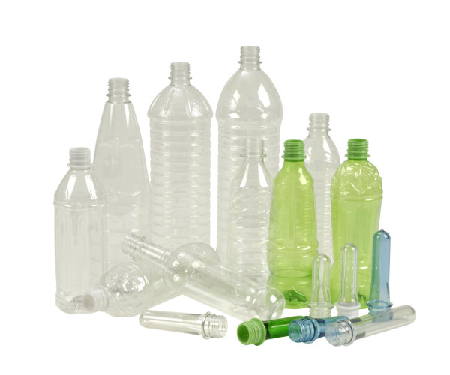
Polyethylene Terephthalate (PET)
High dimensional stability under heat
High stiffness and hardness
Good bearing strength
Good electrical properties
Good resistance to chemicals
Good stress-cracking resistance
Excellent flow characteristics
Notes:
Commercial production of polyester bottle polymer began in 1976. There are tremendous commercial
applications for PET — as an injection-molding grade material, for blow-molded bottles and for oriented films.
PET does not require the use of plasticizers or other processing additives and is shatter resistant and has excellent
clarity and gloss. PET is lightweight and resistant to abrasion and stress cracking and has excellent stability and
provides a very good barrier for water vapor, oxygen and carbon dioxide.
Semi-crystalline PET has a sharp melting point, which varies depending on its composition and the conditions of
crystallization. Depending on the end use, PET can be processed using a variety of processes, such as stretch blow
molding and extruding.
Polybutylene terephthalate (PBT) is another member of the thermoplastic polyester family. Blending polycarbonate
(PC) with a thermoplastic polyester like PBT improves flowability, low temperature ductility, notch sensitivity,
weatherability and chemical resistance.
The only structural difference between PBT and PET is the substitution in PBT of four methylene repeat units rather
than the two present in PET. This feature imparts additional flexibility to the backbone and reduces the polarity of
the molecule, resulting in similar mechanical properties to PET — high strength, stiffness and hardness.

Slide 34
Plastic Processes
Thermoplastic
  Extrusion
  Blow mold
  Rotational Molding
  Injection
  Thermo forming
  Injection molding
Thermosetting
  Compression
  Transfer

Slide 35
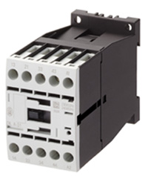
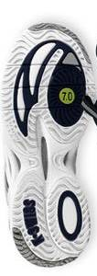
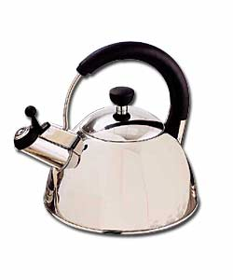

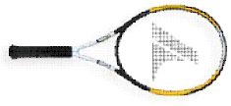
Plastics Processing: Compression and Transfer Molding
used mostly for thermosetting polymers
mold is heated and closed using pressure
plastic flows to fills the cavity
flash must be trimmed by finishing
dishes, handles for cooking pots
skis, housing for high-voltage switches
some rubber parts like shoe soles
and even composites such as fiber-reinforced parts

Slide 36
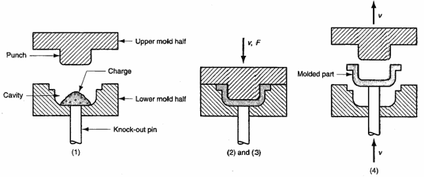
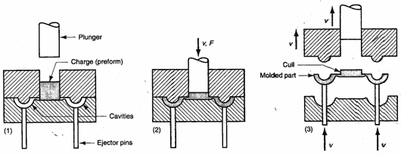
Plastics Processing: Compression and Transfer Molding
compression molding
transfer molding
(more complex shapes)

Slide 37
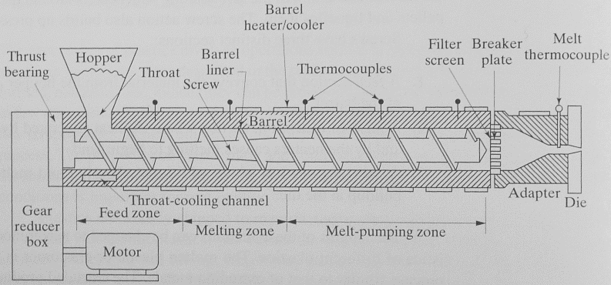
Plastics Processing: Extrusion

Slide 38
Plastics Processing:
Blow molding

Slide 39
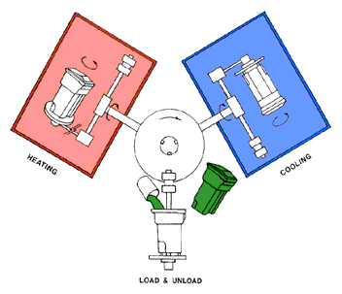
Rotational Molding
The process generally makes use of polyethylene powders, other powders, and liquids. However, nylon, elastomers, fluoropolymers, and polypropylene can also be used

Slide 40
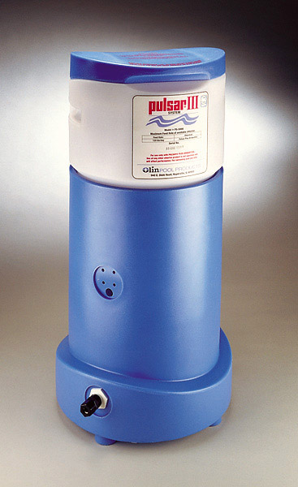
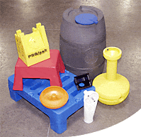
Sample
Rotational molding, otherwise known as rotomolding or rotational casting, is a thermoplastic processing method for producing simple to complex, leak-proof hollow parts that can be filled with foam.

Slide 41

Plastics Processing: Thermoforming
Sheet of plastic → Heated (soft) → Molded using a shaped die

Slide 42




Vacuum thermoforming

Slide 43


Thermoforming
*
Heater
Clamping
Plastics sheet
Vacuum
Thin corner
**
* Source: R. Ogorkiewicz, “Engineering Properties of Thermoplastics.”; ** http://www.arrem.com/designguide/dgprocesscap.htm

Slide 44





Plastics Processing: Injection Molding
- Probably the most common, most important, most economical process

Slide 45

Injection Molding Machine

Slide 46

Steps of Injection Molding
– Mold closing

Slide 47

Mold filling

Slide 48

Packing, holding, cooling

Slide 49

Mold opening, part removal
Ejector pins

Slide 50

Mold Structure

Slide 51




Mold Structure - Cavity and core

Slide 52


Mold Structure: Parting line
A dividing line between a cavity plate and a core plate of a
mold.
- Make a parting line on a flat or simple-curved surface so that flash cannot be generated.
- Venting gas or air.

Slide 53

Two plate mold
One parting line

Slide 54

Three plate mold
Two parting lines

Slide 55



Melt Delivery
Sprue
A sprue is a channel through which to transfer molten plastics injected from the injector nozzle into the mold.
Runner
A runner is a channel that guides molten plastics into the cavity of a mold.
Gate
A gate is an entrance through which molten plastics enters the cavity.

Slide 56


Gate
Delivers the flow of molten plastics.
Quickly cools and solidifies to avoid backflow after molten plastics has filled up in the cavity.
Easy cutting from a runner
Location is important to balance flow and orientation and to avoid defects.

Slide 57

Runner cross section
Runner cross section that minimizes liquid resistance and temperature reduction when molten plastics flows into the cavity.
Too big
  Longer cooling time, more material, cost
Too small
  short shot, sink mark, bad quality
Too long
  pressure drop, waste, cooling
Hot runner, runnerless mold

Slide 58


Runner balancing
Balanced
Not balanced

Slide 59
Defects
Molding defects are caused by related and complicated reasons as follows:
* Malfunctions of molding machine
* Inappropriate molding conditions
* Flaws in product and mold design
* Improper Selection of molding material

Slide 60

Weldline
This is a phenomenon where a thin line is created when different flows of molten plastics in a mold cavity meet and remain undissolved. It is a boundary between flows caused by incomplete dissolution of molten plastics. It often develops around the far edge of the gate.
Cause
Low temperature of the mold causes incomplete dissolution of the molten plastics.
Solution
Increase injection speed and raise the mold temperature. Lower the molten plastics temperature and increase the injection pressure. Change the gate position and the flow of molten plastics. Change the gate position to prevent development of weldline.

Slide 61
Flashes
Flashes develop at the mold parting line or ejector pin installation point. It is a phenomenon where molten polymer smears out and sticks to the gap.
Cause
Poor quality of the mold. The molten polymer has too low viscosity.
Injection pressure is too high, or clamping force is too weak.
Solution
Avoiding excessive difference in thickness is most effective.
Slow down the injection speed.
Apply well-balanced pressure to the mold to get consistent clamping force, or increase the clamping force.
Enhance the surface quality of the parting lines, ejector pins and holes.

Slide 62

Short shot
This is the phenomenon where molten plastics does not fill the mold cavity completely. and the portion of parts becomes incomplete shape.
Cause
The shot volume or injection pressure is not sufficient.
Injection speed is so slow that the molten plastics becomes solid before it flows to the end of the mold.
Solution
Apply higher injection pressure. Install air vent or degassing device. Change the shape of the mold or gate position for better flow of the plastics.

Slide 63

Warpage
This deformation appears when the part is removed from the mold and pressure is released.
Cause
Uneven shrinkage due to the mold temperature difference (surface temperature difference at cavity and core), and the thickness difference in the part. Injection pressure was too low and insufficient packing.
Solution
Take a longer cooling time and lower the ejection speed. Adjust the ejector pin position or enlarge the draft angle. Examine the part thickness or dimension. Balance cooling lines. Increase packing pressure.

Slide 64
Sink marks
ts
ts < t
t
-Equal cooling from the surface
-Secondary flow
-Collapsed surface
→Sink Mark

Slide 65


CAE (computer aided engineering)
Process simulation
Material data base
CAD
MOLDFLOW
C-Flow

Slide 66


Considerations in design of injection molded parts
Guideline (3)
gate location determines weld lines
weld lines
* Source: http://www.idsa-mp.org/proc/plastic/injection/injection_design_7.htm

Slide 67



Injection Molding: molds with moving cores and side-action cams
- If the geometry of the part has undercuts [definition ?]

Slide 68


Mold Structure: Undercut, Slide core

Slide 69


Designing injection molds: typical features
[source: www.idsa-mp.org]

Slide 70
Designing injection molds: typical features

