Slide 1
Iron and Steel Production
Manufacturing Process
Dr.Apiwat Muttamara

Slide 2
Today’s Agenda
History of Materials
Production of Iron
Classifications of Metal Alloys
Iron
Metal
Steel
Stainless steel

Slide 3
Classifications of Metal Alloys
Metal Alloys
Ferrous
Nonferrous
Steels
Cast Irons
Steels
Cast Irons
Cu
Al
Mg
Ti
<1.4wt%C
<1.4wt%C
3-4.5
wt%C
3-4.5
wt%C
Ferrous alloys: iron is the prime constituent
-Alloys that are so brittle that forming by
deformation is not possible ordinary are cast

Slide 4
Materials
Ferrous metals: carbon-, alloy-, stainless-, tool-and-die steels
Non-ferrous metals: aluminum, magnesium, copper, nickel,
titanium, superalloys, refractory metals,
beryllium, zirconium, low-melting alloys,
gold, silver, platinum, …
Plastics: thermoplastics (acrylic, nylon, polyethylene, ABS,…)
thermosets (epoxies, Polymides, Phenolics, …)
elastomers (rubbers, silicones, polyurethanes, …)
Ceramics, Glasses, Graphite, Diamond, Cubic Boron Nitride
Composites: reinforced plastics, metal-, ceramic matrix composites

Slide 5
Common properties of metals.
Chemical properties…ex. Corrosion resistance.
Physical properties…color, density, weight, electrical and heat conductivity.
Mechanical properties…are determined when outside forces are applied to a metal.

Slide 6
Properties of Iron and Steel
Many of the properties of steel are affected by:
  Carbon content
  Impurities (sulfur, phosphorus and slag)
  Addition of alloys such as chromium
  Heat treatment

Slide 7
HISTORY OF METALS
86 Metals known today
Only 24 discovered before 19th century
Earliest metals were gold (6000BC) and copper (4200BC)
Seven Origin were: Gold( 6000BC), Copper( 4200BC), Silver (4000BC), Lead (3500BC), Tin (1750BC), Smelted Iron (1500BC) and Mercury ( 750BC)

Slide 8
HISTORY OF METALS
Although several metals occur in the earth’s crust in their native state, the early civilizations learned to process ores -- usually metal sulfides or oxides -- by reduction or oxidation processes at elevated temperatures.
At first, this probably happened by accident, when these ores were dropped into campfires.
By smelting tin ores with copper ores a new kind of “copper” was produced that was stronger and easier to cast.. This was discovery of bronze.

Slide 9
Melting of Materials
Melting point ( c )
Aluminium | 659
Silver | 961
Gold | 1063
Copper | 1083
Iron | 1520
Cast iron | 1093
Steel | 1371
Carbon | 3500

Slide 10
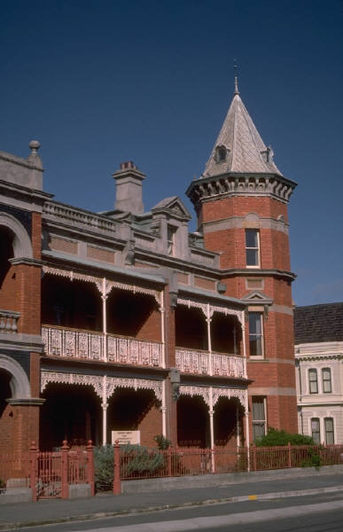
Iron weapons revolutionized warfare and
iron implements did the same for farming.
Iron and steel have become the the building blocks of our society.

Slide 11
Where Does Iron Come From?
Naturally occurring iron exists as iron-oxide (rust)
The iron in meteorites is metallic iron, but there aren’t enough meteorites to supply our iron needs

Slide 12
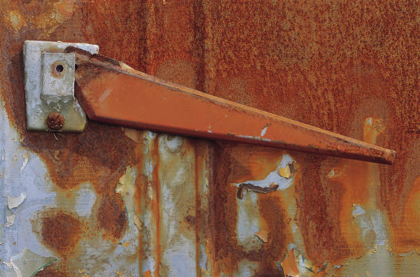
Iron Ores
Hematite -Fe₂O₃
Magnetite Fe₃O₄
P
Mn
Si
S
limonite
Siderite

Slide 13
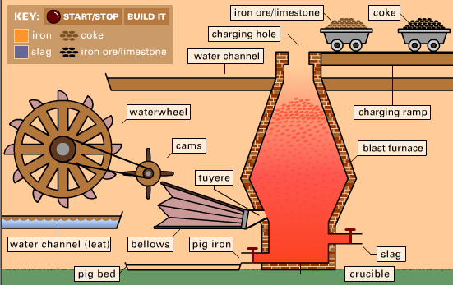
Blast Furnace
40
10

Slide 14
Metallurgy
Mid-18th century use of coke instead of charcoal for smelting iron, main advantage is that it required less labour than charcoal.
Slag is the left-overs from the removal of non-metallic impurities during the smelting of metals.

Slide 15
Production of Pig iron
(Mn,P,Si)
Hematite
(Fe2O3)
CO2
Slag
(Mn,P,Si)
Coke
C
limestone

Slide 16
Reaction
Coke CO, H₂, CO₂, H₂O, N₂ , O₂
Fe₂O₃ + CO 2FeO+CO₂
CO₂ + C (coke) 2CO
FeO + CO Fe + CO2
CaCO3 CaO + CO2

Slide 17
Pig Iron
The principal raw material for all ferrous products is pig iron or direct iron.
Pig iron has a very high carbon content, typically 4-5%, which makes it very brittle and not very useful directly as a material.
on and several % Carbon

Slide 18
Steel
It wasn’t possible to make steel until about 1850
An open hearth furnace is used to burn off the excess carbon
Carbon can also be burned off with
  Electric Furnace

Slide 19
Steel
Percent of carbon in Iron
Iron with controlled amounts of carbon. Steels
are classified by their carbon content.
Designation
  Wrought Iron
  Low Carbon
  Medium Carbon
  High Carbon
  Very High Carbon
  Gray Cast Iron
% Carbon
  .02 - .03
  .05 - .30
  .30 - .45
  .45 - .75
  .75 - 1.00
  1.7 - 4.5

Slide 20
Wrought iron
is a very pure form of commercial iron, having a very small carbon content. It is tough, malleable(easily forming), ductile and can be easily welded. However, it is too soft to make blades from; steel, with a carbon content between wrought and the high-carbon brittle cast iron, is used for that. Wrought iron has been used for thousands of years, and represents the "iron" that is referred to throughout history.

Slide 21
Steel generally has less than about 0.7% C, but can have up to 1.4 (2.11theory) % C.
T(°C)
1600
δ
1400
L
γ
+L
1200
γ
L+Fe
3
C
1148°C
austenite
Eutectic
1000
4.30
Fe
C
α
γ
+Fe
3
C
3
α
800
+
γ
cementite
727°C
Eutectoid
6
00
0.77
α
+Fe
3
C
4
00
0
1
2
3
4
5
6
6.7
(Fe)
Carbon concentration, wt% C

Slide 22
Furnaces for Converting Steel
Open hearth furnace
Bessemer furnace
Basic Oxygen furnace
Induction furnace

Slide 23
Open-hearth furnace
THE FLOOR OF FIRE PLACE
In the furnace, which has a wide, saucer-shaped hearth and a low roof, molten pig iron and scrap are packed into the shallow hearth and heated by overhead gas burners using preheated air.

Slide 24
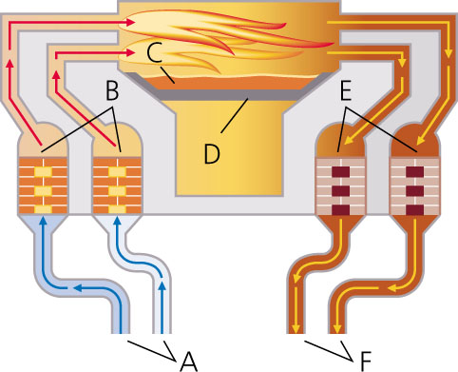
Open hearth furnance
C. molten pig iron
hearth
chamber (cold)
pre-heated chamber
gas and air enter
gas and air exit
Notes:
open-hearth furnace
Method of steelmaking, now largely superseded by the basic–oxygen process. It was developed in 1864 in England by German-born William and Friedrich Siemens, and improved by Pierre and Emile Martin in France in the same year. In the furnace, which has a wide, saucer-shaped hearth and a low roof, molten pig iron and scrap are packed into the shallow hearth and heated by overhead gas burners using preheated air.

Slide 25
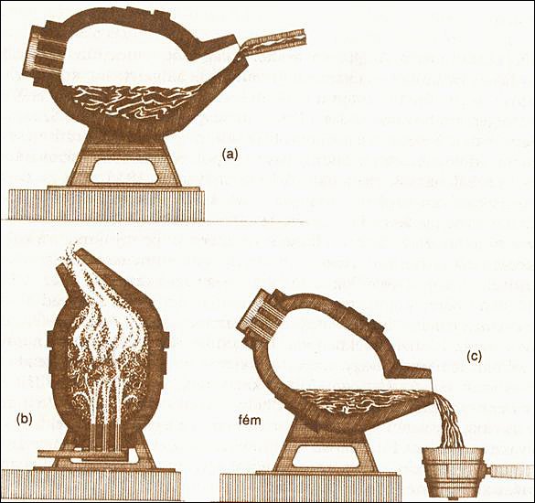
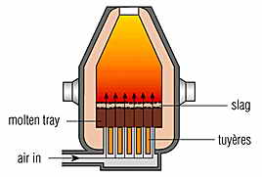
Blessemer
Notes:
In a Bessemer converter, a blast of high-pressure air oxidizes impurities in molten iron and converts it to steel.

Slide 26
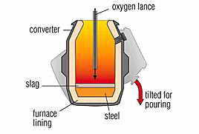
Basic–oxygen Furnance
Tap hole
Notes:
the basic–oxygen process oxygen is blown at high pressure through molten pig iron and scrap steel in a converter lined with basic refractory materials. The impurities, principally carbon, quickly burn out, producing steel.
(Image © Research Machines plc)
Most widely used method of steelmaking, involving the blasting of oxygen at high pressure into molten pig iron.
Pig iron from a blast furnace, together with steel scrap, is poured into a converter, and a jet of oxygen is then projected into the mixture. The excess carbon in the mix and other impurities quickly burn out or form a slag, and the converter is emptied by tilting. It takes only about 45 minutes to refine 350 tonnes/400 tons of steel. The basic–oxygen process was developed 1948 at a steelworks near the Austrian towns of Linz and Donawitz. It is a version of the Bessemer process.

Slide 27
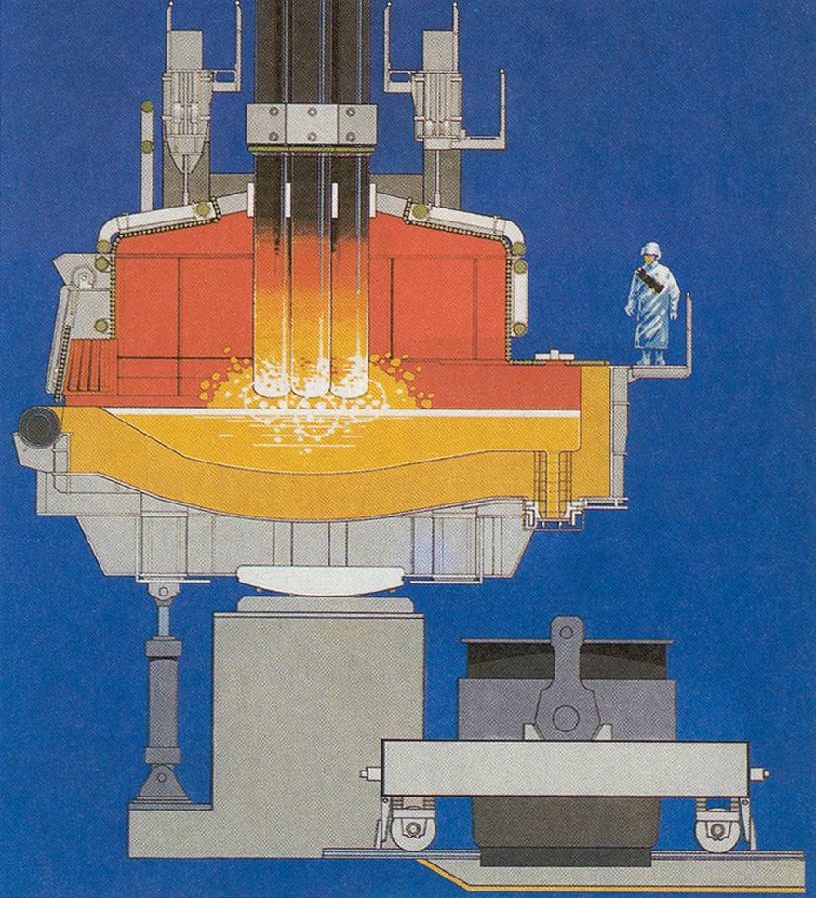
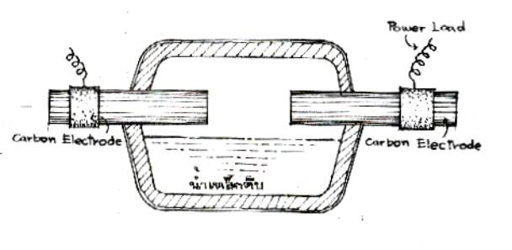
Electric arc furnace
Direct
Indirect

Slide 28
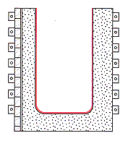
Induction furnance
coil
Refractory
Insulator

Slide 29
Ingot
An ingot is a mass of metal or semiconducting material, heated past the melting point, and then recast, typically into the form of a bar or block.
More generally, these objects are typically cast into a specific shape with the aim of rendering them easy to handle. Additionally, ingots may be molds from which metal objects are cast.

Slide 30
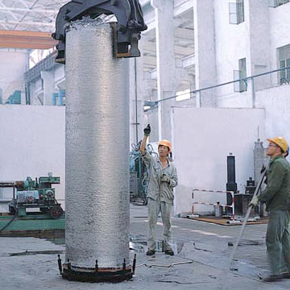
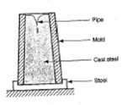
Ingot
pipe
mold
Cast
Stool

Slide 31
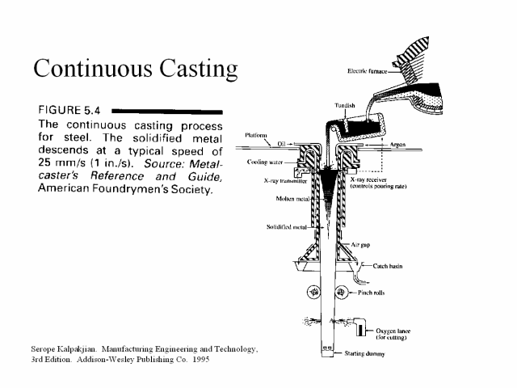

Slide 32
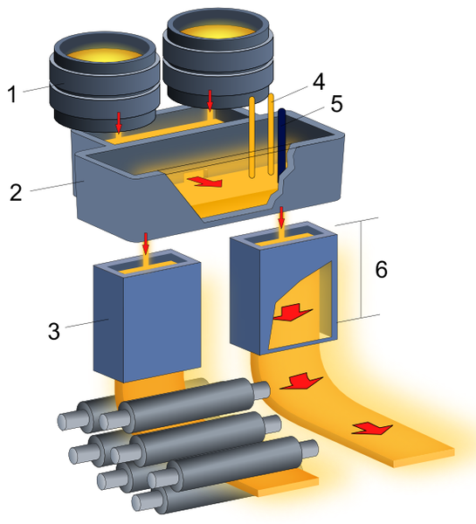
Continuous casting
Ladle
Tundish
Straight Zone
mold

Slide 33
Summary: Steels
Low-Carbon Steels
Properties: nonresponsive to heat treatments; relatively soft and weak; machinable and weldable.
Typical applications: automobile bodies, structural shapes, pipelines, buildings, bridges, and tin cans.
Medium-Carbon Steels
Properties: heat treatable, relatively large combinations of mechanical characteristics.
Typical applications: railway wheels and tracks, gears, crankshafts, and machine parts.
High-Carbon Steels
Properties: hard, strong, and relatively brittle.
Typical applications: chisels, hammers, knives, and hacksaw blades.
High-Alloy Steels (Stainless and Tool)
Properties: hard and wear resistant; resistant to corrosion in a large variety of environments.
Typical applications: cutting tools, drills, cutlery, food processing, and surgical tools.

Slide 34
Standards Designation Equivalent of Tool Steels ---
AISI | American Iron & Steel Institute
JIS | Japanese Industrial Standards
DIN | Deutsches Institut für Normung
 | (German Standards Institute)
SS | Svensk Standard
 | (Swedish Standard)
BS | British Standards

Slide 35
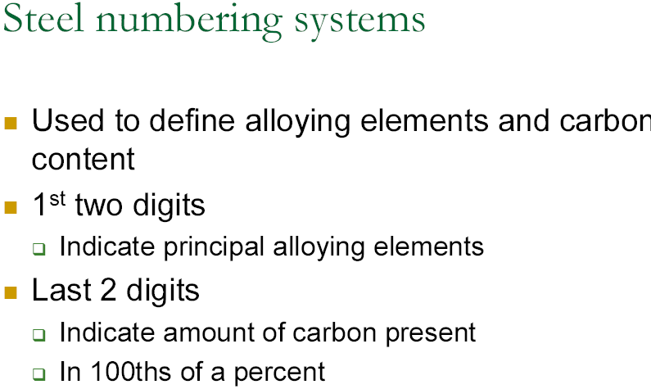

Slide 36
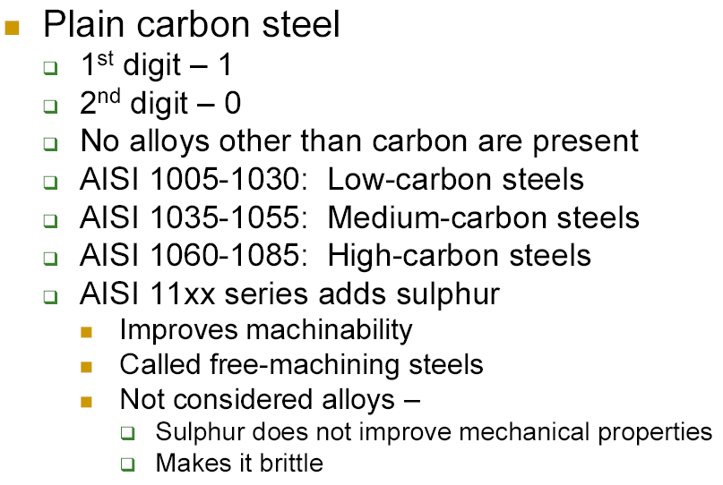

Slide 37
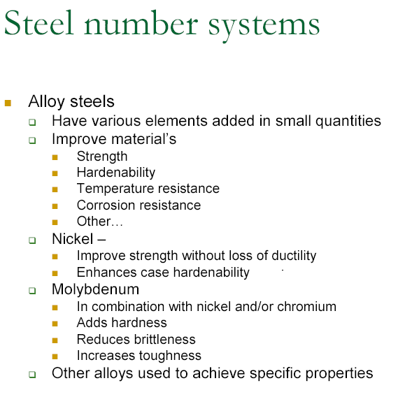

Slide 38
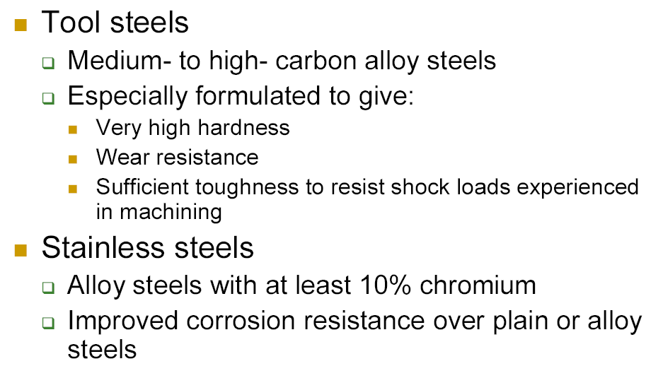

Slide 39
Stainless Steel
>10% Chromium
May also contain large amounts of nickel
The austenite structure survives at room temperature
Makes the steel especially corrosion resistant
Non magnetic-Only martensitic stainless

Slide 40
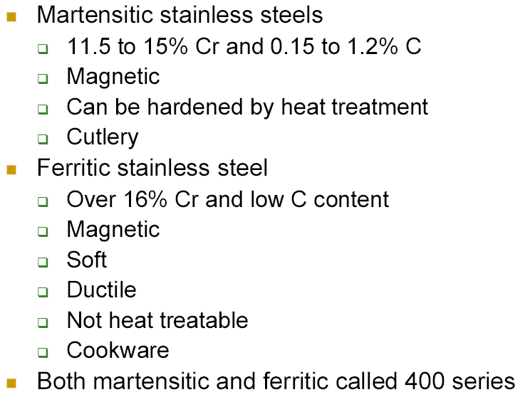

Slide 41
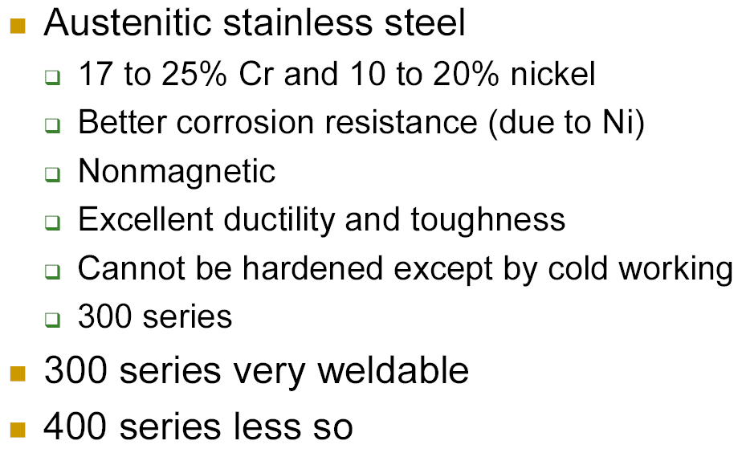

Slide 42
Metal Casting
Manufacturing Process
Dr.Apiwat Muttamara

Slide 44
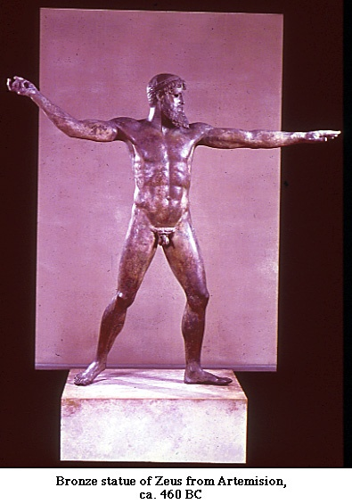
Casting
Cast iron
Has quite a bit more cementite in it than steel
That makes it hard and brittle
But cementite is a “metastable” compound, that can decompose into iron and graphite with the appropriate thermal treatment

Slide 45
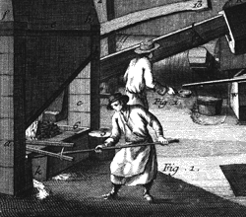
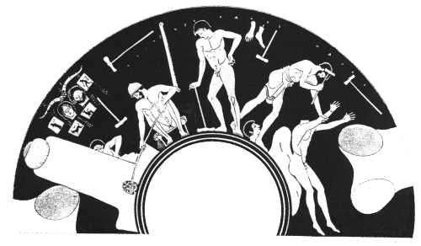
Casting since about 4000 BC…
Ancient Greece; bronze
statue casting circa 450BC
Iron works in early Europe,
e.g. cast iron cannons from
England circa 1543

Slide 46
Casting
The situations in which casting is the preferred fabrication technique are:
- For large pieces and/or complicated shapes.
- When mechanical strength is not an important consideration.
- For alloys having low ductility.
- When it is the most economical fabrication technique.

Slide 47
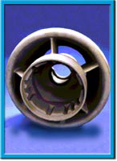
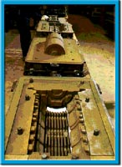
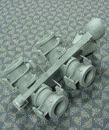
Casting Methods
Sand Casting
High Temperature Alloy, Complex Geometry, Rough Surface Finish
Investment Casting
High Temperature Alloy, Complex Geometry, Moderately Smooth Surface Finish
Die Casting
High Temperature Alloy, Moderate Geometry, Smooth Surface

Slide 48
Casting Mold
1. Expendable mold
2. Permanent mold

Slide 49
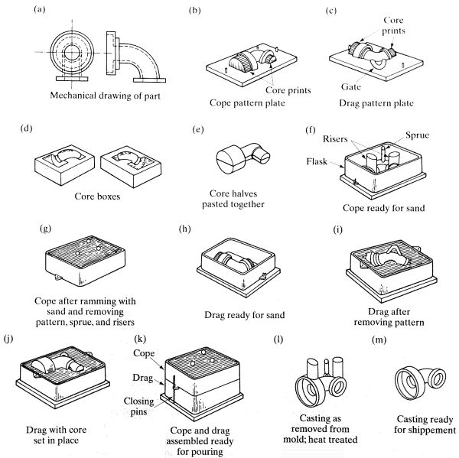
Sand Casting
cope: top half
drag: bottom half
core: for internal cavities
pattern: positive
funnel → sprue →
→ runners → gate →
→ cavity →
→ {risers, vents}

Slide 50
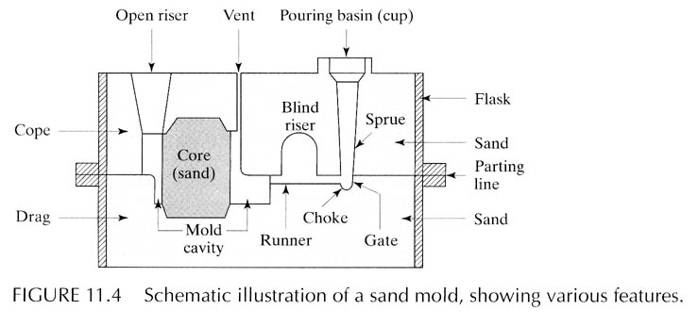
Sand Casting
Gate
Vents, which are placed in molds to carry off gases produced when the molten metal comes into contact with the sand in the molds and core. They also exhaust air from the mold cavity as the molten metal flows into the mold.

Slide 51
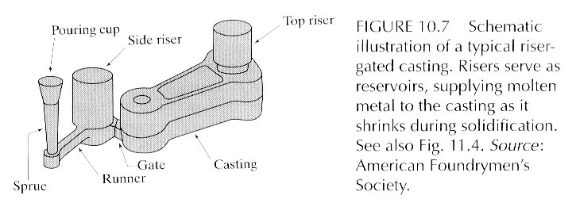
Sand Casting Mold Features

Slide 52
Sand Casting Considerations
(a) How do we make the pattern?
[cut, carve, machine]
(b) Why is the pattern not exactly identical to the part shape?
- pattern → outer surfaces; (inner surfaces: core)
- shrinkage, post-processing
(c) parting line
- how to determine?

Slide 53
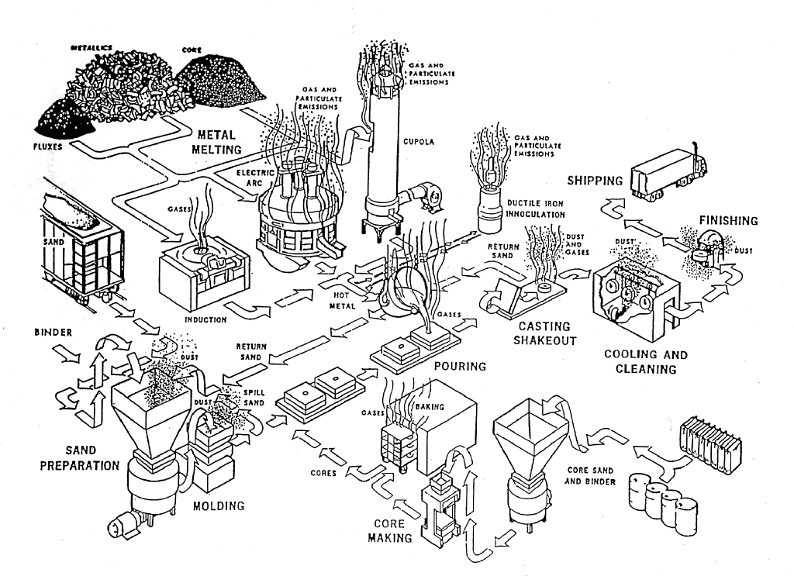
Sand Casting

Slide 54



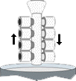



Investment casting (lost wax casting)
(a) Wax pattern
(injection molding)
(b) Multiple patterns
assembled to wax sprue
(c) Shell built →
immerse into ceramic slurry
→ immerse into fine sand
(few layers)
(d) dry ceramic
melt out the wax
fire ceramic (burn wax)
(e) Pour molten metal (gravity)
→ cool, solidify
[Hollow casting:
pouring excess metal before solidification
(f) Break ceramic shell
(vibration or water blasting)
(g) Cut off parts
(high-speed friction saw)
→ finishing (polish)
Notes:
The investment-casting process, also called the lost-wax process, was first used during the period 4000-3500 B.C. The pattern is made of wax or a plastic such as polystyrene. The sequences involved in investment casting are shown in Figure 11.18. The pattern is made by injecting molten wax or plastic into a metal die in the shape of the object.

Slide 55
Evaporative-pattern casting (lost foam process)
- Styrofoam pattern
- dipped in refractory slurry → dried
- sand (support)
- pour liquid metal
- foam evaporates, metal fills the shell
- cool, solidify
- break shell → part

Slide 56
Permanent mold casting
MOLD: made of metal (cast iron, steel, refractory alloys)
CORE: (hollow parts)
- metal: core can be extracted from the part
- sand-bonded: core must be destroyed to remove
Mold-surface: coated with refractory material
- Spray with lubricant (graphite, silica)
- improve flow, increase life
- good tolerance, good surface finish
- low mp metals (Cu, Bronze, Al, Mg)

Slide 57
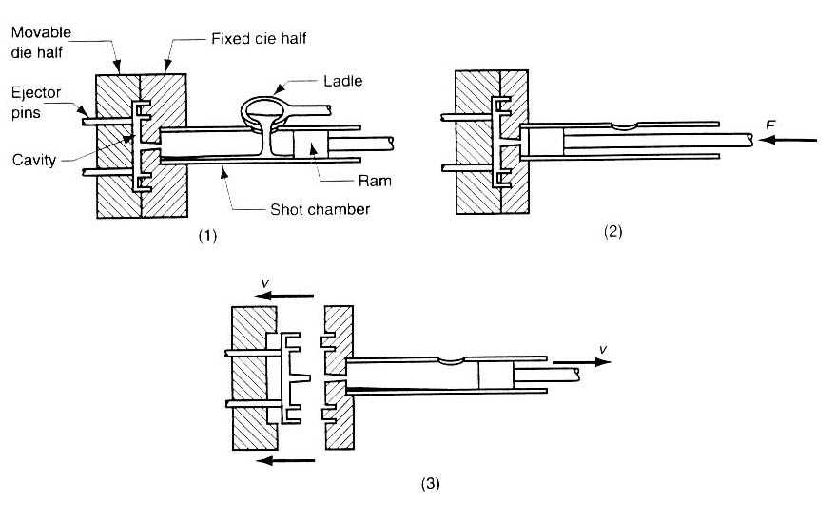
Die Casting – Cold-Chamber Casting
(1) with die closed and ram withdrawn, (2)forces and, maintaining pressure during the cooling and solidification
(3) ram is withdrawn, die is opened, and part is ejected. Used for higher temperature metals eg. Aluminum, Copper and alloys

Slide 58
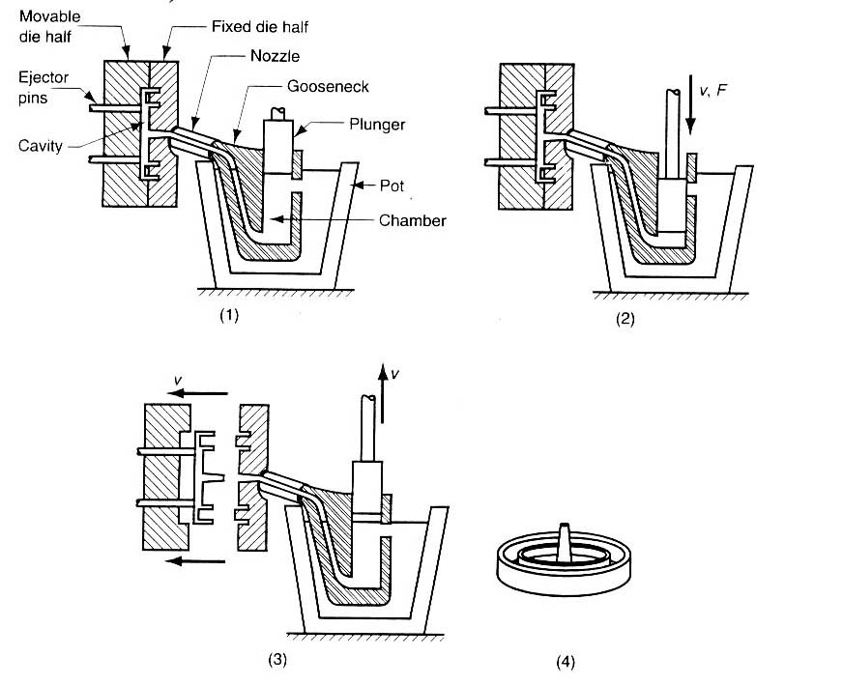
Die Casting – Hot-Chamber Casting
(1) with die closed and plunger withdrawn,
(2) forces metal in, maintaining pressure during cooling and solidification;

Slide 59
Die Casting – Hot-Chamber Casting
(3) plunger is withdrawn, die is opened, and solidified part is ejected
Finished part

Slide 60
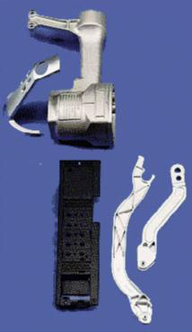
Die Casting
Description: Molten metal is injected, under pressure, into hardened steel dies, often water cooled. Dies are opened, and castings are ejected.
Metals: Aluminum, Zinc, Magnesium, and limited Brass.
Size Range: Not normally over 2 feet square. Some foundries capable of larger sizes.
Tolerances:
Al and Mg ± .002″/in.
Zinc ± .0015″/in.
Brass ± .001″/in.
Add ± .001″ to ± .015″ across parting line depending on size

Slide 61
High Melt Temperature
Chemical Activity
High Latent Heat
Handling
Off-gassing
3000° C
Tungsten Carbide, WC,
Silicon Carbide, SiC
2000° C
Alumina Al₂O₃
Platinum, Pt
Titanium, Ti
IronFE, Nickel, Ni
1000° C
Copper, Cu, Bronze, Brass
Aluminum
Magnesium
Zinc, Zn
Tin, Sn
0° C

Slide 62
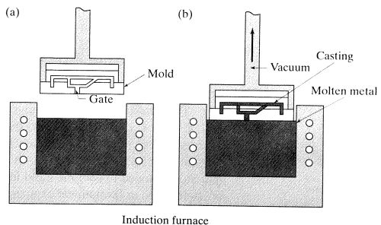
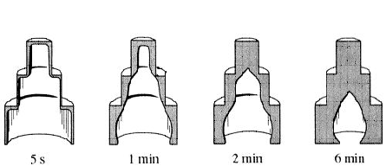
Vacuum casting
Similar to investment casting, except: fill mold by reverse gravity
Easier to make hollow casting: early pour out

Slide 63
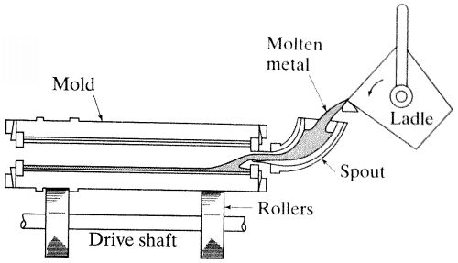
Centrifugal casting
- permanent mold
- rotated about its axis at 300 ~ 3000 rpm
- molten metal is poured
- Surface finish: better along outer diameter than inner,
- Impurities, inclusions, closer to the inner diameter (why ?)

Slide 64
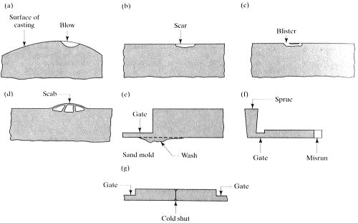
Casting Design: Typical casting defects

Slide 65
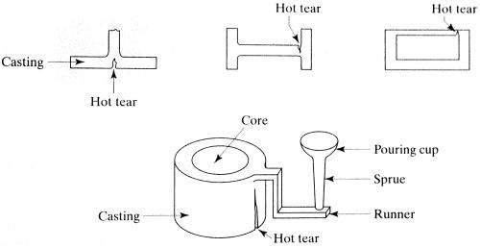

Slide 66
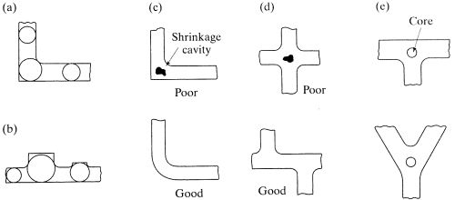
Casting Design: guidelines
(a) avoid sharp corners
(b) use fillets to blend section changes smoothly
(c1) avoid rapid changes in cross-section areas

Slide 67
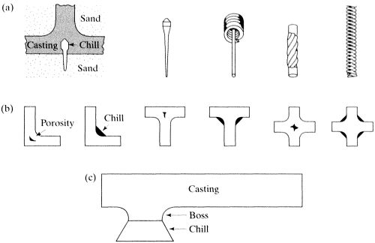
Casting Design: guidelines
(c1) avoid rapid changes in cross-section areas
(c2) if unavoidable, design mold to ensure
- easy metal flow
- uniform, rapid cooling (use chills, fluid-cooled tubes)

Slide 68
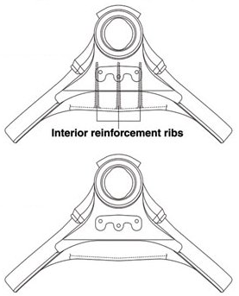
Casting Design: guidelines
(d) avoid large, flat areas
- warpage due to residual stresses (why?)

Slide 69
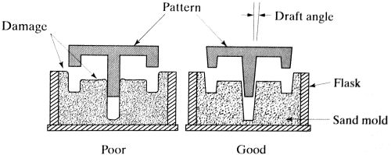
Casting Design: guidelines
(e) provide drafts and tapers
- easy removal, avoid damage
- along what direction should we taper ?

Slide 70
Casting Design: guidelines
(g) proper design of parting line
- “flattest” parting line is best

Slide 71
Different Casting Processes
Process | Advantages | Disadvantages | Examples
Sand | many metals, sizes, shapes, cheap | poor finish & tolerance | engine blocks, cylinder heads
Shell mold | better accuracy, finish, higher production rate | limited part size | connecting rods, gear housings
Expendable pattern | Wide range of metals, sizes, shapes | patterns have low strength | cylinder heads, brake components
Plaster mold | complex shapes, good surface finish | non-ferrous metals, low production rate | prototypes of mechanical parts
Ceramic mold | complex shapes, high accuracy, good finish | small sizes | impellers, injection mold tooling
Investment | complex shapes, excellent finish | small parts, expensive | jewellery
Permanent mold | good finish, low porosity, high production rate | Costly mold, simpler shapes only | gears, gear housings
Die | Excellent dimensional accuracy, high production rate | costly dies, small parts, non-ferrous metals | gears, camera bodies, car wheels
Centrifugal | Large cylindrical parts, good quality | Expensive, few shapes | pipes, boilers, flywheels

