Slide 1
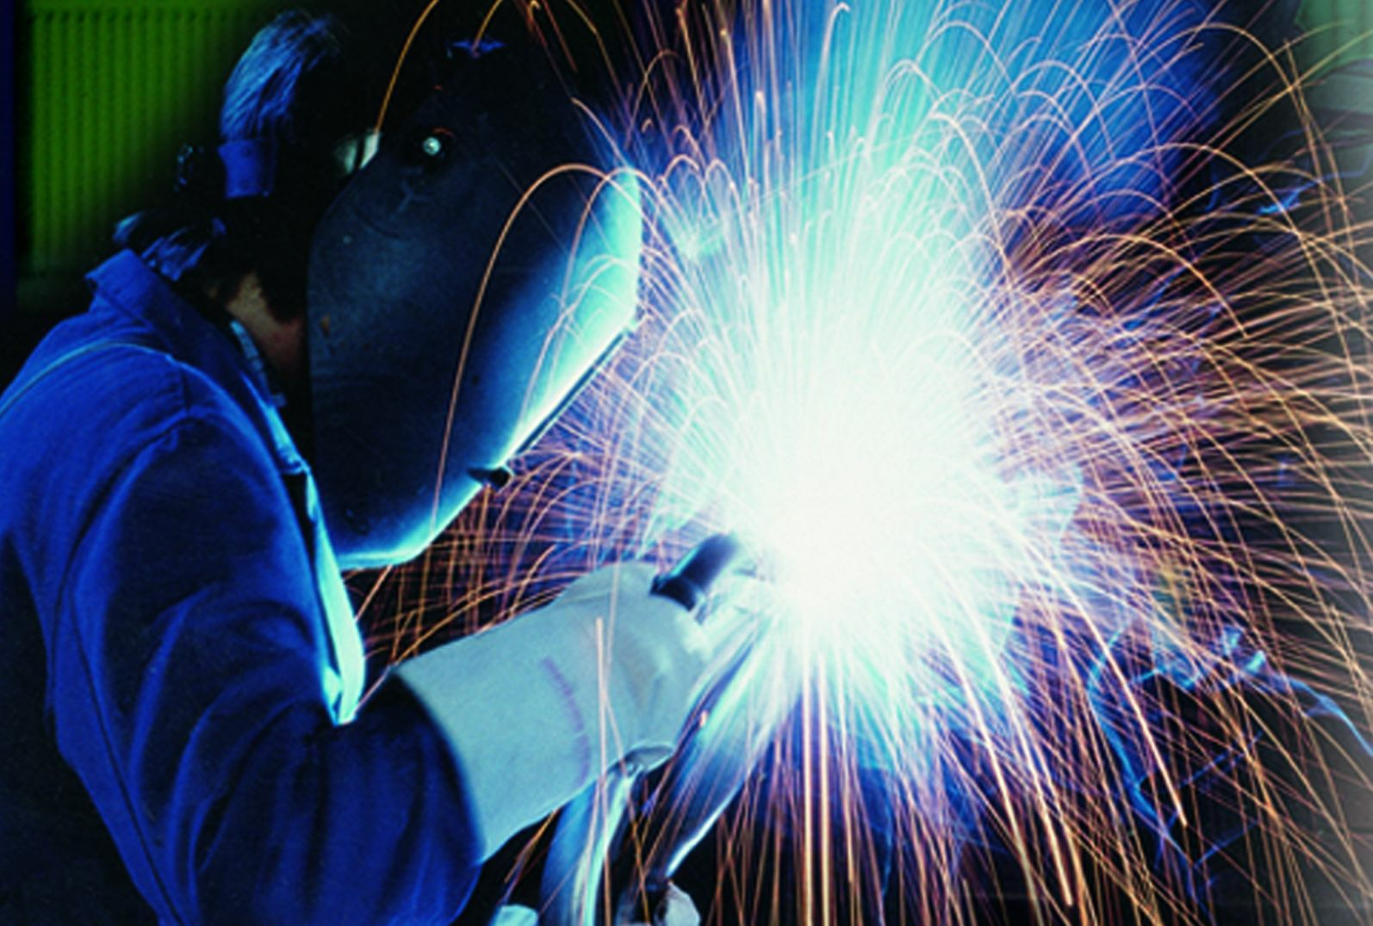
Welding
Notes:
Text book,
Office hour, by appointment

Slide 2
Joining and Assembly
Joining - welding, brazing, soldering, and adhesive bonding
These processes form a permanent joint between parts
Assembly - mechanical methods (usually) of fastening parts together
Some of these methods allow for easy disassembly, while others do not

Slide 3
Types of Welding Processes
Welding processes can be divided into two major categories:
Fusion welding
Arc welding (AW)
Resistance welding (RW)
Oxyfuel gas welding (OFW)
Solid state welding: Joining processes using pressure alone or a combination of heat and pressure
If heat is used, temperature is below melting point of metals being welded
No filler metal is added in solid state welding

Slide 4
Types of Welding
Fusion Welding
Pressure Welding
Homogeneous
Heterogeneous
Friction Welding
Gas Welding
Brazing
Soldering
Electroslag
MIG
High Energy Beam
TIG
Shielded Metal Arc – “Stick”
Electric Arc

Slide 5
Five Types of Joints
(a) Butt joint, (b) corner joint, (c) lap joint, (d) tee joint, and (e) edge joint

Slide 6
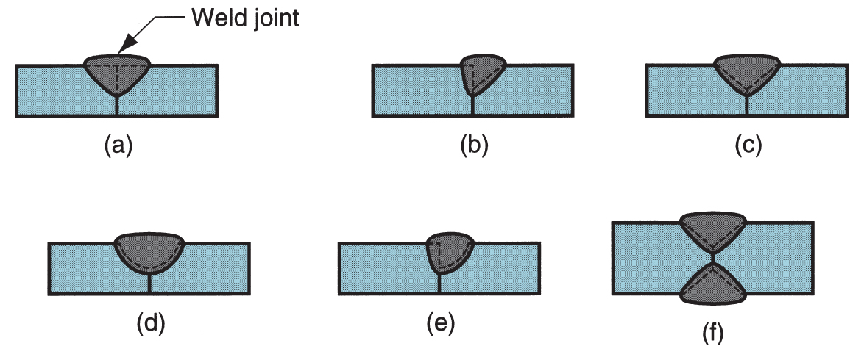
Groove Welds
(a) Square groove weld, one side; (b) single bevel groove weld; (c) single V‑groove weld; (d) single U‑groove weld; (e) single J‑groove weld; (f) double V‑groove weld for thicker sections (dashed lines show original part edges)

Slide 7
Fillet Welds
(a) Inside single fillet corner joint; (b) outside single fillet corner joint; (c) double fillet lap joint; (d) double fillet tee joint (dashed lines show the original part edges)

Slide 8
Plug Weld and Slot Weld
(a) Plug weld and (b) slot weld

Slide 9
Spot Weld and Seam Weld
Fused section between surfaces of two sheets or plates: (a) spot weld and (b) seam weld
Used for lap joints
Closely associated with resistance welding

Slide 10
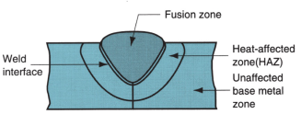
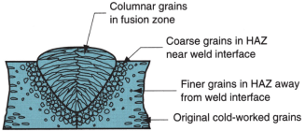
Typical Fusion Welded Joint

Slide 11
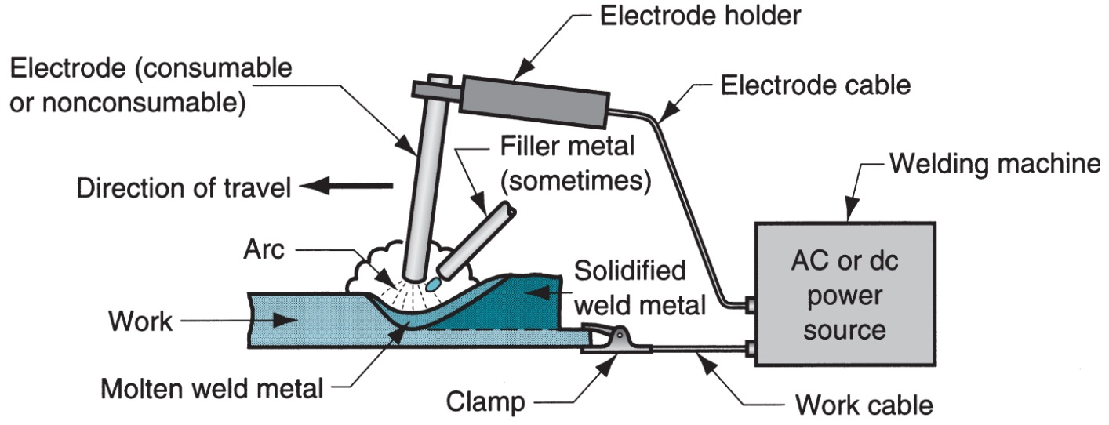
Arc Welding: The most common fusion welding
A pool of molten metal is formed near electrode tip, and as electrode is moved along joint, molten weld pool solidifies in its wake
http://www.youtube.com/watch?v=TeBX6cKKHWY

Slide 12
Two Basic Types of Arc Welding Electrodes
Consumable – consumed during welding process
Source of filler metal in arc welding
Nonconsumable – not consumed during welding process (e.g. Tungsten)
Filler metal must be added separately if it is added

Slide 13
Arc Shielding
At high temperatures in arc welding, metals are chemically reactive to O₂, N₂ and H₂ in air
Mechanical properties of joint can be degraded by these reactions
To protect operation, arc must be shielded from surrounding air in AW processes
Arc shielding is accomplished by:
Shielding gases, e.g., argon, helium, CO₂
Flux

Slide 14
Flux
A substance that prevents formation of oxides and other contaminants in welding, or dissolves them and facilitates removal
Provides protective atmosphere for welding
Stabilizes arc
Reduces spattering
Flux Application
Pouring granular flux onto welding operation
Stick electrode coated with flux material that melts during welding to cover operation
Tubular electrodes in which flux is contained in the core and released as electrode is consumed

Slide 15
Consumable Electrode Arc Welding Processes
Shielded Metal Arc Welding
Gas Metal Arc Welding
Flux‑Cored Arc Welding
Electrogas Welding
Submerged Arc Welding

Slide 16
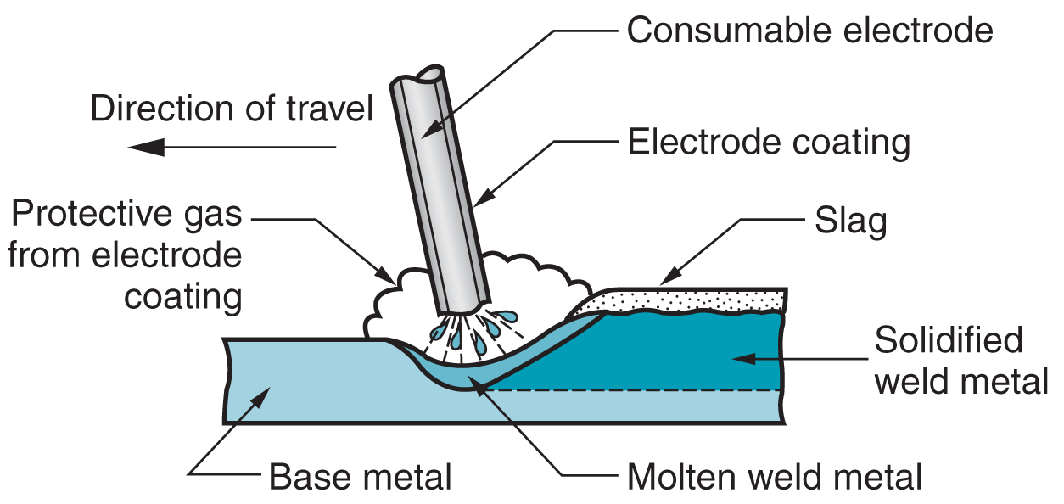
Shielded Metal Arc Welding (SMAW)
Uses a consumable electrode consisting of a filler metal rod coated with chemicals that provide flux and shielding

Slide 17
Welding Stick in SMAW
Composition of filler metal usually close to base metal
Coating: powdered cellulose mixed with oxides and carbonates, and held together by a silicate binder
Disadvantages of stick welding:
Sticks must be periodically changed
High current levels may melt coating prematurely

Slide 18
SMAW Applications
Used for steels, stainless steels, cast irons, and certain nonferrous alloys
Not used or rarely used for aluminum and its alloys, copper alloys, and titanium

Slide 19
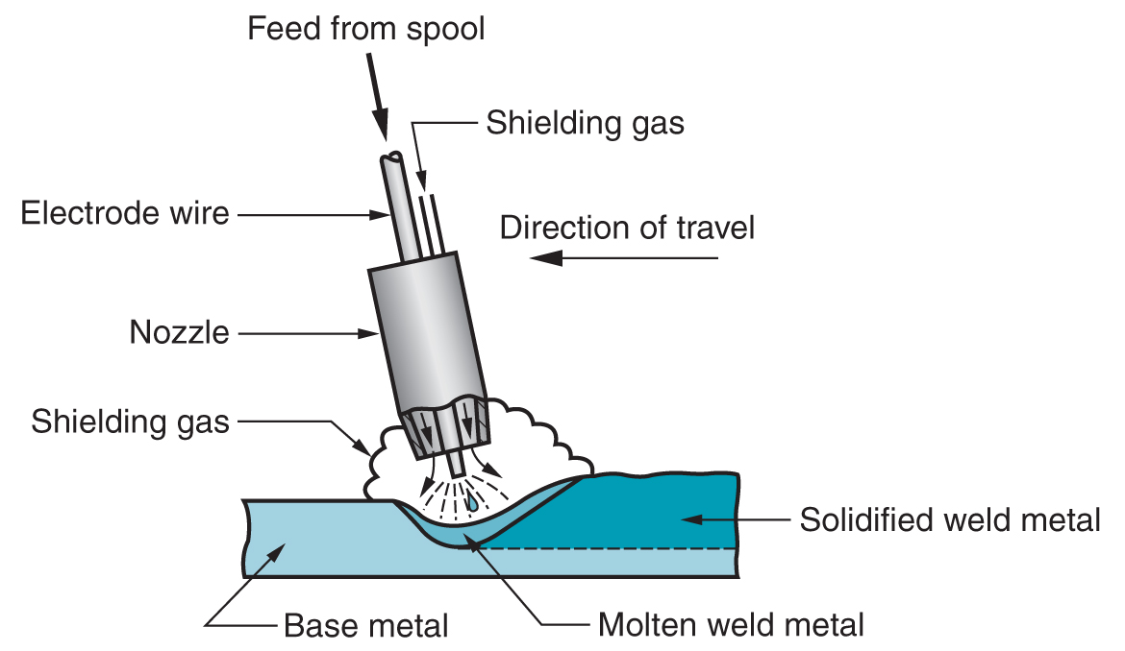
Gas Metal Arc Welding
Uses a consumable bare metal wire as electrode with shielding by flooding arc with a gas
http://www.youtube.com/watch?v=wPeHA9Szhhg

Slide 20
Inert Gas Welding
For materials such as Al or Ti which quickly form oxide layers, a method to place an inert atmosphere around the weld puddle had to be developed

Slide 21
Metal Inert Gas (MIG)
Uses a consumable electrode (filler wire made of the base metal)
Inert gas is typically Argon
Inert gas is CO₂ Called GMAW
CONSUMABLE ELECTRODE
DRIVE WHEELS
POWER SOURCE
SHIELDING GAS
ARC COLUMN
BASE METAL
PUDDLE

Slide 22
GMAW Advantages over SMAW
Better arc time because of continuous wire electrode
Sticks must be periodically changed in SMAW
Better use of electrode filler metal than SMAW
End of stick cannot be used in SMAW
Higher deposition rates
Eliminates problem of slag removal
Can be readily automated

Slide 23
Tungsten Inert Gas (TIG)
Tungsten electrode acts as a cathode
A plasma is produced between the tungsten cathode and the base metal which heats the base metal to its melting point
Filler metal can be added to the weld pool
Can be called (GTAW)
TUNGSTEN ELECTRODE
POWER SOURCE
Filler wire
SHIELDING GAS
BASE METAL
PUDDLE

Slide 24
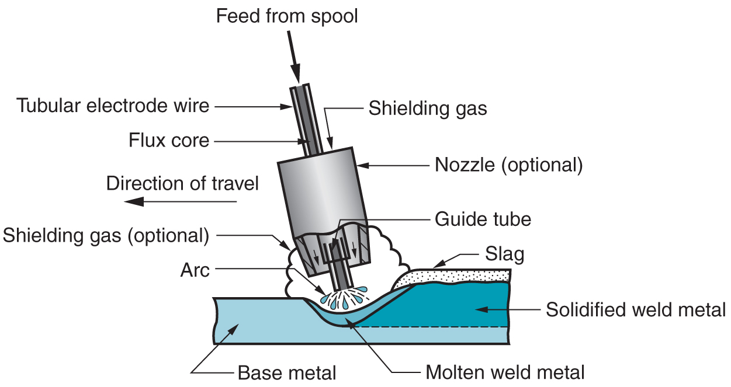
Flux-Cored Arc Welding
Presence or absence of externally supplied shielding gas distinguishes: (1) self‑shielded - core provides ingredients for shielding, (2) gas‑shielded - uses external shielding gases
http://www.youtube.com/watch?v=kI7GOVrB33c

Slide 25
Oxyacetylene Welding
Flame formed by burning a mix of acetylene (C₂H₂) and oxygen
Fusion of metal is achieved by passing the inner cone of the flame over the metal
Oxyacetylene can also be used for cutting metals
TORCH TIP
2300 deg F
Inner Cone: 5000-6300 deg F
Combustion Envelope 3800 deg F

Slide 26
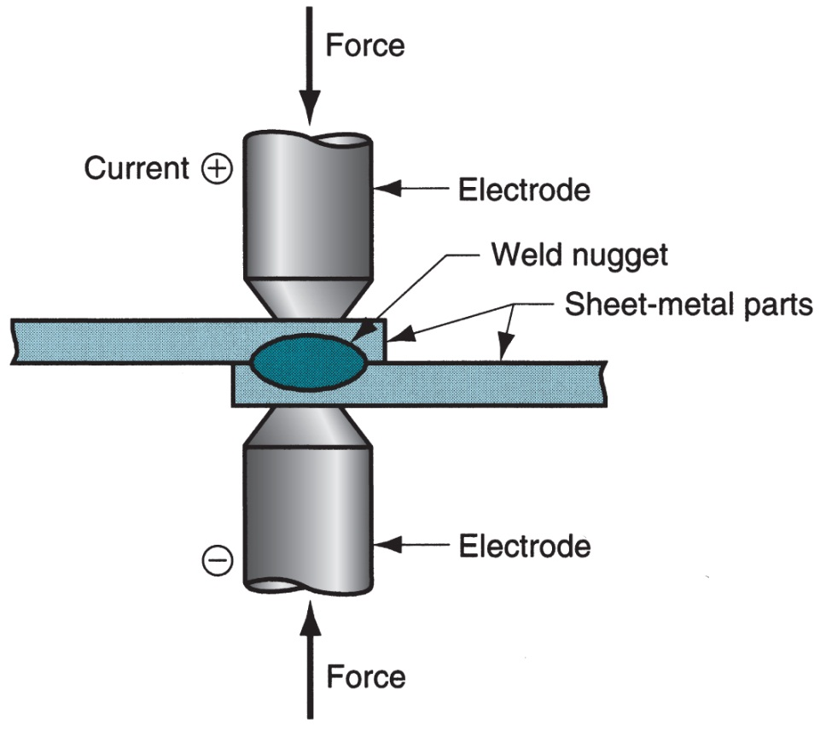
Resistance Welding
Resistance welding, showing components in spot welding, the main process in the RW group
http://www.youtube.com/watch?v=66-RK0DPXfU

Slide 27
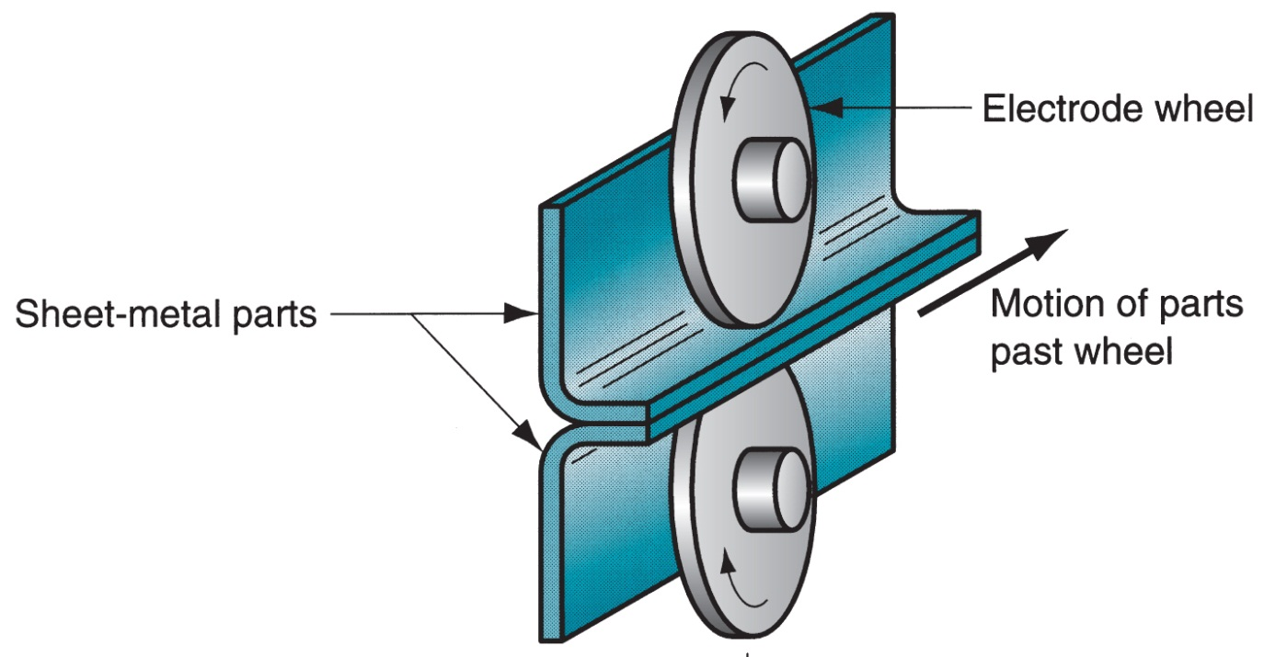
Resistance Seam Welding
https://www.youtube.com/watch?v=xZ5SMBoIh4s

Slide 28
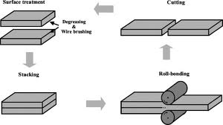
Roll Welding

Slide 29
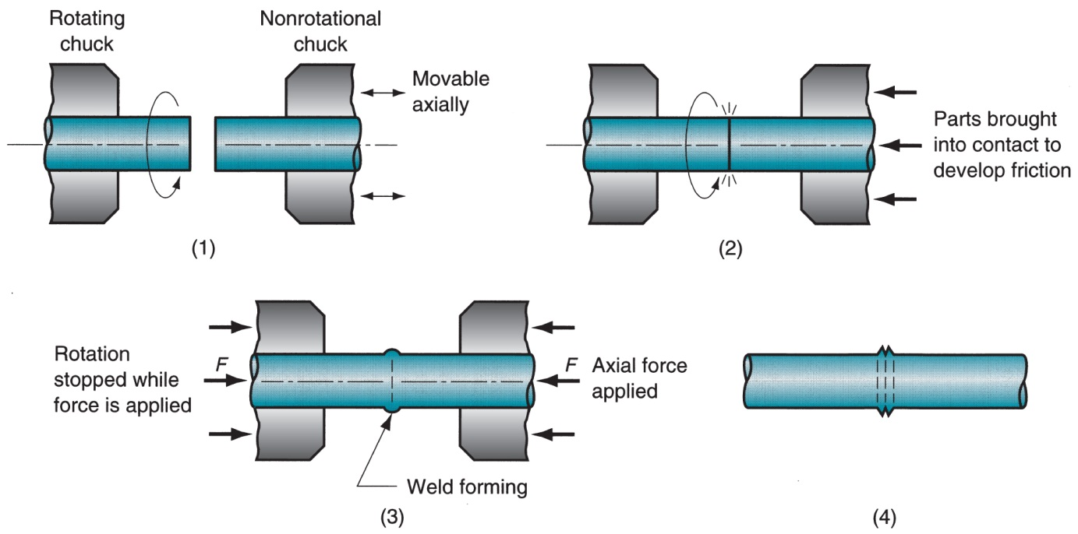
Friction Welding
(1) Rotating part, no contact; (2) parts brought into contact to generate friction heat; (3) rotation stopped and axial pressure applied; and (4) weld created
http://www.youtube.com/watch?v=5JbnDXw-0pM 1 min

Slide 30
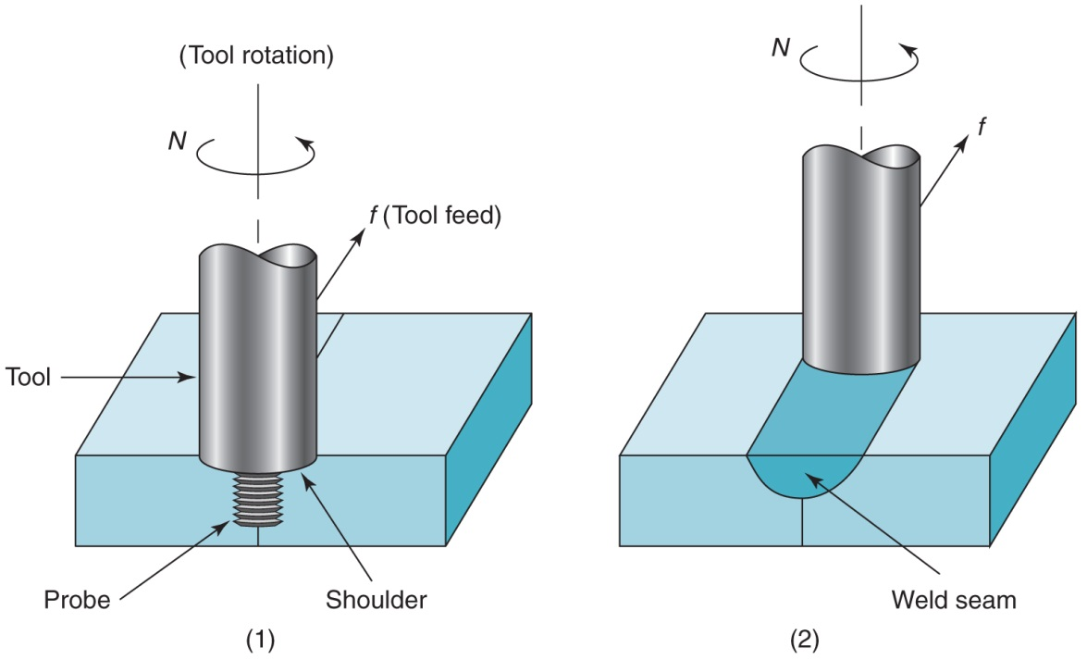
Friction Stir Welding
(1) Rotating tool just before entering work, and (2) partially completed weld seam
http://www.youtube.com/watch?v=_qAOKR6mdTI 1.5 min

Slide 31
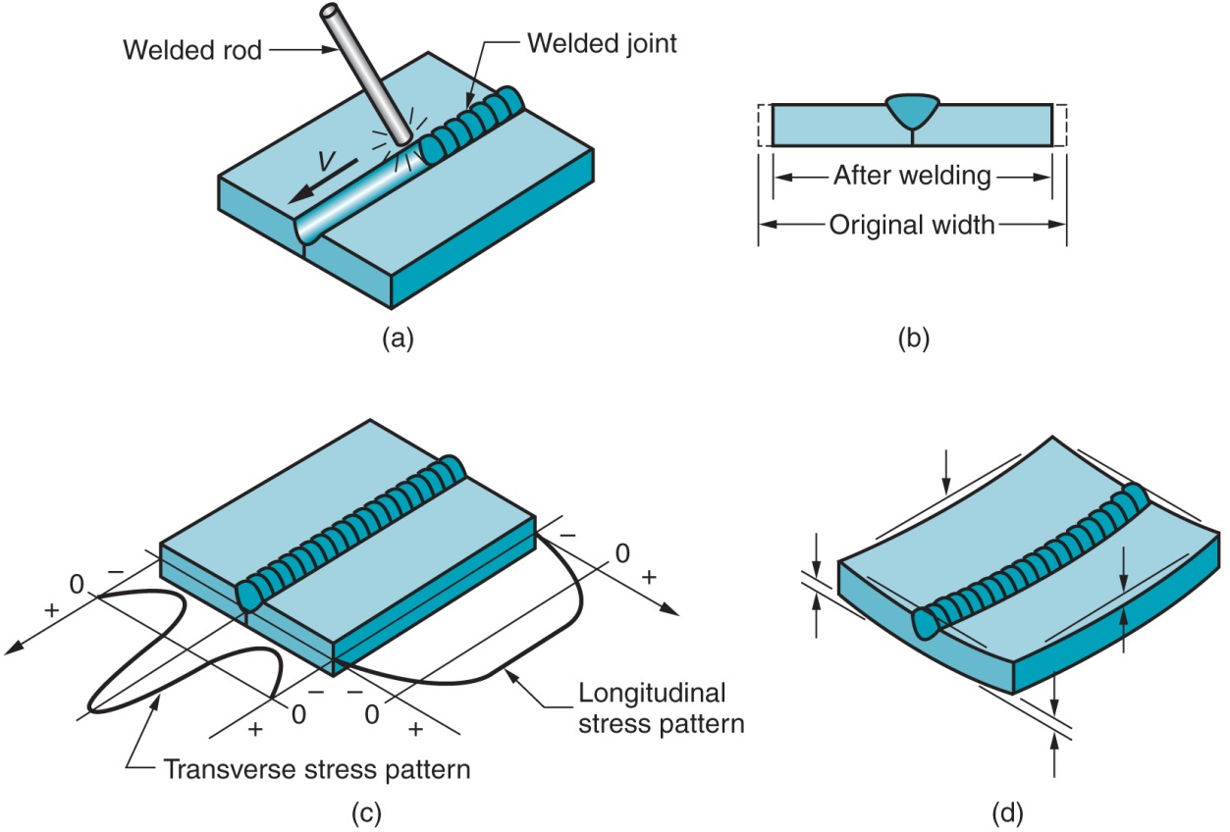
Residual Stresses and Distortion
(a) Butt welding two plates
(b) Shrinkage
(c) Residual stress patterns
(d) Likely warping of weldment

Slide 32
Techniques to Minimize Warpage
Welding fixtures to physically restrain parts
Heat sinks to rapidly remove heat
Tack welding at multiple points along joint to create a rigid structure prior to seam welding
Preheating base parts
Stress relief heat treatment of welded assembly

Slide 33
Brazing
Joining process in which a filler metal is melted and distributed by capillary action between faying surfaces of metal parts being joined
No melting of base metals occurs
Only the filler melts
Filler metal T_{m} is greater than 450°C (840°F)
But less than T_{m} of base metal(s) to be joined
http://www.youtube.com/watch?v=m678-clpbjw 3 min

Slide 34
Brazing Compared to Welding
Any metals can be joined, including dissimilar metals
Can be performed quickly and consistently, permitting high production rates
Multiple joints can be brazed simultaneously
Less heat and power required than Fussion Welding
Problems with HAZ in base metal are reduced
Joint areas that are inaccessible by many welding processes can be brazed
Capillary action draws molten filler metal into joint

Slide 35
Disadvantages and Limitations of Brazing
Joint strength is generally less than a welded joint
Joint strength is likely to be less than the strength of the base metals
High service temperatures may weaken a brazed joint
Color of brazing metal may not match color of base metal parts

Slide 36
Brazing Applications
Automotive (e.g., joining tubes and pipes)
Electrical equipment (e.g., joining wires and cables)
Cutting tools (e.g., brazing cemented carbide inserts to shanks)
Jewelry
Chemical process industry
Plumbing and heating contractors join metal pipes and tubes by brazing
Repair and maintenance work

Slide 37
Soldering
Joining process in which a filler metal with T_{m} less than or equal to 450C (840F) is melted and distributed by capillary action between faying surfaces of metal parts being joined
No melting of base metals, but filler metal wets and combines with base metal to form metallurgical bond
Filler metal called solder
Closely associated with electrical assembly
http://www.youtube.com/watch?v=BLfXXRfRIzY

Slide 38
Soldering Advantages and Disadvantages
Advantages:
Lower energy than brazing or fusion welding
Variety of heating methods available
Good electrical and thermal conductivity in joint
Easy repair and rework
Disadvantages:
Low joint strength unless reinforced mechanically
Joint weakens or melts at elevated temperatures

Slide 39
Solders
Traditionally alloys of tin and lead (both have low T_{m})
Lead is poisonous and its percentage is minimized in most solders
Tin is chemically active at soldering temperatures and promotes wetting action for successful joining
In soldering copper, copper and tin form intermetallic compounds that strengthen bond
Silver and antimony also used in soldering alloys

Slide 40
Soldering Methods
Many soldering methods are same as for brazing, except less heat and lower temperatures are required
Additional methods:
Hand soldering – manually operated soldering gun

